Slide 1
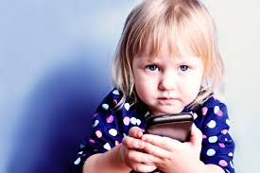
Fonoholism
Fight with phone addiction in our school

Slide 2
When and where do we use phones?

Slide 3
WARSZTATY SP 12 W GDYNI- FONOHOLIZM

Slide 5
The whole truth about phones

