Slide 1
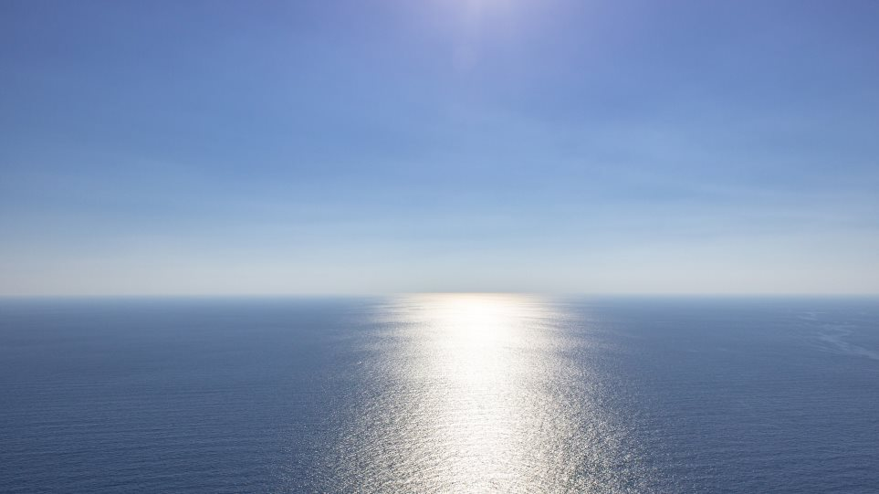
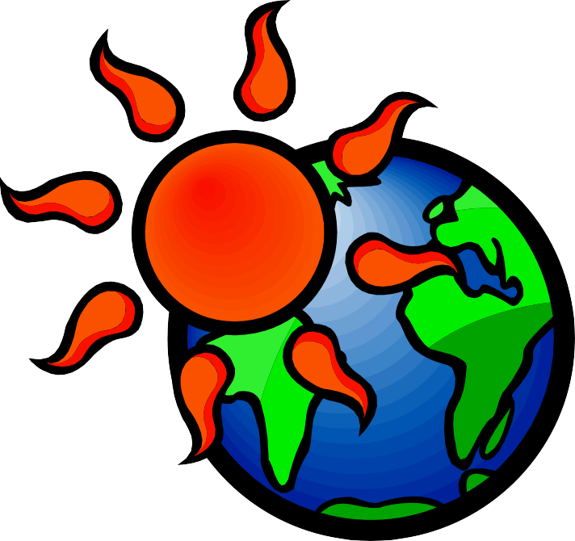
or
Climate change
Natural process
Human intervention

Slide 2
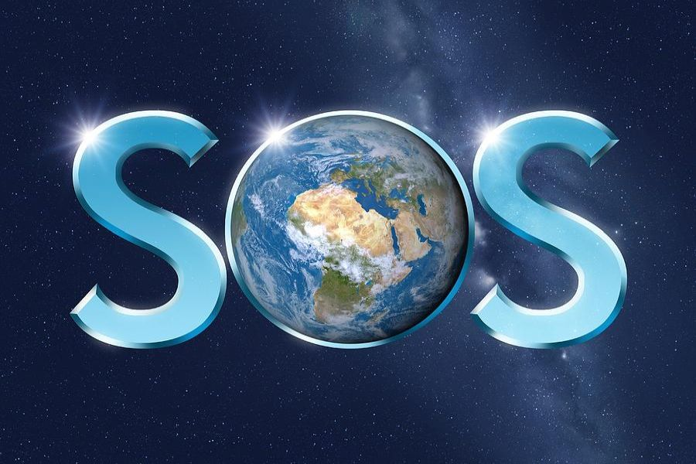
WHAT ABOUT CLIMATE CHANGE?
Today΄s average earth temperature is 0,85 ⁰C higher than at the end of the 19th century
If the temperature rise, reaches 2 ^{0,}C scientists think it will be very dangerous for the planet. For this reason, the international community has recognized the need to keep global warming below 2⁰ C
Climate scientists in the world believe that human activities are almost certainly the main cause of overheating observed since the mid-20th century
So the goal of the EU for 2020 is to reduce greenhouse gas emissions by 20% compared to 1990 level

Slide 3
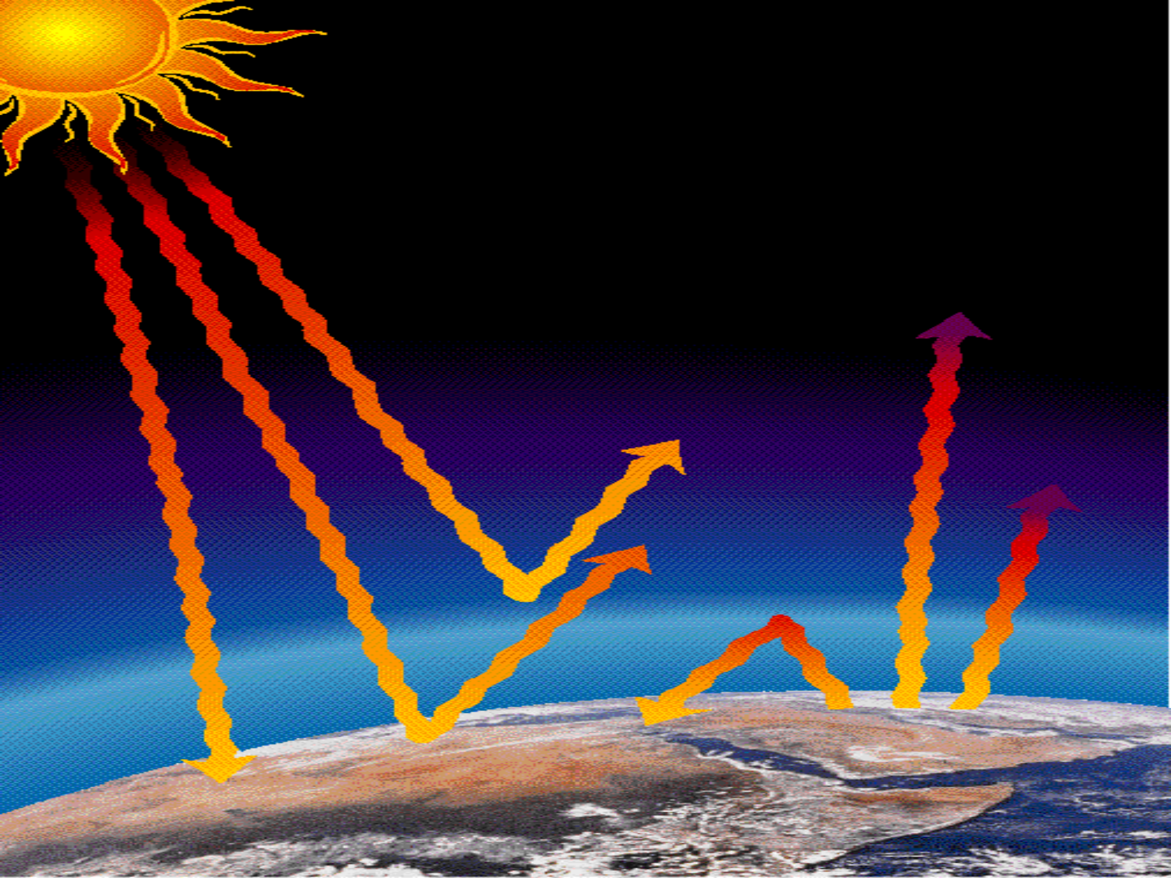
GREENHOUSE
Part of infrared radiation penetrates the
Atmosphere while part of it returns and is absorbed by greenhouse gas molecules. So the surface and the atmosphere of the
Earth are warmed up
Part of the solar radiation is reflected
by the Earth and the
atmosphere
The solar radiation
going through the Earth’s atmosphere

Slide 4
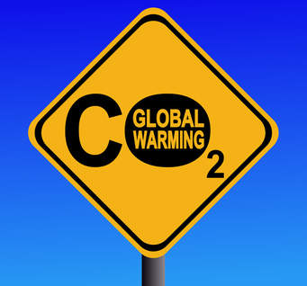
CAUSES
CAUSES
Concentrations of carbon dioxide ( CO₂) into the atmosphere have increased by 40% over the last 200 years
…. and since 2000, they continue to grow by more than 2% per year
The increase in carbon dioxide CO₂ emissions is mainly due to combustion of fossil fuels (for energy production)
…… but also to the destruction of forests which disrupts the carbon cycle
….but livestock also contributes to the greenhouse effect

Slide 5
CAUSES
Combustion of coal, oil and natural gas produces carbon dioxide and nitrous oxide
Trees regulate the climate because they absorb CO₂ from the atmosphere. Therefore, when they are reduced, this positive effect is lost and the coal that will be stored in them is released into the atmosphere exacerbating the greenhouse effect
Increase livestock, cows and sheep and goats, produce large amounts of methane when digesting their food

Slide 6
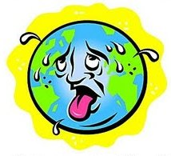
Temperature rise

Slide 7
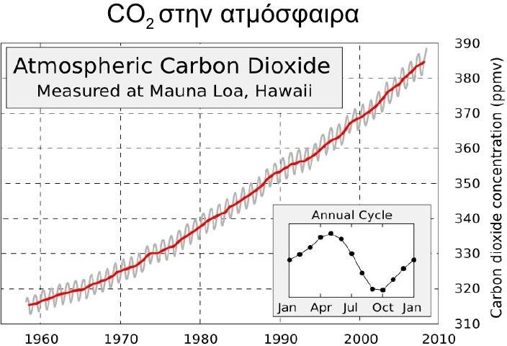

Slide 8
Consequences of climate change
Melting ice and rising sea levels
When the water is heated, it expands. At the same time, global warming
causes collapses of ice to both poles and melting glaciers.
Because of these changes, sea levels are rising, causing flooding and
erosion on coasts and lowland coastal areas
The frequency of extreme weather events is increasing
Troubling signs of climate change are increased extreme weather events
natural disasters like, floods, tornadoes and deadly heat waves
The southern and central European countries are affected by heat waves ,
forest fires and droughts.
Water scarcity in the Mediterranean is steadily rising, resulting in
increased drought and uncontrollable fires
Loss of biodiversity

Slide 9
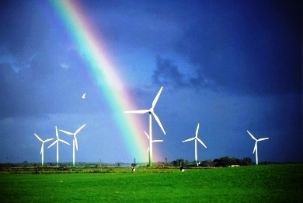
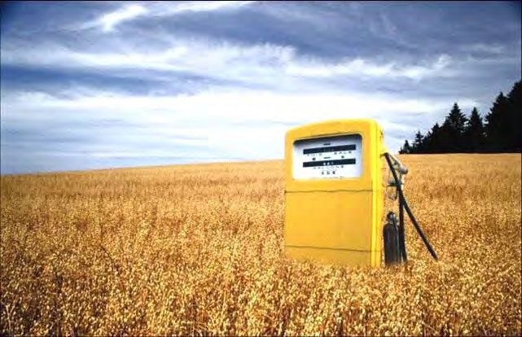
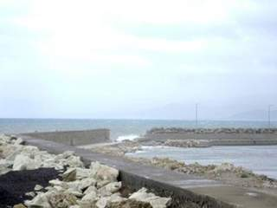
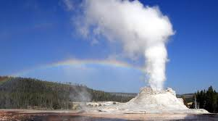
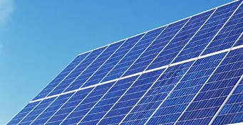
Another goal of the EU for 2020 is to increase the renewable energy consumption by 20%
RENEWABLE ENERGY SOURCES
WIND POWER
BIOFUELS
WAVE ENERGY
GEOTHERMAL
SOLAR POWER

Slide 10
WHAT CAN I DO ?

Slide 11
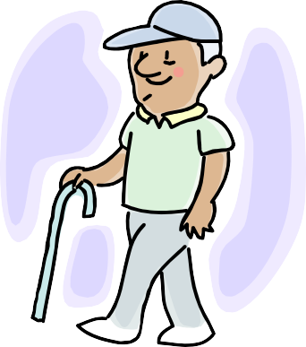
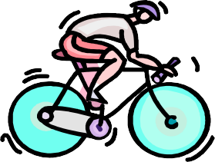
I use public transport
and reduce the emissions of gases that overheat the atmosphere

Slide 12
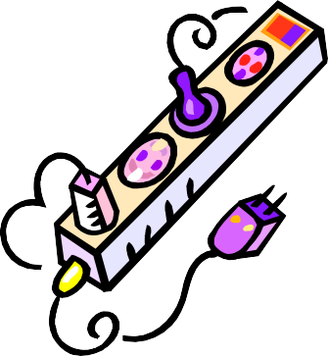
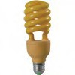
I turn off the electrical devices from the main switch
… so I save energy capable of
electrifying a big island,for a year
I use energy-saving lamp
….so I prevent the release of
about 280kg of CO₂

Slide 13
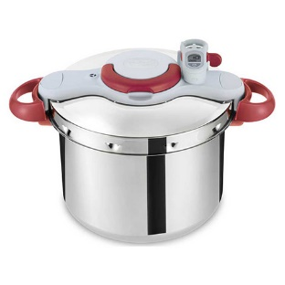
I use household electrical appliances, correctly!!
I prefer………
Instead of the electric heater to heat water.
I boil as much water as I need , no more.
I prefer small appliances because they consume less power.
I cook .in the pressure cooker.Isave up to
60% electricity and a lot of time.

Slide 14
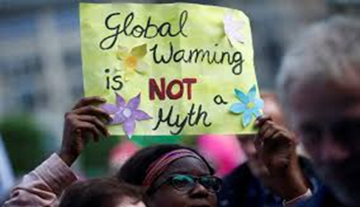
ALTHOUGH WE ARE PART
OF THE CAUSE
WE CAN ALSO BE PART
OF THE SOLUTION

Slide 15
http://ec.europa.eu/clima/sites/quiz/index.html

Slide 16
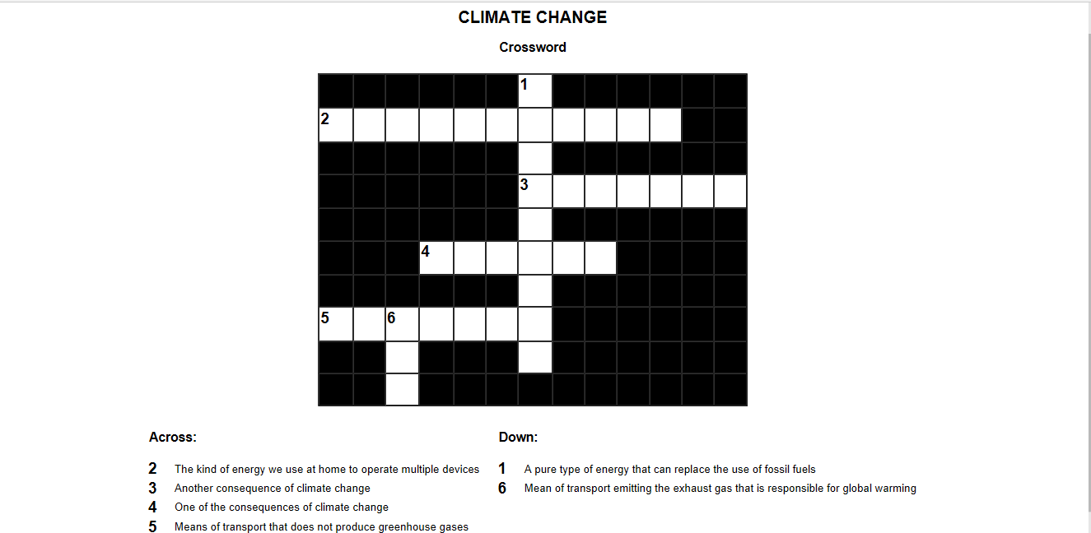

Slide 17
THE ENERGY CHAIN
A group What΄s behind the lamp
B group What΄s behind the chimney of the house
C group What’s behind the exhaust of the car

