Slide 1
Erasmusday & science fair
BC BROEKHIN – THE NETHERLANDS

Slide 2
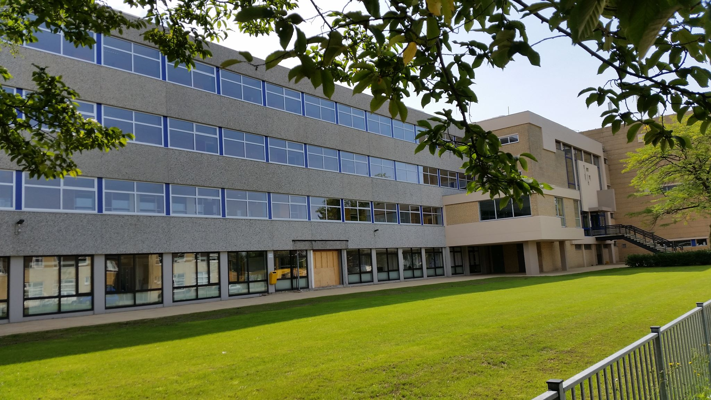
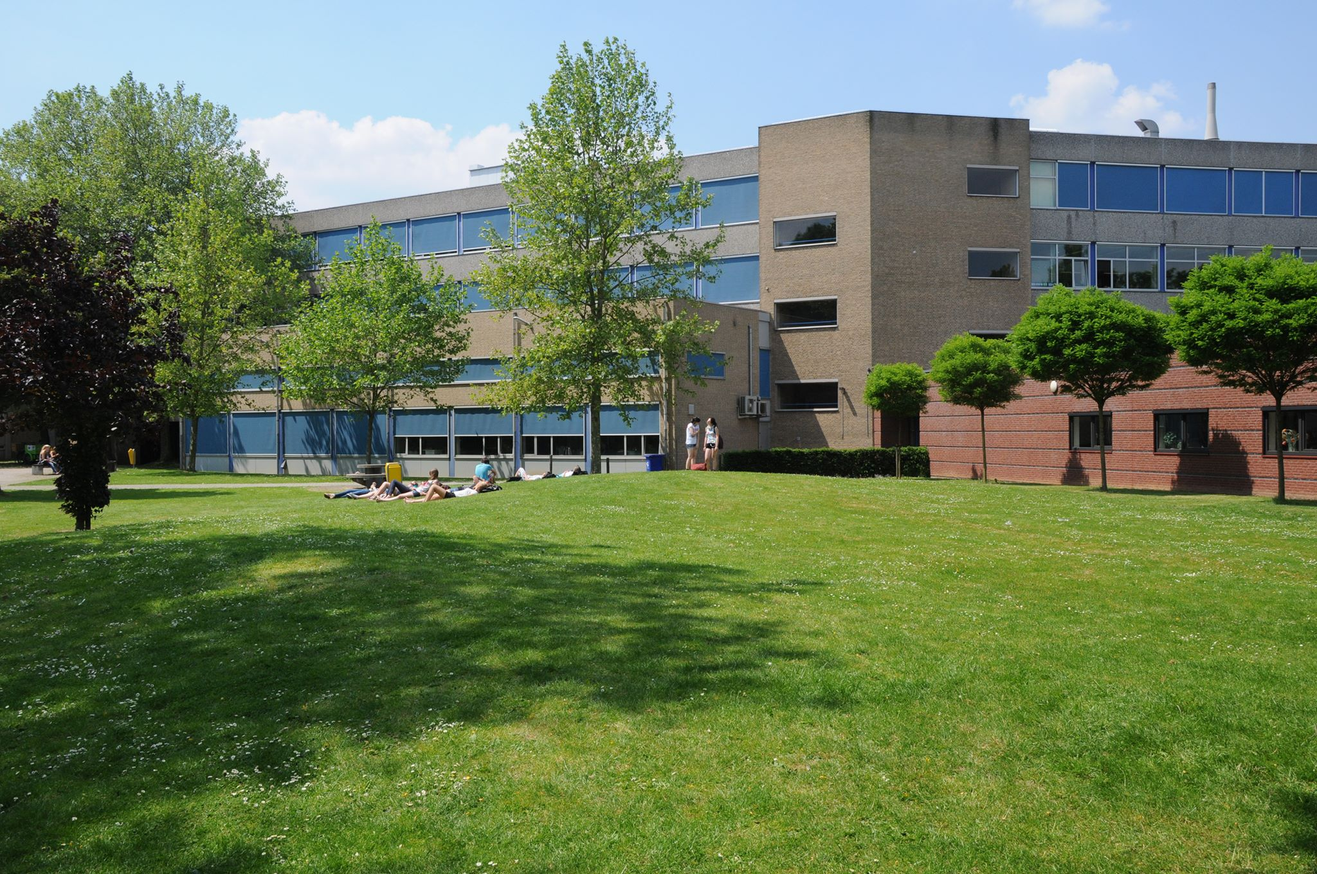
As part of the Erasmus+ project “Stop climate change – together Europe achieves more” we organised an Erasmus day and science fair at our school. Students, parents and people from the local community came to visit our school on this day. On this day we showed the visitors what we have been working on the past year and we did some climate based experiments. We hope we raised awareness for the climate among the visitors.
Notes:
Voeg een kaart van uw land bij.

Slide 3
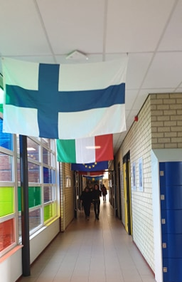
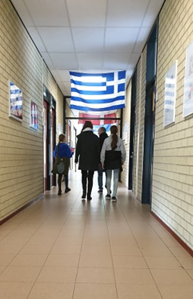
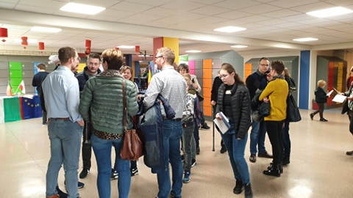
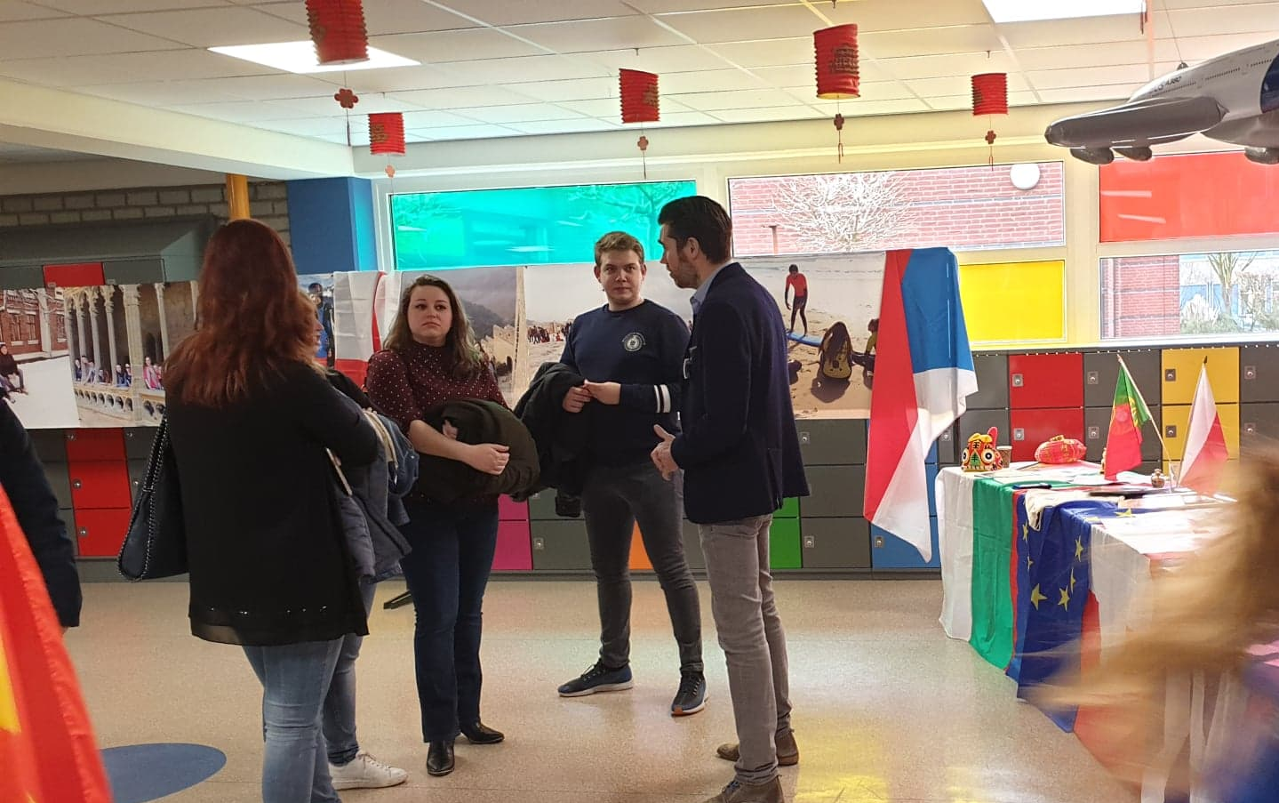

Slide 4
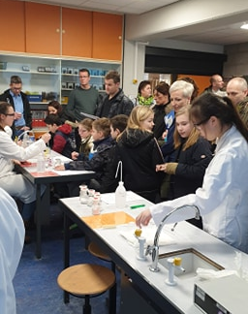
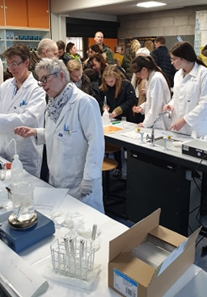
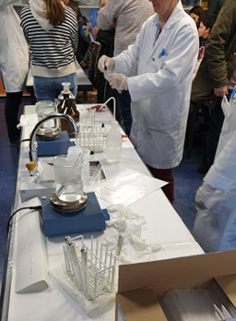
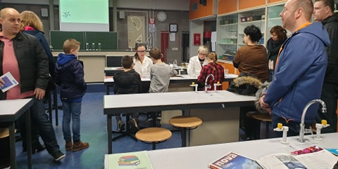
Notes:
Voeg een afbeelding bij van een van de bezienswaardigheden in uw land.

Slide 5
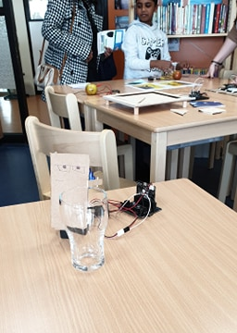
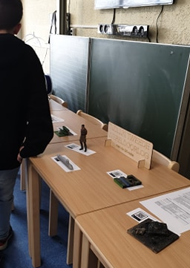
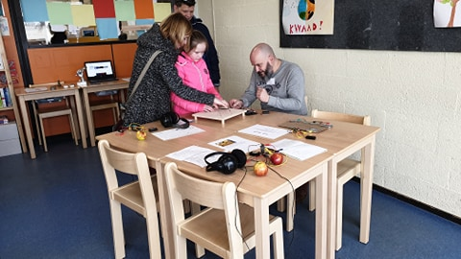
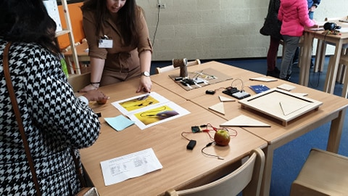

Slide 6
