Slide 1
ERASMUS DAY MAY 2018-20
Stop Climate Change
Together Europe Achieves More

Slide 2
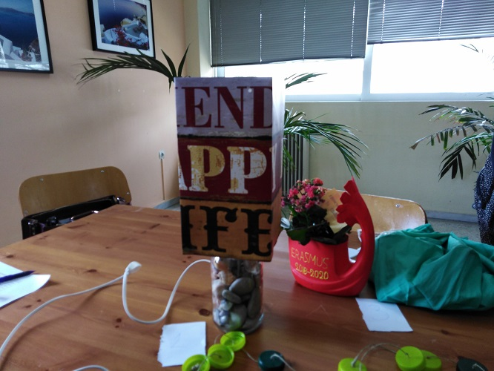
Science Fair
Competition for the best model
from recycled material

Slide 3
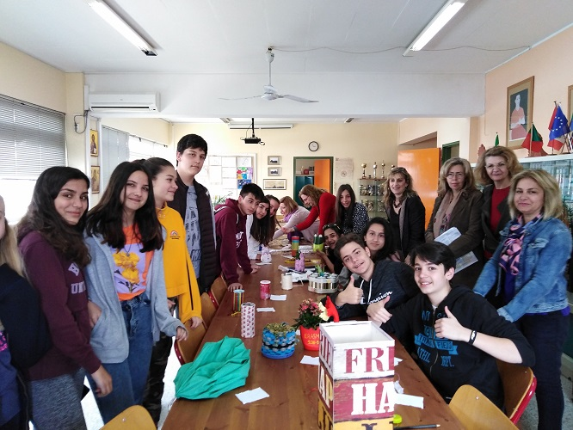
Students and teachers admiring the models

Slide 4
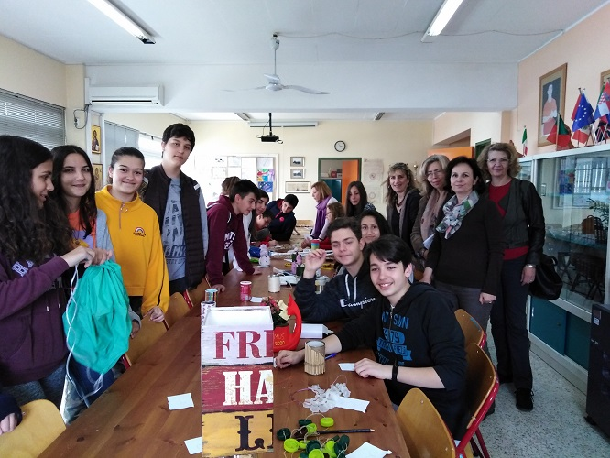
Students prepare for voting for the best model

Slide 5
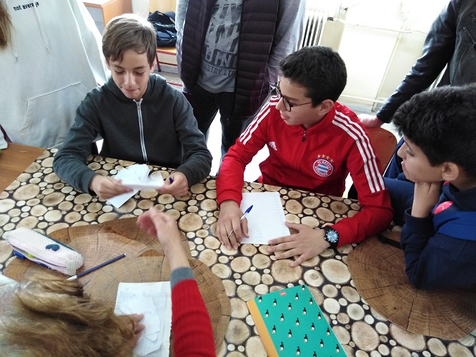
Students seriously considering their votes

Slide 6
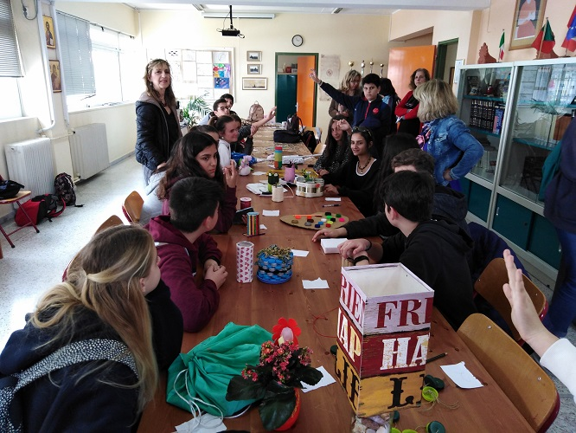
By raising their hand
students vote
between the two models
that have the same score

Slide 7
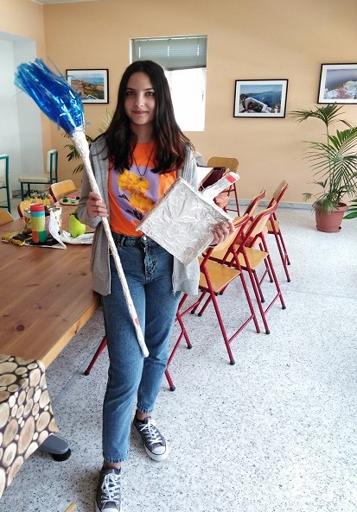
Here is the model
that got the first prize,
α broom with a dustpan

Slide 8
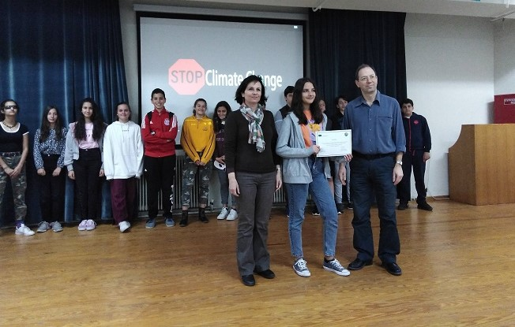
The student who won the first prize with
Mr Pantos, the headmaster
and Mrs Bravou,
the coordinator of Greece

Slide 9
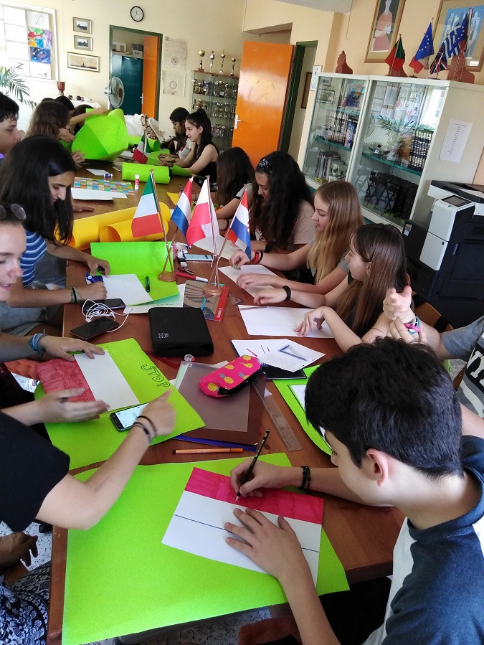
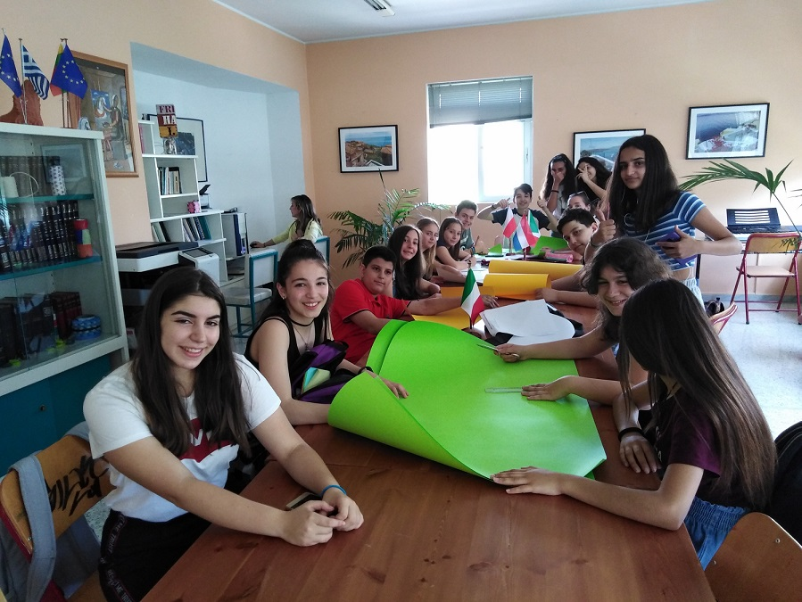
MAKING POSTERS WITH CLIMATE CHANGE SLOGANS

Slide 10
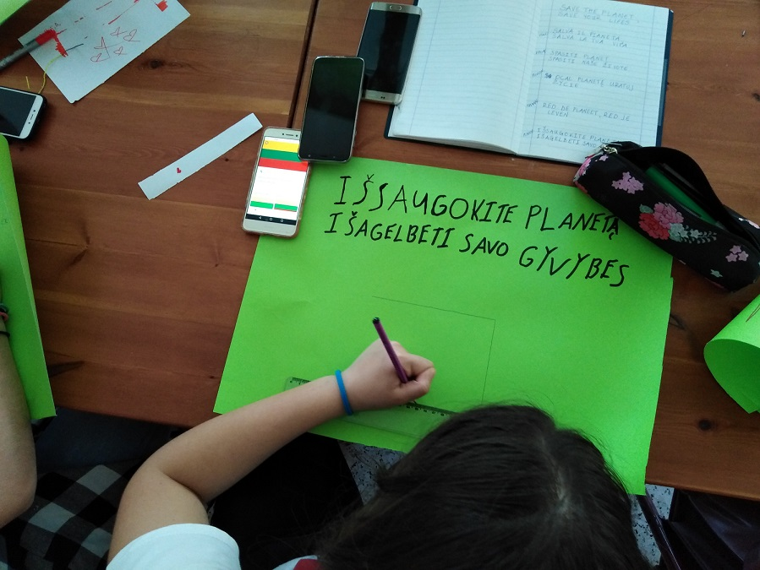
Students of Erasmus Project painted flags of each country taking part in the project and wrote in six languages climate slogans

