Slide 1
RENEWABLE ENERGY SOURCES
Osnovna škola Bartola Kašića Vinkovci
Erasmus+ project 2018-2020 Stop climate Change – Together Europe Achieves More

Slide 2
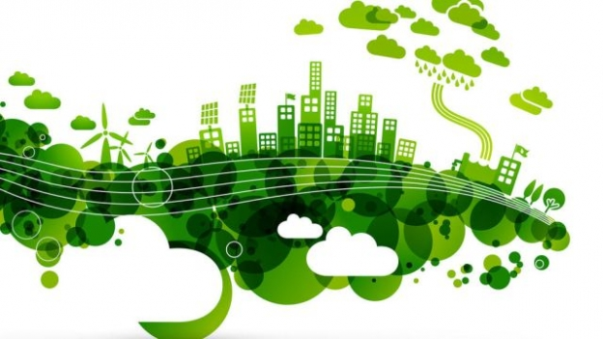
Slide Title
Morgan Freeman, Climate change
https://www.youtube.com/watch?v=8YQIaOldDU8

Slide 3
Renewable energy sources are
energy of the sun
energy of the wind
energy of the water
geothermal energy
energy of the biomass

Slide 4
Unrenewable energy sources are:
Coal
Oil
Gas

Slide 5
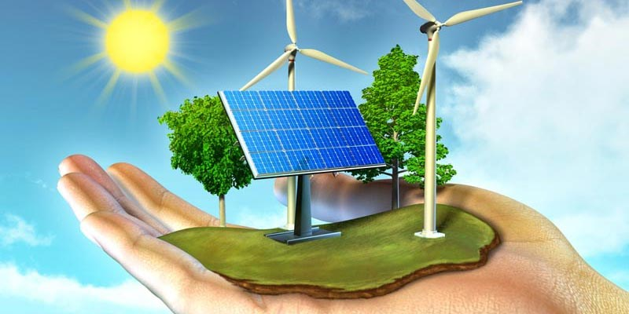
Slide Title
They can be used for heating of water and homes, schools and can be used for production of electrical energy.

Slide 6
ADVANTAGES
they are impossible to use up
they are renewable
better for the environment than unrenewable energy
sources.

Slide 7
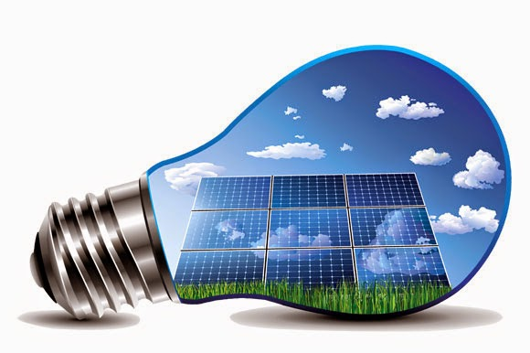
Energy of the sun
it can be used for heating spaces.
Advantages: it is free, panels don't let harmful gases into the air, they operate safely and quietly, energy is produced in the place where it is spent. The Sun will not dissappear!

Slide 8
Energy of the sun
Disadvantages: It can't be used at night, on cloudy days there is less energy. The equipment is expensive.

Slide 9
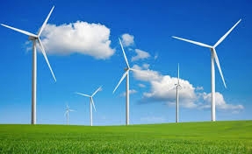
Energy of the wind
Wind is air in motion. Its energy can be used for production of electrical energy. Those power plants are called wind farms.
Advantages:
Wind is a renewable source of energy – it will never dissappear.
Wind farms do not let polluted gases into the environment.
Ground where the wind farms are can be used for other purposes like agriculture.
Electrical energy gained from the wind isn't more expensive than energy gained from fossil fuel.

Slide 10
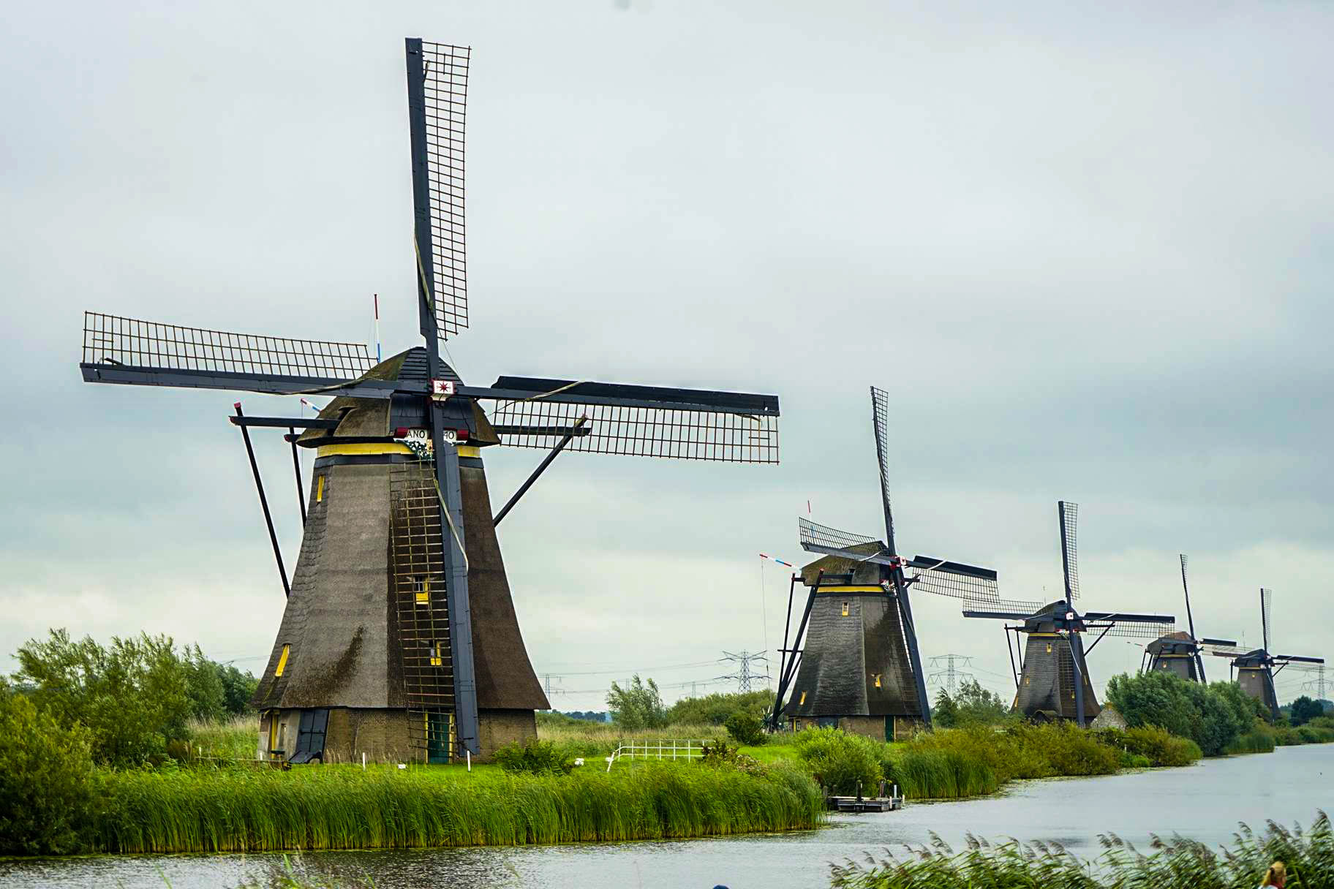
Energy of the wind
Disadvantages:
Wind farms don't work when there is no wind or when the wind is either too strong or too light.
Some people just don't like wind farms – they think it is not a pretty sight. Others think they are harmful for the birds. But, more birds get hurt as a result of crashing into cars or buildings.

Slide 11
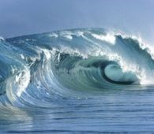
Energy of the water:
It was used throughout history for flour production. Today it is mostly used for electrical energy production.
Advantages:
Water power because it won't stop raining.
Hydroelectric power plants don't let polluted gases into the environment.
They are more reliable than solar power plants or wind farms because they usually have water tanks and can start operating when needed.

Slide 12
Energy of the water:
Disadvantages:
Building of a big hydroelectric power plant is very expensive,
they take up a lot of space that could be used for other purposes like agriculture.
It is also harmful for flora and fauna when a large area is flooded to create an accumulation lake.

Slide 13
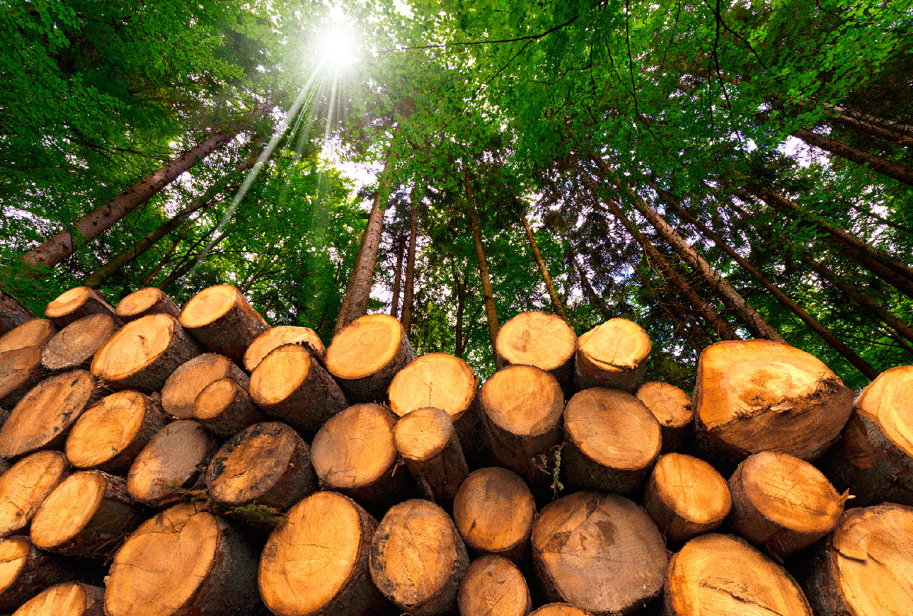
Energy of biomass
is energy contained in mass of vegetal or animal origin.
Advantages:
A part of waste can be used as biomass, and that decreases the amount of waste on landfills.
Biogass plants prevent the release of harmful methane into the air and use it for electrical and thermal energy.
Biomass doesn't depend on weather.

Slide 14
Energy of biomass
Disadvantages:
Although biomass is a renewable source of energy, it should be used carefully because forests should not be cut down uncontrolably.
Separating and recycling waste could be expensive.
Biomass and waste combustion lets out a certain amount of pollutants into the air, but the amount is significantly smaller than with fossil fuel combusition.

