Slide 1
Endangered Flora And Fauna Of Europe
Elena Nikolakea

Slide 2
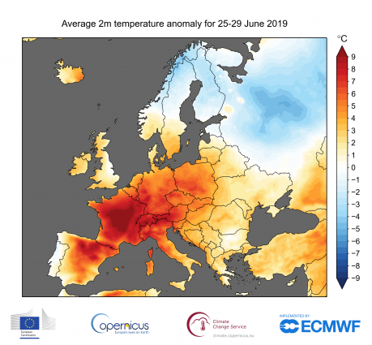
General information
Climate Change is a widely spread issue. What most people don’t know is that it mostly affects Europe.

Slide 3
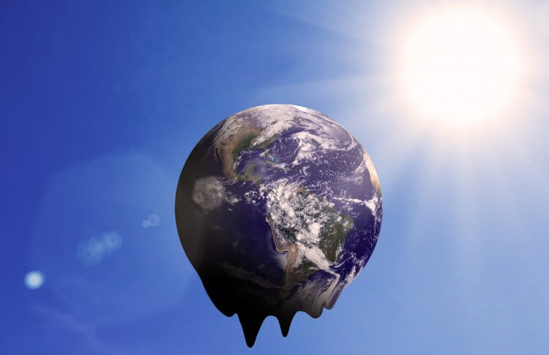
General Information
Sadly, the dramatic temperature changes in the Continent , have left Europe depleted of many animal and plant species

Slide 4
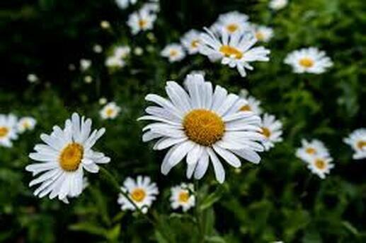
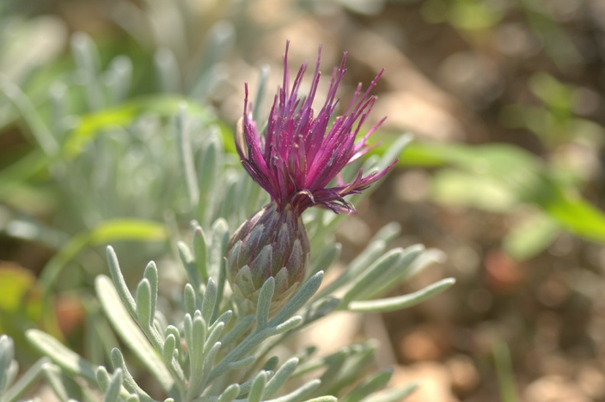
THE FLORA OF EUROPE
Some plants can not adjust to Climate Change and the temperature changes. This leads to some plant species disappearing or being endangered.
Chamomile is an endangered plant even though it’s very common in Greece.
Centaurea akamantis is also and endangered plant. It can be found in Cyprus

Slide 5
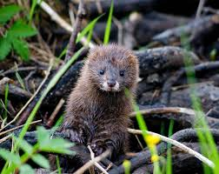
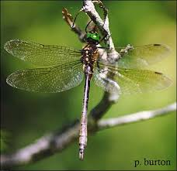
The Fauna Of Europe
A similar situation exists with animals. The position of Europe does not allow species of endangered animals, to migrate southwards and back towards the north.
The European Mink is a critically endangered
Animal.
The Hine’s emerald dragonfly is critically endangered and almost extinct.

Slide 6
Thank you for your time and attention.

