Slide 1
endangered animals in the world and in our country
Valia Spiliopoulou

Slide 2
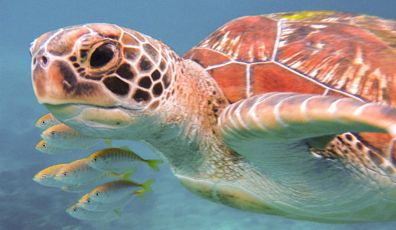
1. Sea turtles
Two types of sea turtles are amongst the most endangered species in the world: the Hawksbill Turtle and the Leatherback Turtle. In the past 100 years, the Hawksbill Turtle has lost 90% of its population, 80% of which has been lost in the past 10 years. Caretta-Caretta is also an endangered type of turtles and we can also find them in Greece.

Slide 3
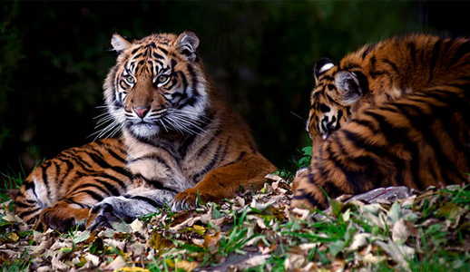
2. tiger
The tiger has long been hunted for its distinctive patterned fur. Of the nine tiger subspecies, three are already extinct, many are endangered but it is the South China Tiger and the Sumatran Tiger that currently face the biggest threat to their survival.
Less than 500 of these tigers exist today in comparison with
a population estimation of up to 1,000 in 1978.

Slide 4
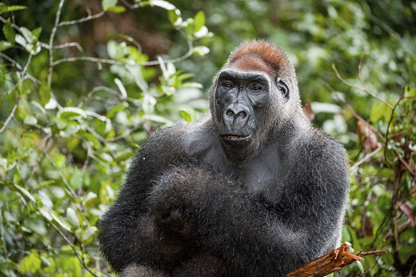
3.GORILLAS
Cross River Gorillas and Mountain Gorillas are both classified as Critically Endangered since 1996. Mountain gorillas are closely related to human beings, making them vulnerable to human diseases. With the already existing burden of diseases that these mountain gorillas suffer from, visiting tourists pose a further threat of infecting them with illnesses such as the flu and even the common cold.

Slide 5
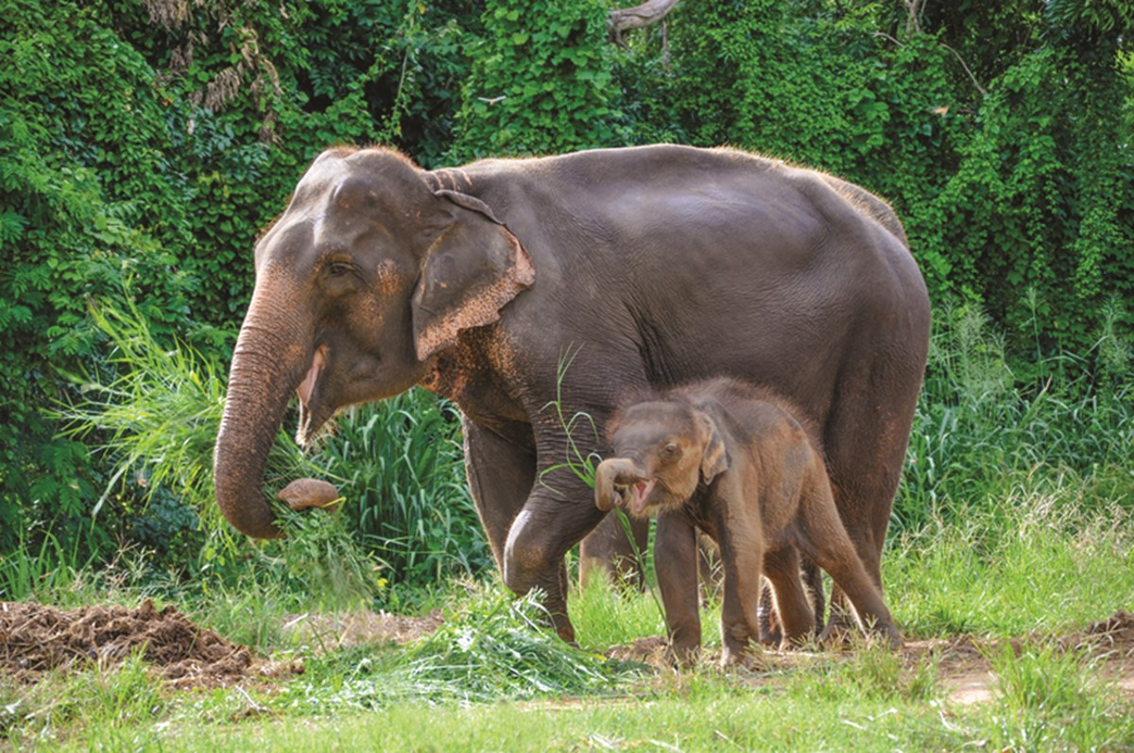
4.ASIAN ELEPHANTS
Asian elephants have been considered an endangered species since 1986,with fewer than 50,000 remaining in the wild.
Fragmentation, deforestation and an increasing human population are destroying the elephants' habitat and decreasing the space available for them to live in.

Slide 6
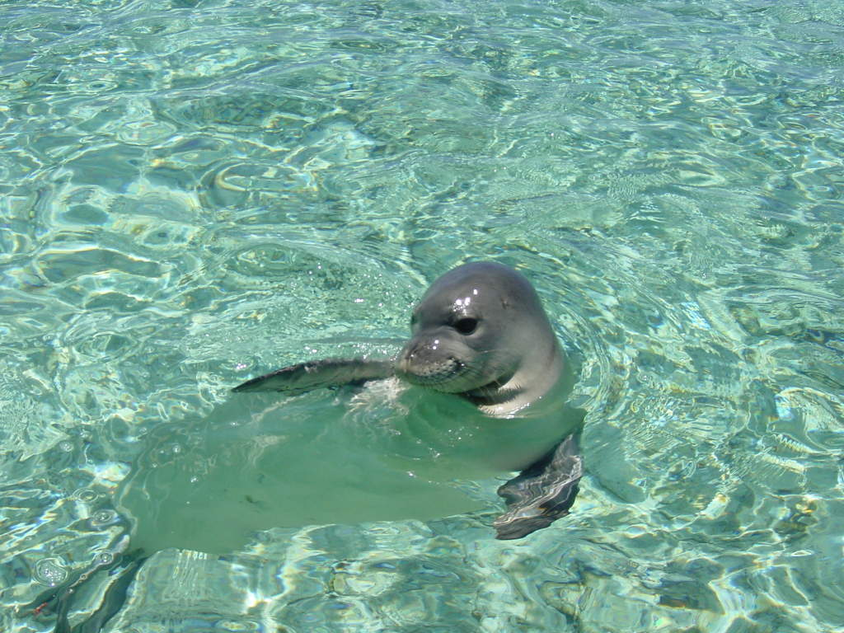
5.Monachus monachus
The Mediterranean monk seal (Monachus monachus) as of 2015, it is estimated that fewer than 700 individuals survive in three or four isolated subpopulations in the Mediterranean, (especially) in the Aegean Sea, the archipelago of Madeira and the Cabo Blanco, area in the northeastern Atlantic Ocean.
It is believed to be the world's rarest pinniped species.

Slide 7
These where 5 of the most endangered animals in the world and some of them in Greece but there are still a thousand more which need help, so we should try our best to protect them. Either from volunteering on animal organizations or from trying to keep our planet clean.

