Slide 1
ENDANGERED ANIMALS IN THE WORLD
MICHAELLA ANTONOPOULOU

Slide 2
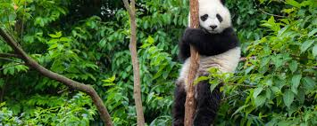
GIANT PANDA
The giant panda, also known as panda,is a bear native to south central china. You can easily recognise it by the large black patches arount its eyes over its ears, and across its round body. A 2007 report showed 239 pandas living in captivity inside China and another 27 outside the country. As of December 2014, 49 giant pandas lived in captivity outside China, living in 18 zoos in 13 different countries. In 2016, the IUCN reclassified the species from "endangered" to "vulnerable".

Slide 3
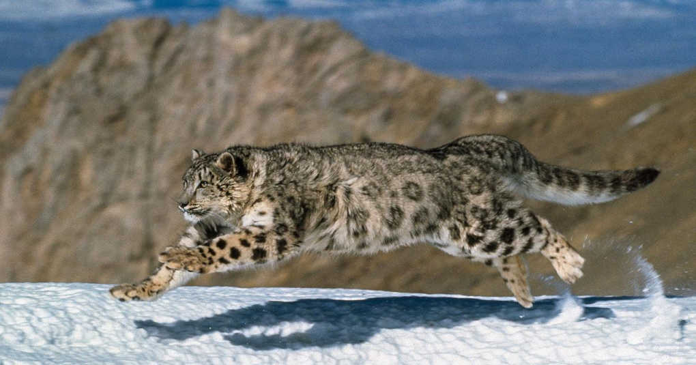
SNOW LEOPARD
The snow leopard , also known as the ounce, is a large cat native to the mountain ranges of Central and South Asia. It is listed as Vulnerable on the IUCN Red List because the global population is estimated to number less than 10,000 mature individuals and decline about 10% in the next 23 years. Since 2008, it is considered a member of the genus Panthera based on results of genetic studies.It is threatened by poaching and habitat destruction following infrastructural developments.

Slide 4
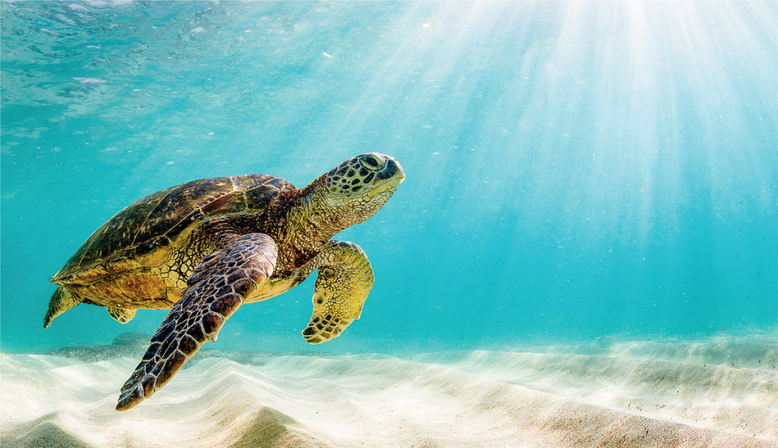
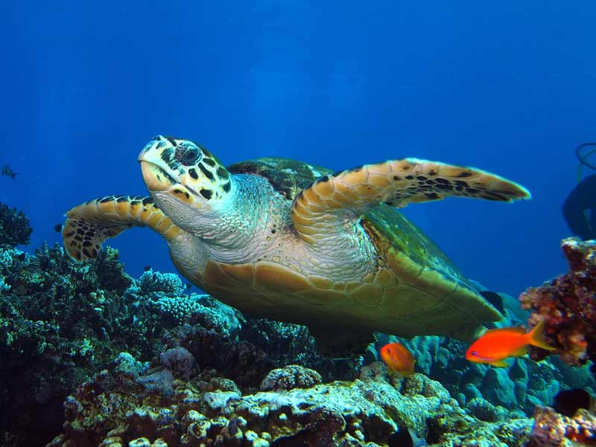
GREEN TURTLE
The green turtle is one of the largest sea turtles and the only herbivore among the different species. Green turtles are in fact named for the greenish color of their cartilage and fat, not their shells. In the Eastern Pacific, a group of green turtles that have darker shells are called black turtles by the local community.
They are found mainly in tropical and subtropical waters.

Slide 5
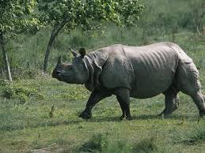
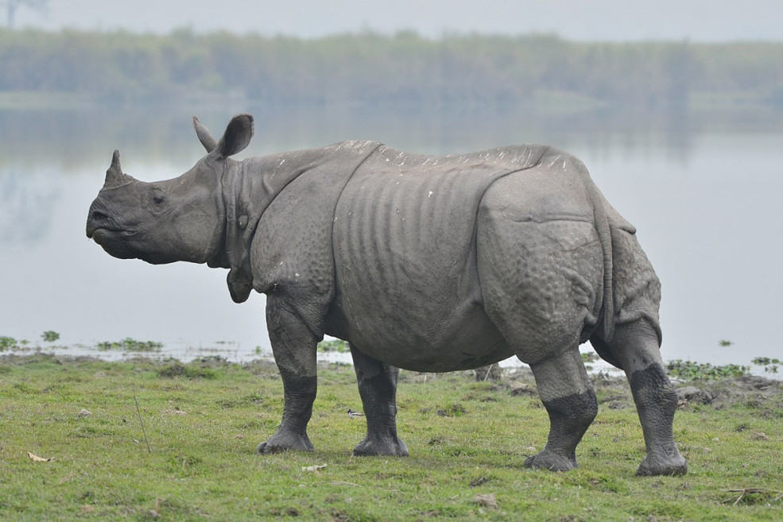
THE GREATER ONE HORNED RHINO
The greater one-horned rhino (or “Indian rhino”) is the largest of the rhino species. Once widespread across the entire northern part of the Indian sub-continent, rhino populations plummeted as they were hunted for sport or killed as agricultural pests. This pushed the species very close to extinction and by the end of the 20th century, fewer than 200 animals remained.

Slide 6
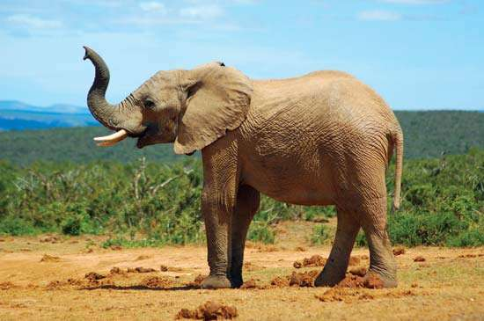
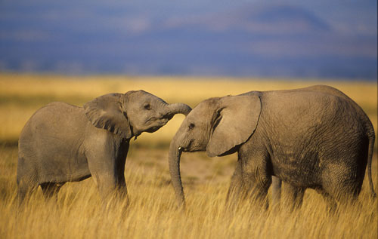
INDIAN ELEPHANT
The Indian elephant (Elephas maximus indicus) is one of the three living subspecies of Asian elephants .Indian elephants are large, herbivorous mammals, which means that they eat plants, not animals. Elephants are not only a cultural icon in India and throughout Asia, they also help to maintain the integrity of their forest and grassland habitats. Since they need to drink at least once a day, these elephants are always close to a source of fresh water.

Slide 7
THANK YOU

