Slide 1
ENDANGERED ANIMALS
In the world and in the Netherlands

Slide 2
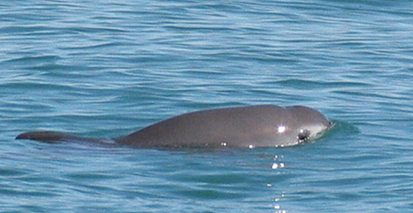
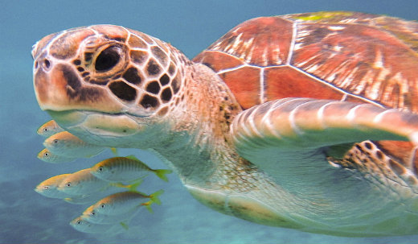
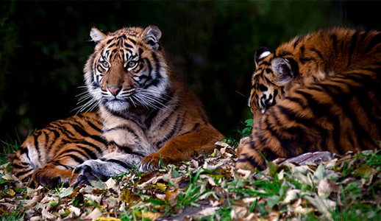
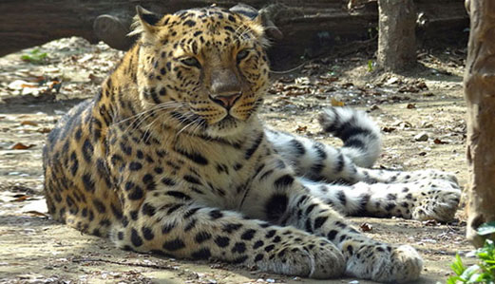
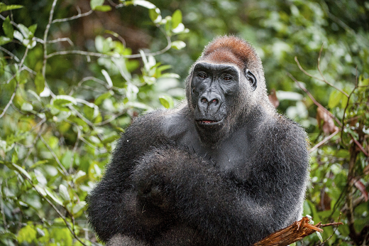
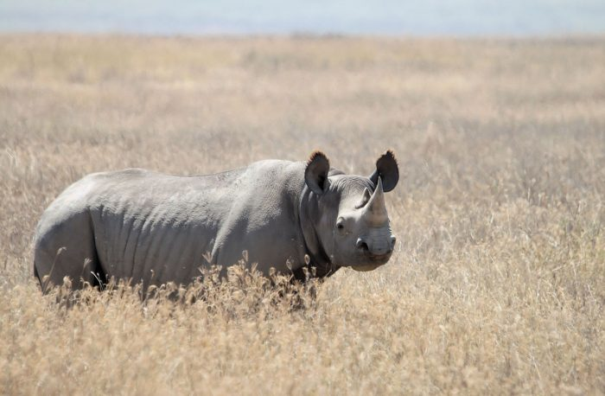
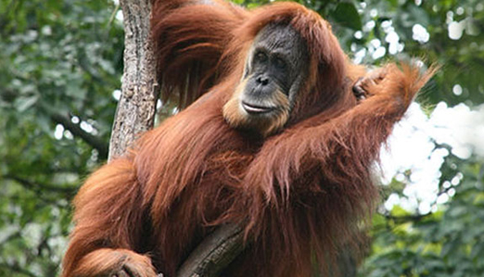
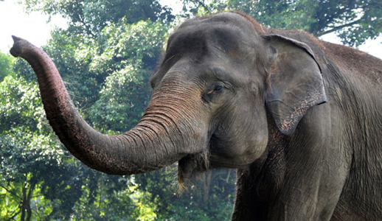
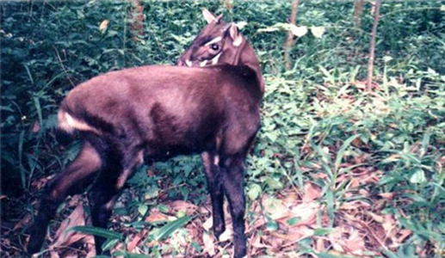
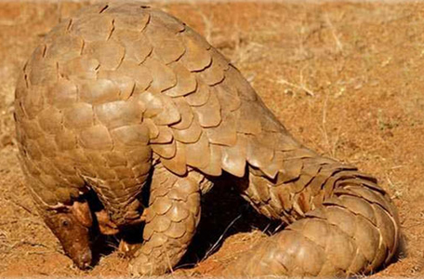
Endangered animals in the World
For some species, time on planet Earth is running out. Human beings are the greatest threat to the survival of endangered species with poaching, habitat destruction and the effects of climate change causing a lot of the problems. Most endangered animals in the world: Gorillas Amur Leopard Sea turtles Orangutan Sumatran elephant Saola Vaquita Tiger Rhinos Pangolin

Slide 3
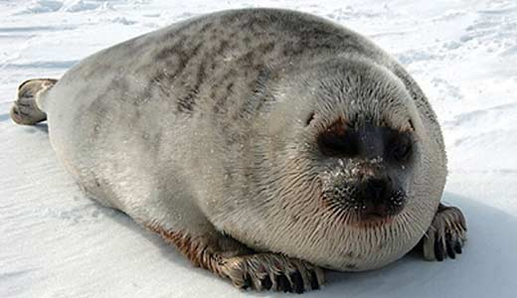
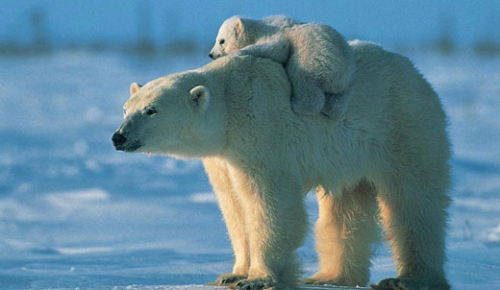
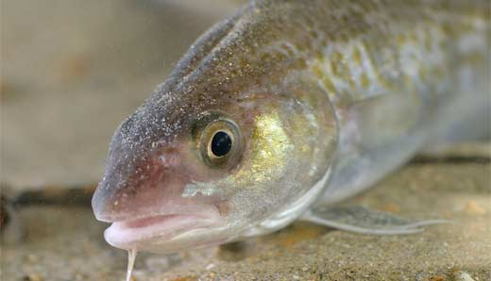
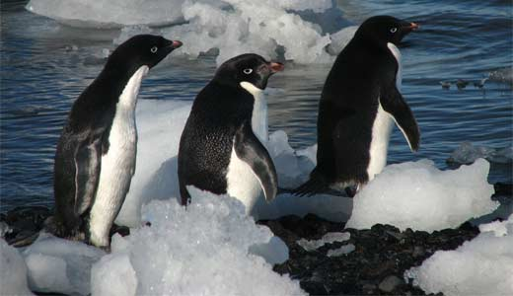
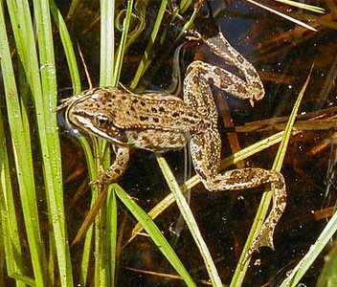
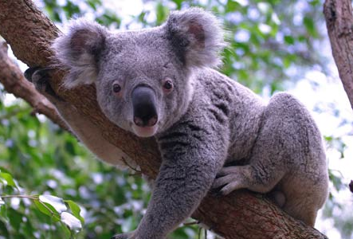
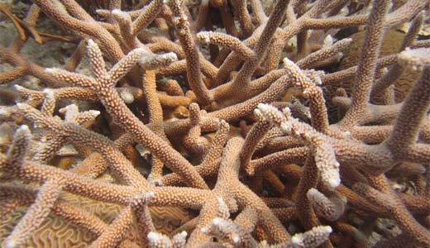
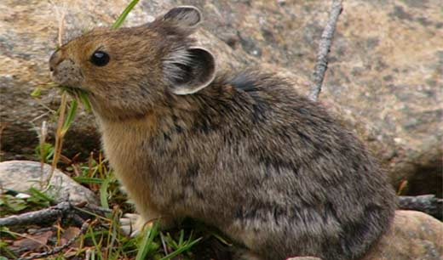
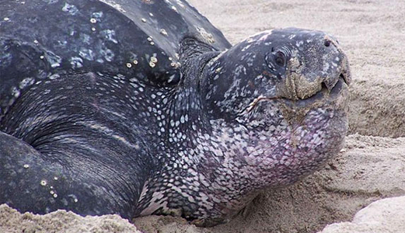
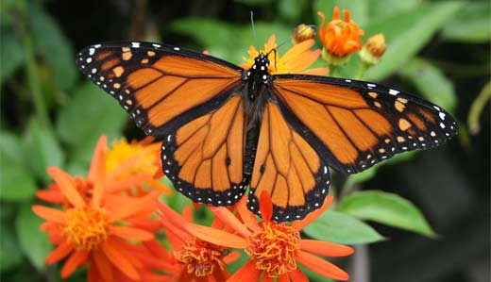
Endangered animals in the World
Our planet is getting warmer. The threat of climate change is real, and our dependence on fossil fuels is the biggest contributor. Unless we make some radical changes, global temperatures will continue to rise and it will have severe consequences for humans and animals. Most endangered animals by climate change: Columbia spotted frog staghorn coral American pika Adélie penguin leatherback sea turtle koala atlantic cod monarch butterfly ringed seal polar bear

Slide 4
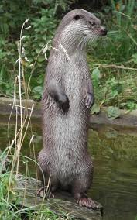
Endangered animals in the Netherlands
The otter
Otters are predators. With their elongated body and small, short legs, they mainly hunt fish. There are webbed feet. That is so easy in the water. In 1988 the last otter in the Netherlands was run over in Friesland. Polluted water, cars, hunting and the cultivation of banks had caused the otter to become extinct in the Netherlands. Soon after the death of the last otter, plans were made to reintroduce it to our country. Several nature reserves were made “otterproof” and in 2002 a number of otters from Latvia and Belarus were released in De Weerribben National Park in Overijssel. Initially with little success, because a large number of the released otters were killed. But now six years later, things are going in the right direction. Recently, about 35 wild otters have been counted in the release areas, and more than have been released.

Slide 5
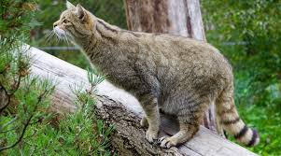
Endangered animals in the Netherlands
Wild cat
Is the wild cat back in the Netherlands? Opinions are divided on this. It is certain that there were three official sightings between 1999 and 2004. Unofficial observations run to well over a hundred, but they don't apply to science. It can also be a feral domestic cat and to be sure, DNA tests must therefore be taken. A large population of wild cats lives in Germany, about 20 kilometers from the border with the Netherlands. So it seems that these cats make trips to our country. Now that the wild cat is being observed in the Netherlands again, this has a number of consequences for nature management in our country. Feral house cats with a tabby coat should no longer be shot by hunters, as it may be a feral cat. The wild cat looks a lot like the striped tabby house, garden and kitchen cat. A mistake is therefore quickly made. Even though the wild cat looks the same at first sight, it is really a different animal. For example, the head of the wild cat is wider, it has white whiskers and a shorter tail. Wild cats cannot be tamed and therefore cannot be kept as pets. The wild cat has disappeared from the Netherlands since Roman times, probably due to deforestation and hunting.

Slide 6
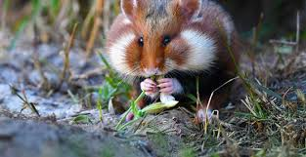
Endangered animals in the Netherlands
Ordinary hamster
The hamster is famous in the Netherlands under the Limburg name Korenwolf. The common hamster is also called European hamster, black-bellied hamster or field hamster. It's a lot of names for such a small animal. The common hamster is originally only found in Southern Limburg, but due to various activities it had almost disappeared. It resulted in years of actions and discussions. Whole construction projects were halted because there may have been a family hiding on the property. Through breeding programs and the designation of reserves, this animal occurs in nature again. The common hamster grows about 20 to 35 centimeters. The top is yellowish brown, the belly is black. He has large, hairless ears.

Slide 7
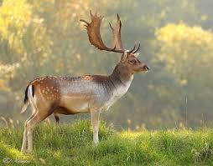
Endangered animals in the Netherlands
Fallow deer
Surprised that fallow deer is on the Red List of endangered species in the Netherlands? That's because you often encounter fallow deer in deer camps. But in the wild there are not that many more in the Netherlands, only in the Veluwe and in the dunes. Since the fallow deer is on the Red List, they should not be hunted. Fallow deer live in packs and can mainly be seen during the day. Also striking: they are good swimmers. Before the Ice Age, fallow deer lived all over Western Europe. But because of the cold of the ice age, they have been driven to Asia. The Romans brought the fallow deer back to Europe, including the Netherlands. The fallow deer is larger than a deer and smaller than a red deer. There are white spots on the yellowish, light brown coat. The male has a hoe antler, which means that there are plates between the branches.

Slide 8
Endangered animals in the Netherlands
Notched bat
His coat is long and woolly and has a reddish color. With a wingspan of about 22 centimeters, it is not a big appearance. The large, wide ears are noticeable and he also owes his name to that. There is a kink in his ears, so basketted. His name sounds exotic and that is also the bat. The basked bat lives in countries such as Kazakhstan, Morocco and Saudi Arabia, but also in our little country. In the Netherlands there are only two colonies, with a total of about 500 bats. Both are in the attic of a monastery and both in the town of Echt in Limburg.

Slide 9
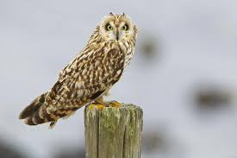
Endangered animals in the Netherlands
Short-eared owl
The Netherlands has six species of owls. Unlike the other owls, the short-eared owl is also active during the day and that is quite special. Nor does this owl breed in the trees, but on the ground. The short-eared owl is still rare in the Netherlands, only on the Wadden Islands there are a few places where they can breed. In total that is just under 50 pairs. Due to large-scale mining and dewatering, few areas remain where they can still build a nest. Short-eared owls are true vagrants. Birds born in the Netherlands easily migrate to Scandinavia. They are easiest to see in winter, because the mice then migrate to higher areas because of the cold. There are also more short-eared owls in the Netherlands in winter, because owls from the North hibernate here.

Slide 10
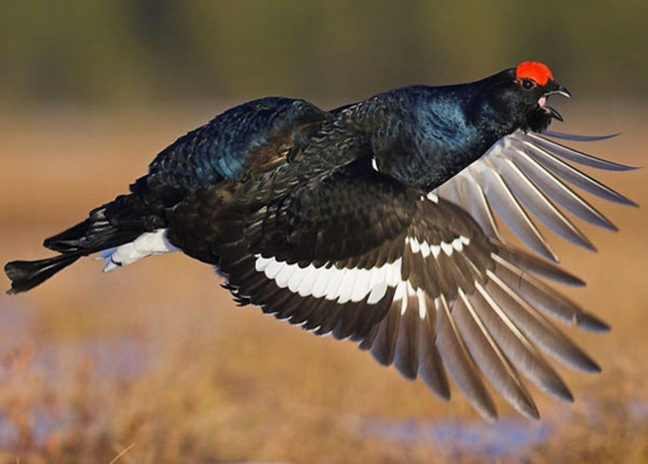
Endangered animals in the Netherlands
Black grouse
The size of a chicken and it may even look a little like it. The female black grouse is brown, the male is blue-black. Unfortunately, the black grouse likes a large amount of space, which is no longer available in our country today. That is why the species has declined sharply and there are still about 15 in the Netherlands. These are all located on the Sallantse Heuvelrug. Little is needed to make the animal disappear from the Netherlands, for example if too many males are born and too few females are born. The black grouse is famous for its courtship behavior. The males walk around each other with spread tail feathers early in the morning. During the day, more and more females come to encourage the men.

Slide 11
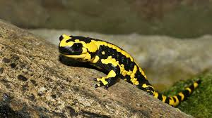
Endangered animals in the Netherlands
Fire salamander
Dutch only land salamander! And it is also the largest in Europe. At 20 centimeters, he is a big boy. 25 cm fire salamanders have even been seen. In the Netherlands, the fire salamander only occurs in the extreme tip of Limburg. He owes his name to the fact that he likes to hide in firewood. It has nothing to do with its color, even if it is shiny black with bright yellow stripes. These colors make it easy to recognize and that is the intention. It scares off other animals. The skin of the fire salamander is full of poisonous glands and the bright colors make it clear to other predators. Fire salamanders can live up to 20 years in the wild.

Slide 12
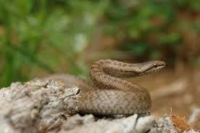
Endangered animals in the Netherlands
Smooth hose
Snakes in the Netherlands? Yes, in addition to the grass snake and viper, the smooth snake also lives in our country. The smooth hose is on average about 60 centimeters long. It is a strangling hose, which means that it is not poisonous. More good news: He's not aggressive and prefers to run rather than fight. He therefore shows little and hides under tree stumps and stones. If you want to see the smooth snake in person, you have the best chance in the Peel or the Fochterlooerveen nature reserve. The fact that the smooth snake is very rare in the Netherlands is probably due to the disappearance of the habitats and because there is less food for them. But because this snake shows so little, little is known about the way it lives. And that makes it difficult for conservationists to determine how best to protect the smooth hose.

Slide 13
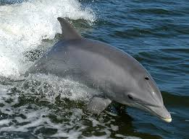
Endangered animals in the Netherlands
Tumbler
You know it: Flipper, the gray dolphin with its pointed snout. Surprised that this bottlenose dolphin occurs in the waters off the Dutch coast? Until the 1960s, the bottlenose dolphin was often seen off the coast, but they disappeared after the Zuiderzee was closed. Now they are very rare. Because the bottlenose dolphin is the largest dolphin species in the North Sea, that could change again. In 2004 two large groups of bottlenose dolphins swam through Dutch waters, in the Marsdiep near Texel. That was special, because it hadn't happened for years! Since there are no signs that the dolphins were lost, this is a hopeful sign. On average, a bottlenose dolphin becomes about three to four meters long and weighs less than 650 kilos. Bottlenose dolphins are gray with a white belly and they are the dolphins that are used in dolphinariums, also in Harderwijk. They are known for their active behavior, they jump, play and run in the water. Moreover, they are also extremely curious.

