Slide 1
Endagered plants and animals due to climate change
By Vasiliki Kokkoliadi

Slide 2
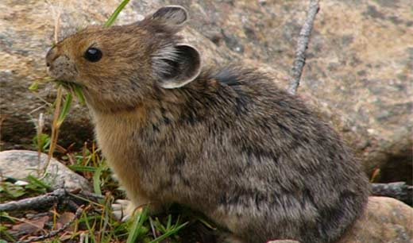
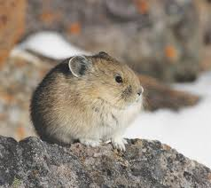
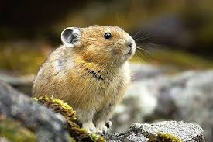
Amerikan Pika
Close relatives of rabbits and hares, Pikas are adapted to cold alpine conditions and are very intolerant of high temperatures. The American Pika (Ochotona Princeps) has been retreating upslope to escape rising temperatures and it is feared the species will eventually have nowhere left to go. In some locations, American Pika populations have already entirely disappeared. Other Pika species native to Eastern Europe and Asia are facing the same dire fate.

Slide 3
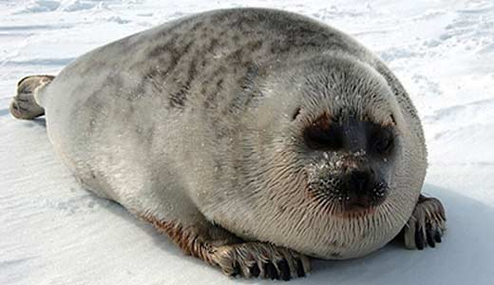
Ringed Seal
Ringed Seals (Pusa Hispida), polar bears’ favourite prey, are highly dependent on Arctic sea ice and almost never come onto land. Warming spring temperatures and early sea ice breakup are causing nursing pups to be prematurely separated from their mothers. Additionally, warmer ocean temperatures are likely to boost seal parasite populations and the forced migration of seals to more stable ice habitats will facilitate the spread of disease.

Slide 4
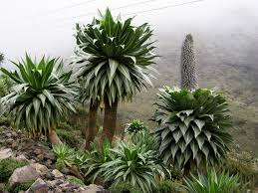
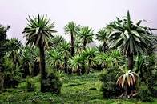
Lobelia Rhynchopetalum
Lobelia rhynchopetalum, the giant lobelia, is a plant endemic to Ethiopia. Its habitat is the Afroalpine climate of the Semien Mountains and Bale Mountains National Park. Recent study show that it is under a threat of climate change.

Slide 5
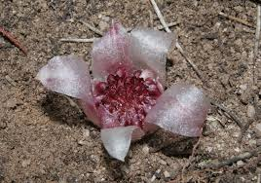
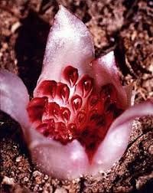
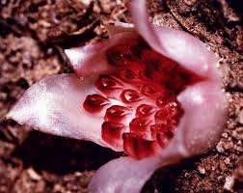
Rhizanthella Gardneri
Rhizanthella gardneri is a cute, quirky and critically endangered orchid that lives all its life underground. It even blooms underground, making it virtually unique amongst plants. Last year, using radioactive tracers, scientists showed that the orchid gets all its nutrients by parasitizing fungi associated with the roots of broom bush, a woody shrub of the Western Australia outback. Now, with less than 50 individuals left in the wild, scientists have made a timely and remarkable discovery about its genome.

Slide 6
Finally,save those poor and beaytiful plants and animals because they are not responsible for anything
Thanks for watching

Slide 7
The end
Erasmus 2019-2020

