Slide 1
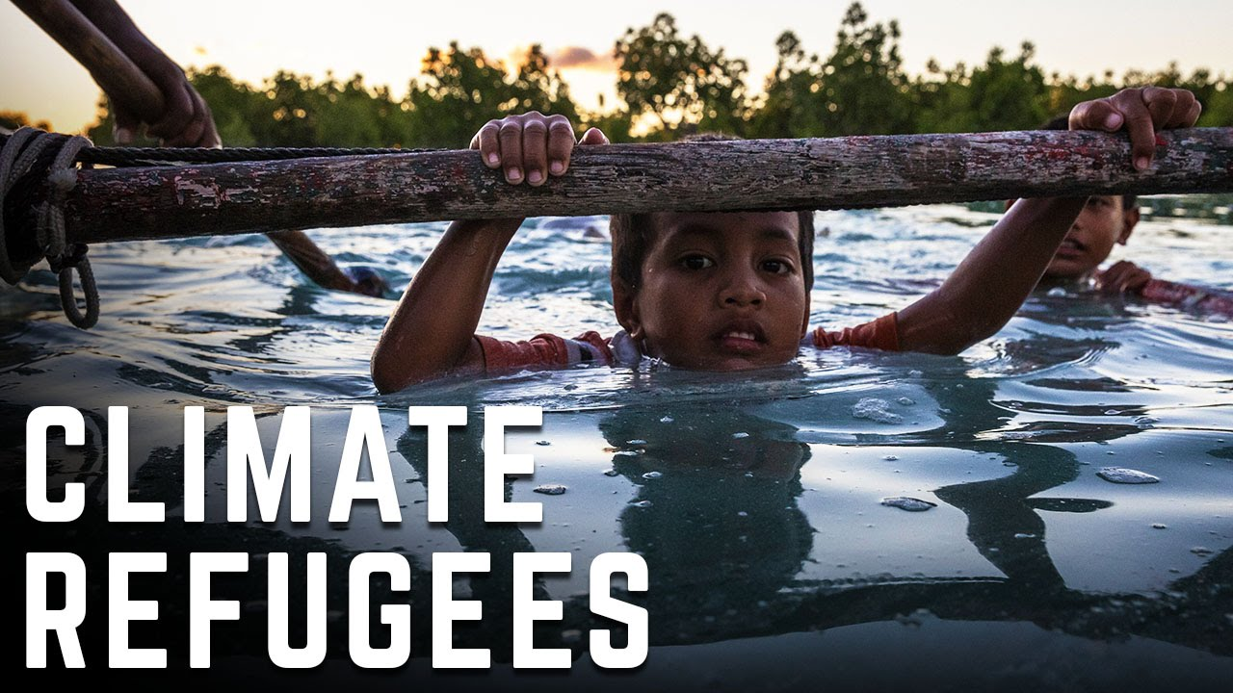

Slide 2
Contens
Who are climate refugees?
Causes of climate change
Causes of global warming
About the problem
Exemplary threatened areas
Why climate migrants do not have the refugee status

Slide 3
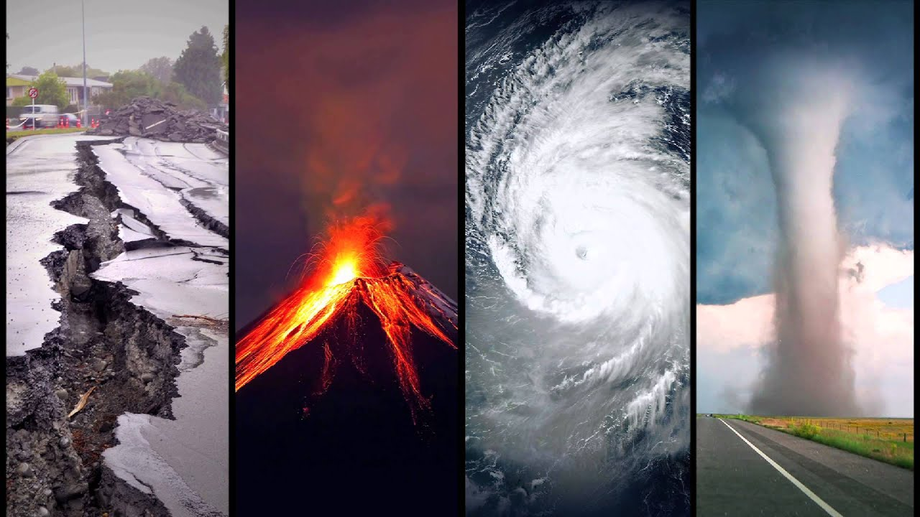
Who are climate refugees?
Climate refugees are people who must leave their homes and communities because of the effects of the climate change and global warming.
They belong to a large group of immigrants known as environmental refugees. Environmental refugees include immigrants forced to flee because of natural disasters, such as volcanic eruptions
and tsunamis.

Slide 4
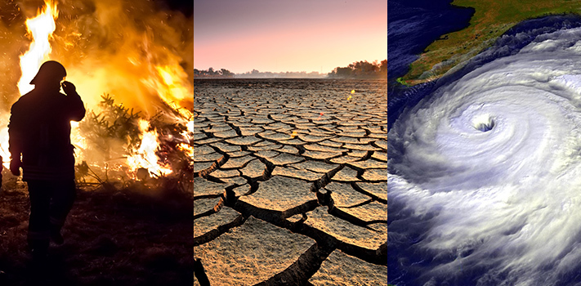
Causes of climate change
Climate change is caused by natural events, such as volcanic
eruptions, as well as human activities. Climate change has
happened many times since Earth was formed billions of
years ago.

Slide 5
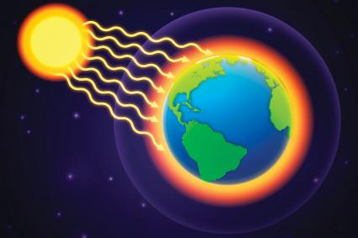
Causes of global warming
Global warming is the most
recent period of climate
change. Human activities like
burning fossil fuels and
cutting down forests
contribute to global
warming because they
release greenhouse gases.
Greenhouse gases trap heat
in the atmosphere.

Slide 6
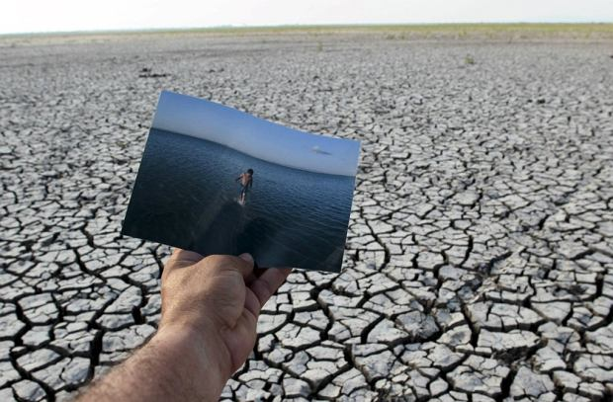
About the problem
The UN Refugee Agency estimates that by 2050, up to 250 million people will be displaced by climate change impacts such as rising sea levels, floods, famine, drought, hurricanes, desertification and the negative effects on ecosystems.

Slide 7
According to World's Bank analysis climate change and global warming may create even 150 million climate refugees who will emigrate to Europe, mainly from:
Africa - 86 million people
South Asia - 40 million people
Latin America - 17 million people

Slide 8
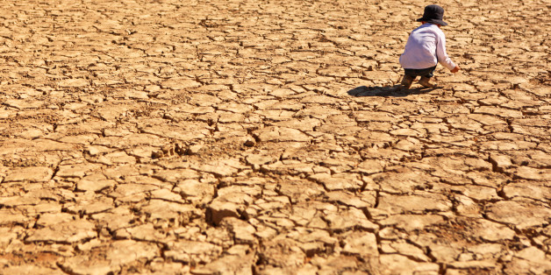
Exemplary threatened areas
The Gobi Desert in China expands more than 3,600 square kilometers every year.
Morocco, Tunisia, and Libya each lose more than 1,000 square kilometers of productive land every year to desertification.
The U.S. state of Louisiana loses about 65 square kilometers to the sea every year.

Slide 9
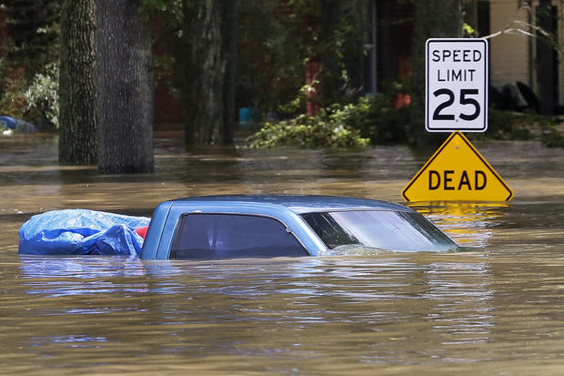
Maldives, an island nation in the Indian Ocean, is perhaps the country most threatened by sea level rise.
About half the population of Bangladesh lives less than 5 meters above sea level. In 1995, Bangladesh’s Bhola Island was half-submerged by rising sea levels, leaving 500,000 people homeless.

Slide 10
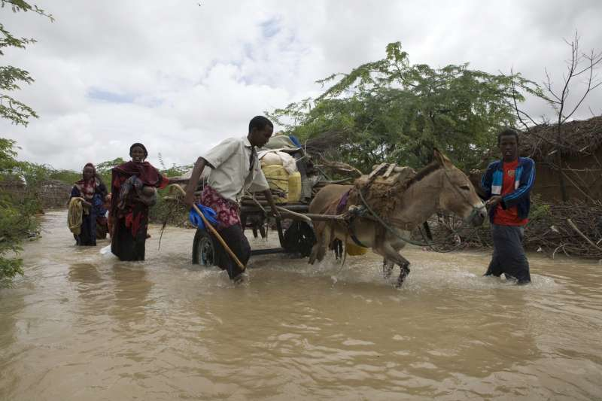
Why climate migrants do not have the refugee status
Environmental migrants are not protected by The 1951
Geneva Convention Relating to the Status of Refugees
which is designed to guard those fleeing persecution, war
or violence.

Slide 11
Presentation was prepared by Zuzanna Wiklent 3A

