Slide 1
SNAKES AND LADDERS, WITH A CLIMATE TWIST
Έλενα νικολακεα & μικαελλα αντωνοπουλου

Slide 2
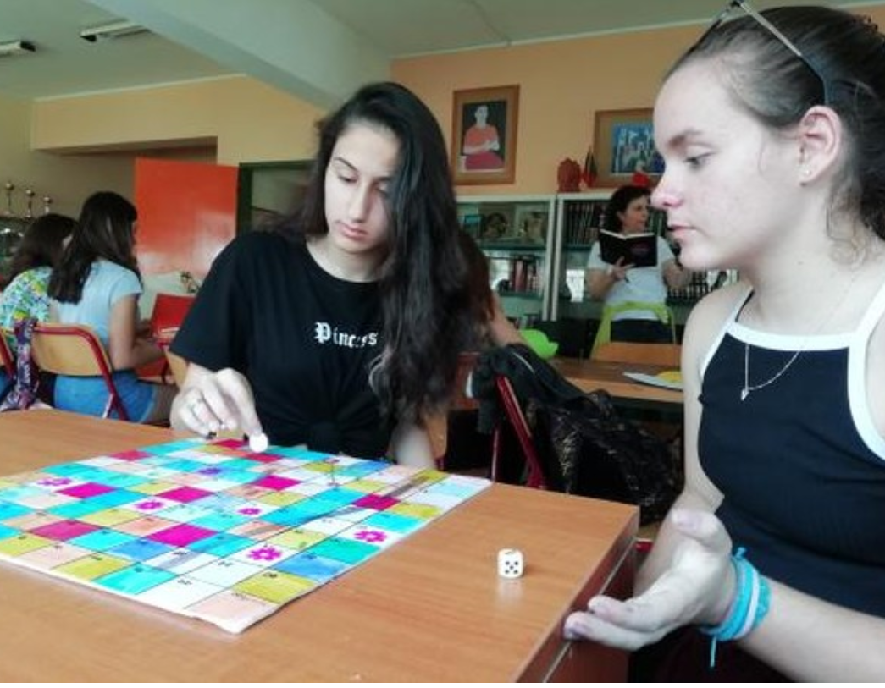
GENERAL INFORMATION
Snakes and ladders is a board game, regarded today as a worldwide classic.
This game is played between two or more players
It is also called “ chutes and ladders”

Slide 3
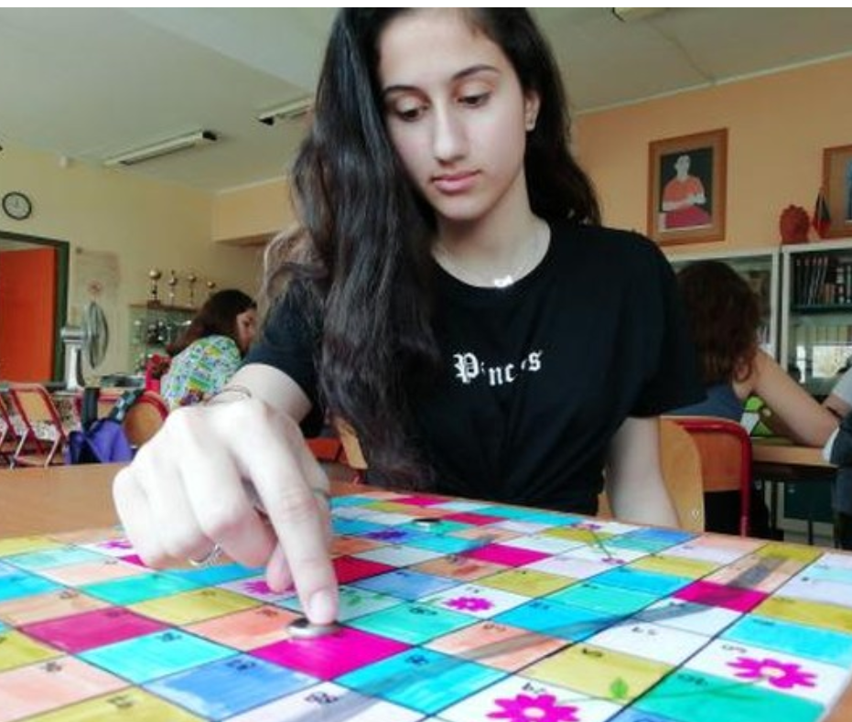
GENERAL INFORMATION
It is played on a board with numbered squares, from 1 to 100
A number of “ snakes “ and “ ladders “ are pictured on the board, each connecting two specific squares.

Slide 4
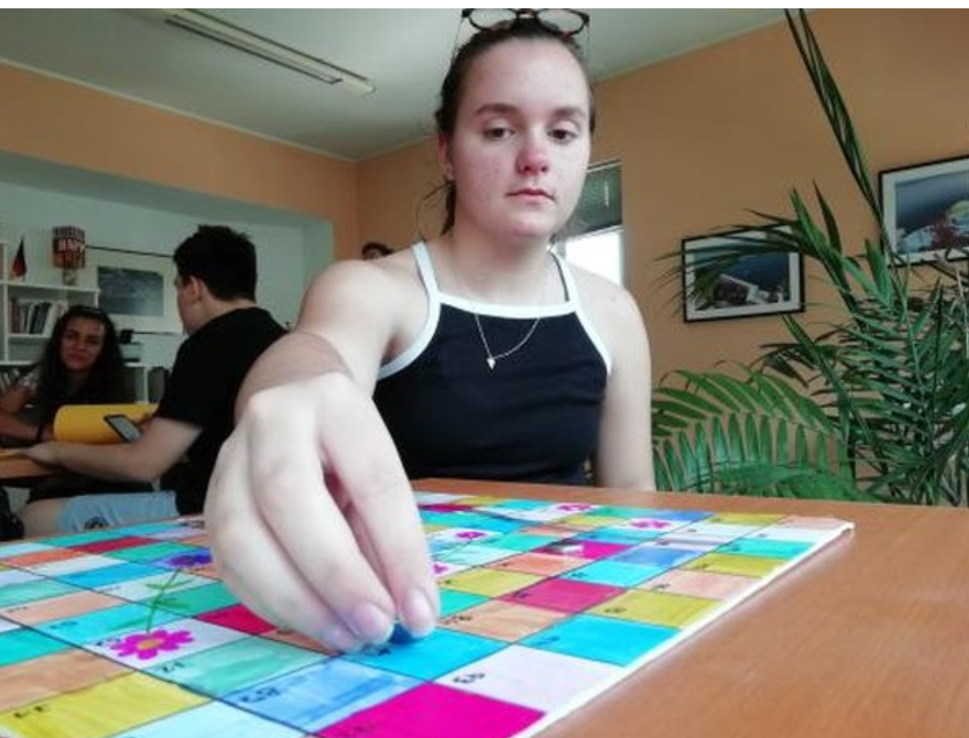
THE GAME’S OBJECT
Each player has to navigate their piece , according to the number on the dice.
Each player starts from the bottom left square, which has number 1 on it, and finishes at the top left square with the number 100 on it.

Slide 5
OUR GAME
The game we have created is almost identical to the original “ snakes and ladders “, the only difference is that, instead of ladders we have flowers. In the original game, the ladders help the players get ahead in the game. In our version, the flowers resemble all the good things we can do to save our planet , that’s why the flowers help the players get to the final square and beat their opponents
As most people know, “ snakes “ in the game are not very helpful. If anyone stumbles on a “snake” the have to go back several squares. We decided to trade the “snakes” with big, grey tubes that resemble the pollution problem the Earth is currently dealing with.

Slide 6
HOW DOES THE GAME END?
The game ends, when one of the players has reached the final square, the one with the number 100 on it.

