Slide 1
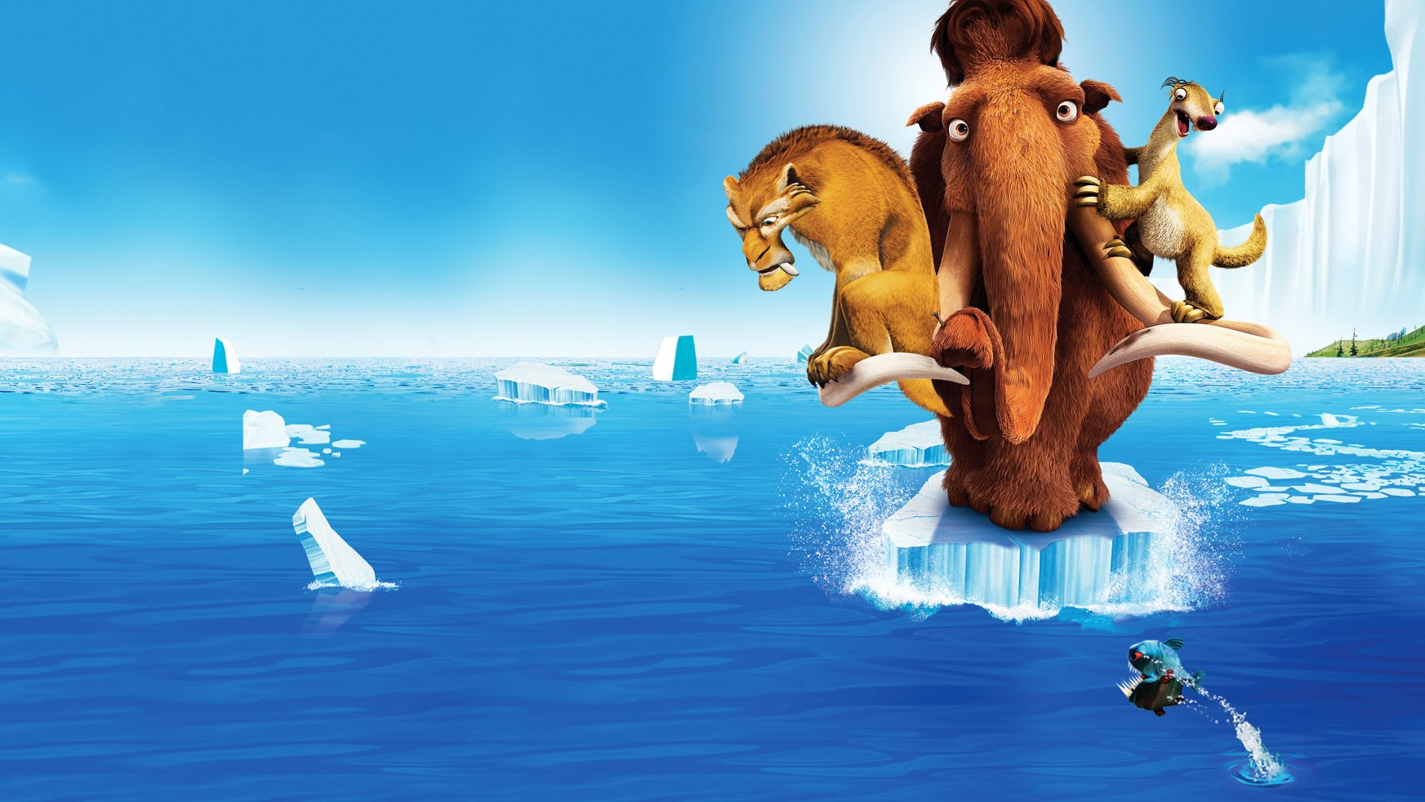
Climate change:The Ice Age in history
Ivana Spajić

Slide 2
Will The Ice Age happen again?
?
What caused The Ice Age?
What is The Ice Age?
What will happen to me?

Slide 3
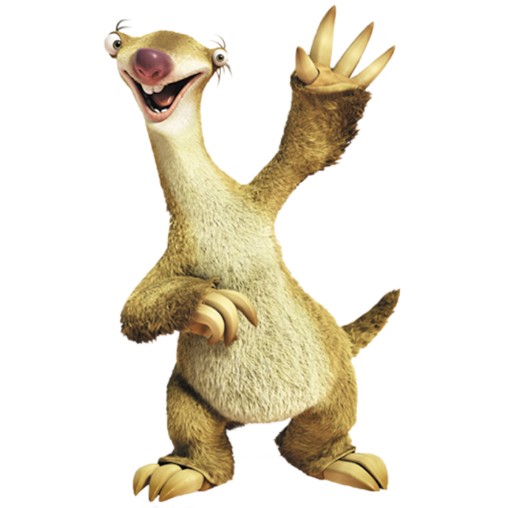
What is The Ice Age?
The Ice Age is a time when the climate was much, much colder than it is today.
There have been about 11 different ice ages that have happened during the earth’s 4.6 billion years of existence. The last Ice Age was called “The Great Ice Age”, and it occurred 11,000 years ago. During the “Great Ice Age” over a third of the earth was covered in ice, and the air had less carbon dioxide in it.
Now the Earth is in an interglacial period - a short warmer period between glacial (or ice age) periods.

Slide 4
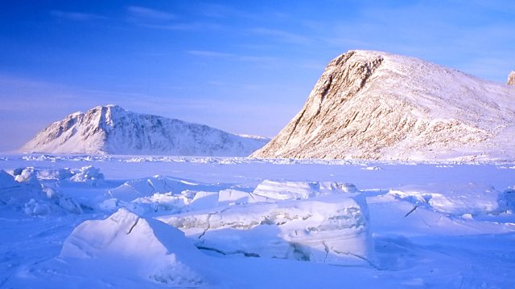
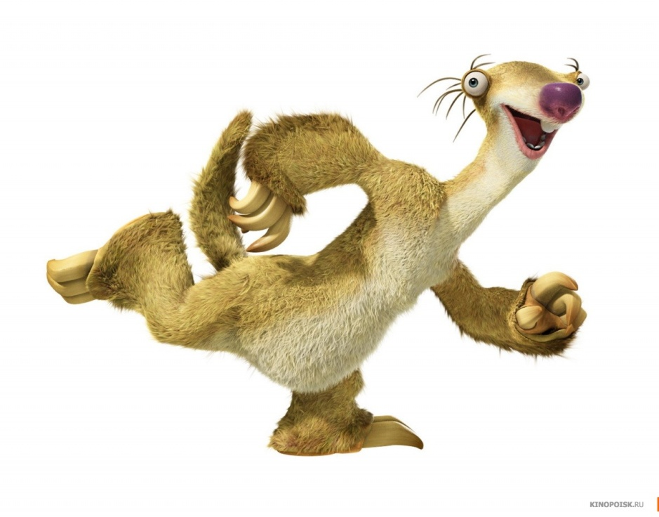
What caused The Ice Age?
Two explanations:
1.Scientists believe that temperatures were much colder
so it never rained, only snowed
2. Scientists believe that the earth changed its tilt away
from the sun
https://www.youtube.com/watch?v=I4EZCy14te0

Slide 5
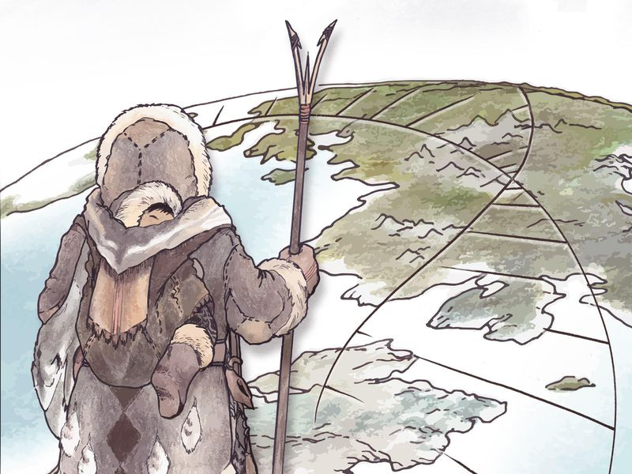
Life in The Ice Age

Slide 6
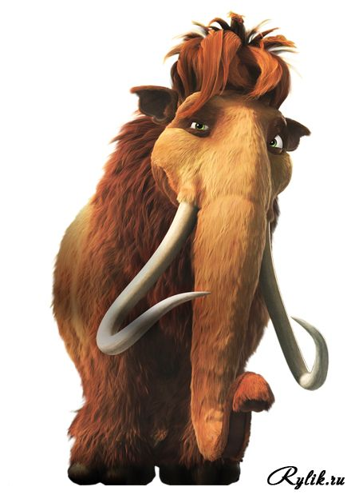
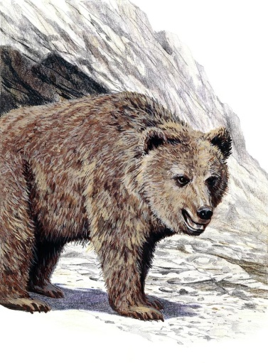
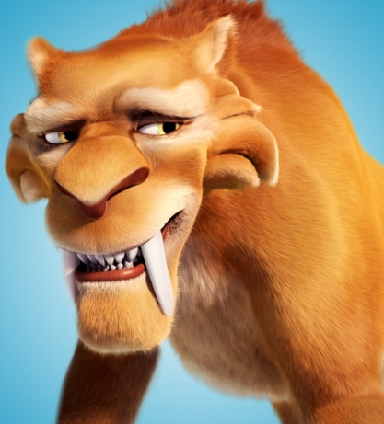
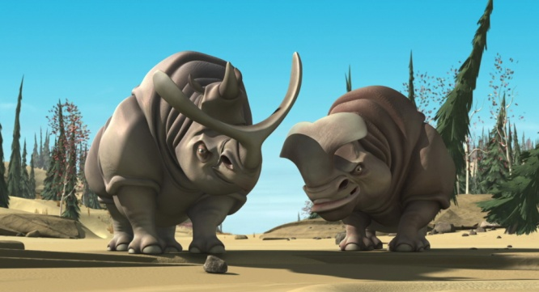
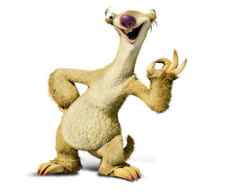
Animals…
woolly mammoth
Cave bear
saber tiger
wooly rhinos
sloth

Slide 7
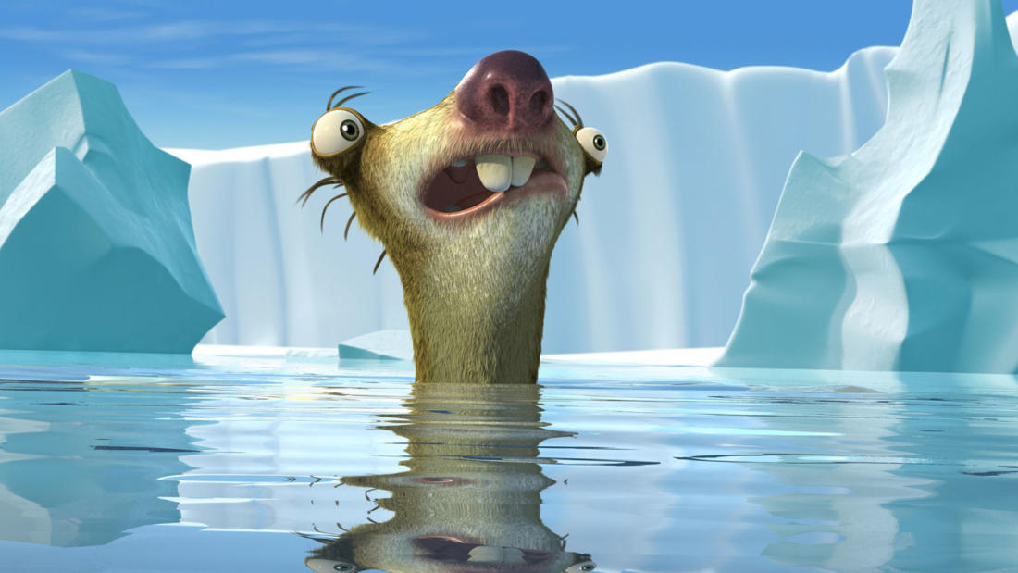
And dinosaurs? Where are the dinosaurs?

Slide 8
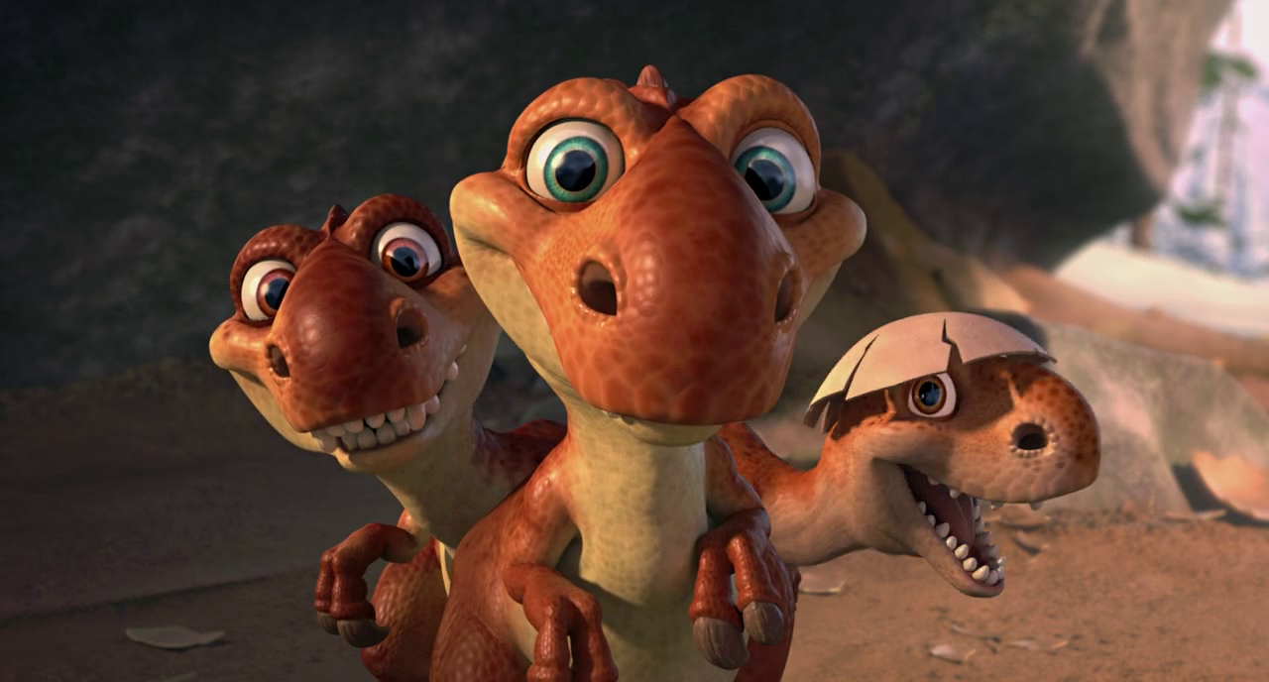
Ok, we may appear in a cartoon, but dinosaurs died long before „The Great Ice Age”

Slide 9
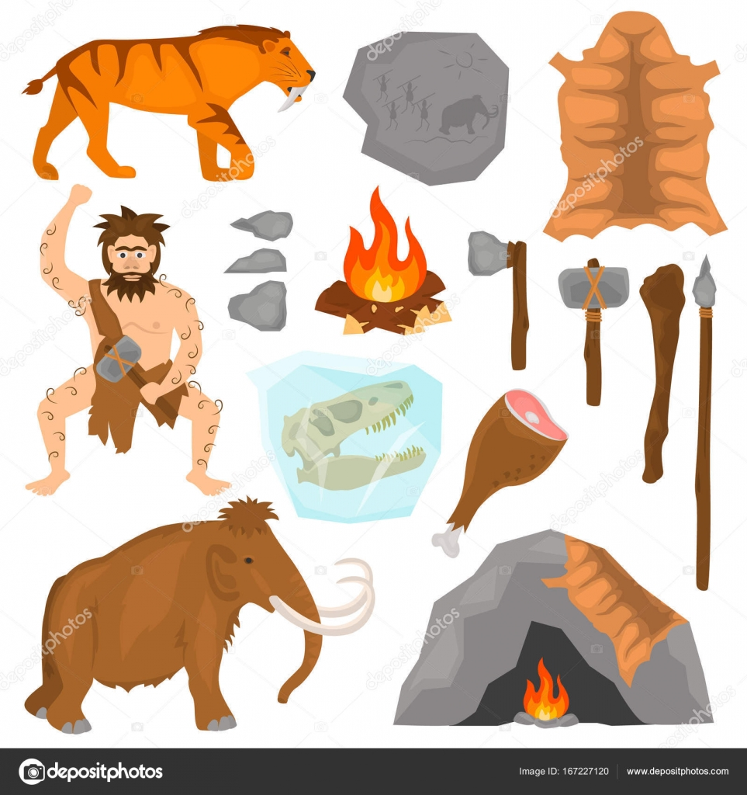
Humans…
CAVE DRAWING
HUNTING
CLOTHES
HUMAN
FIRE
WEAPON
FOOD
SHELTER
Notes:
Ice Age people lived 35,000 years ago. The men hunted and the women and children prepared the food and made the clothing and shelters. Every part of the animal (that was hunted) was used. The meat and organs were used for food. Their skins were used for clothing, blankets and shelters. The stomach was used to carry water. The bones were used for needles, weapons and tools.

Slide 10
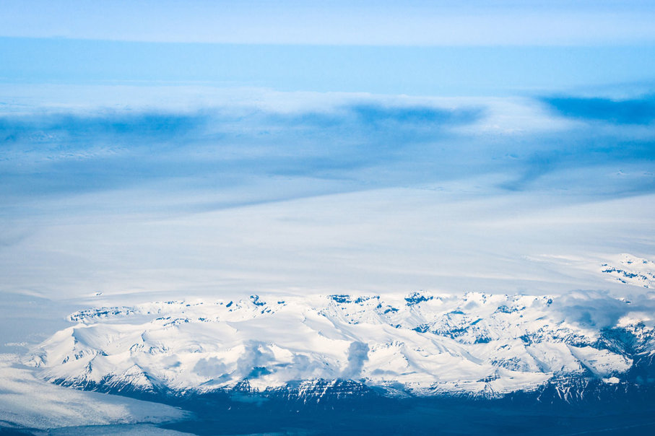
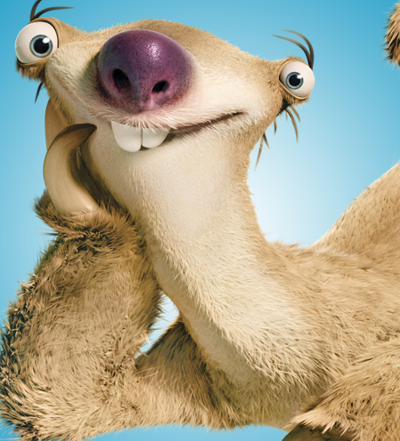
WILL THE ICE AGE HAPPEN AGAIN?
- Scientists have concluded that the shape of the Earth's orbit around the Sun is appropriate for the new ice age, but the amount of carbon dioxide in the atmosphere is too high, so the next ice age is probably delayed by at least 50,000 years.

Slide 11
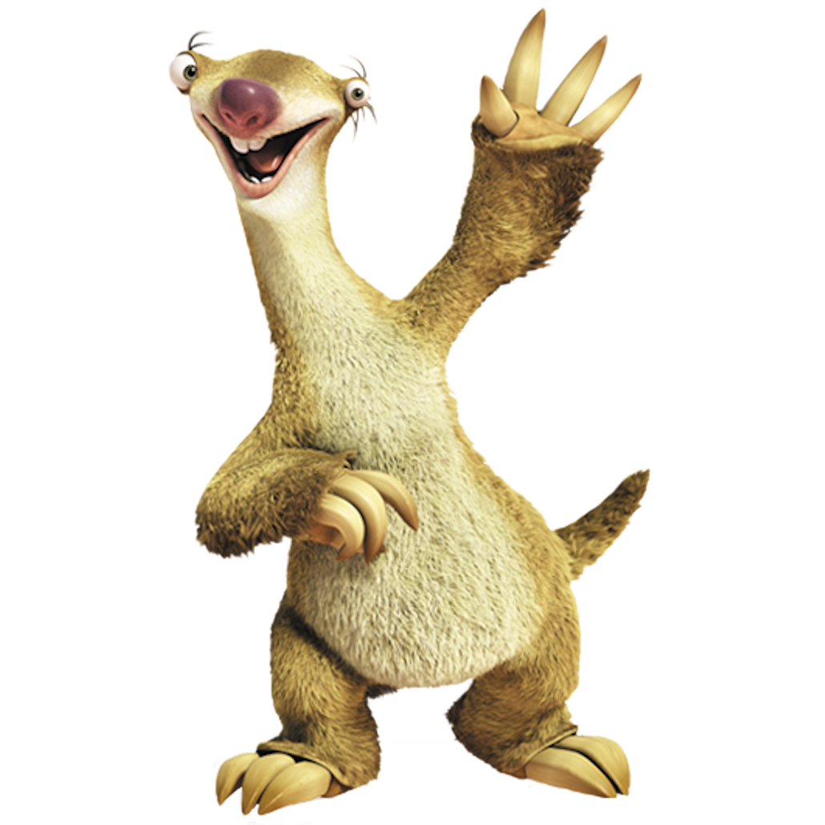
Thanks for listening, watching and participating. Now we can dance ☺
https://www.youtube.com/watch?v=uMuJxd2Gpxo

Slide 12
images were downloaded from:
http://www.iceagemovies.com/characters

