Slide 1
CLIMATE CHANGE AND REFUGEES

Slide 2
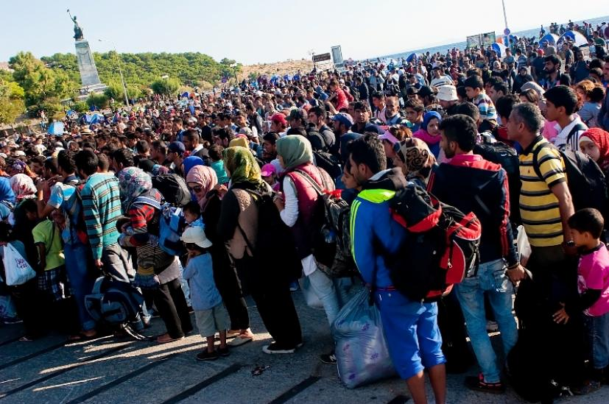
In recent years, the concept of “environmental refugees” has gained new importance.

Slide 3
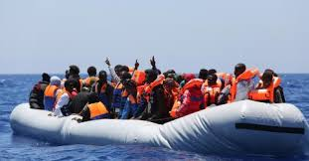
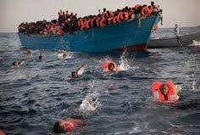
Global climate change and desertification have threatened the livelihoods of millions of people, causing many to leave home in search of new opportunities.

Slide 4
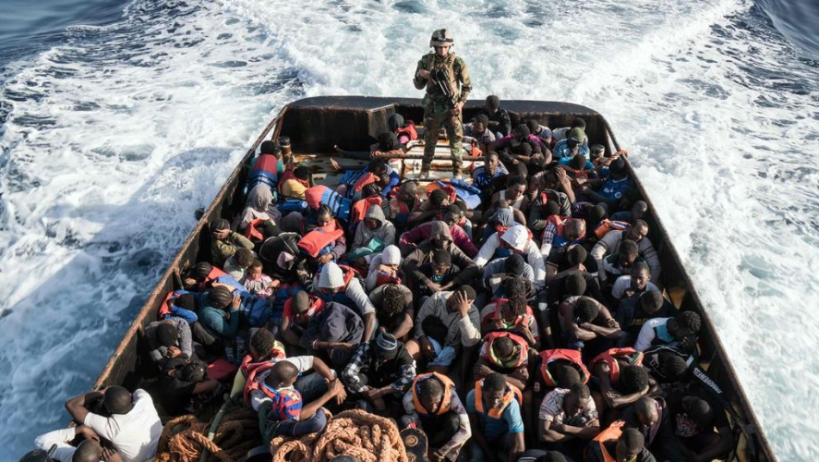
Environmental refugees are people who have been forced to leave their traditional habitat, temporarily or permanently, because of a marked environmental disruption that seriously effects the quality of their life.

Slide 5
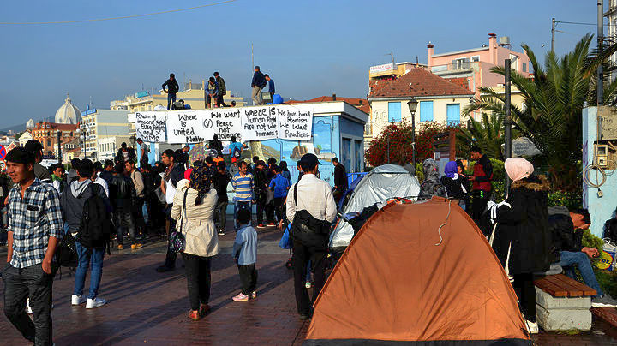
Beyond food and water shortages, people are being forced out of their homes because …

Slide 6
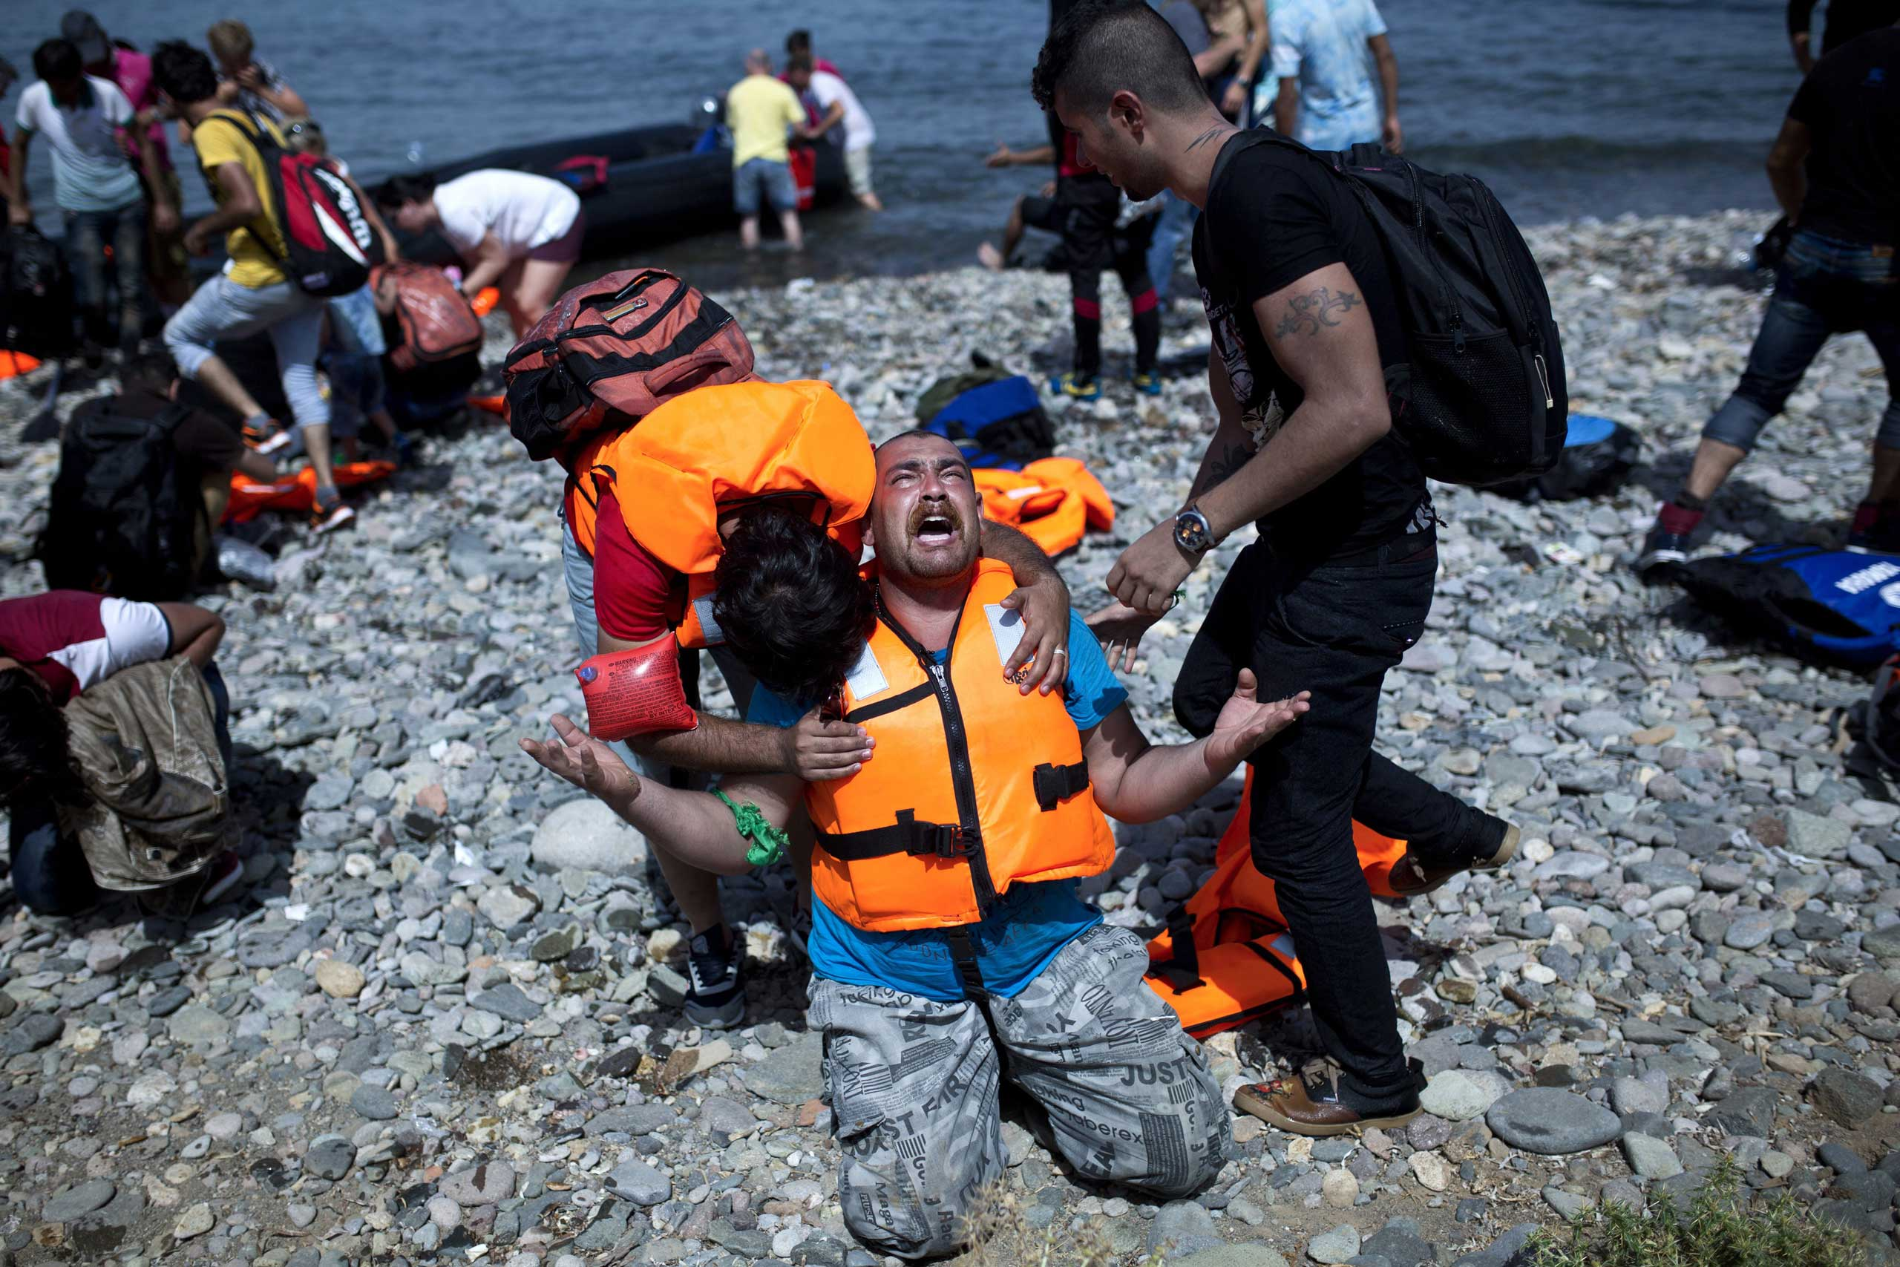
… they can no longer gain a secure livelihood in their homelands.

Slide 7
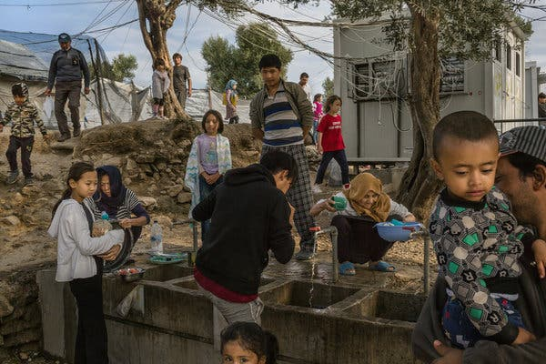
Drought, soil erosion, desertification, deforestation and other environmental problems, together with the associated problems of population pressures and profound poverty.

Slide 8
Climate change will have enormous effects on many populations, especially those in coastal and low-lying areas like Vietnam, the Netherlands and certain parts of the US. Even the most optimistic case showed 85% of UK cities with a river, including London, would face increased flooding.

