Slide 1
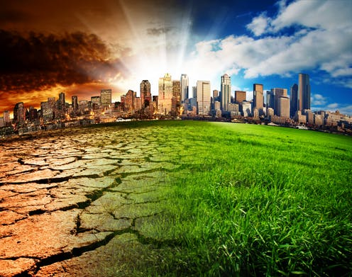
Climate change & agriculture

Slide 2
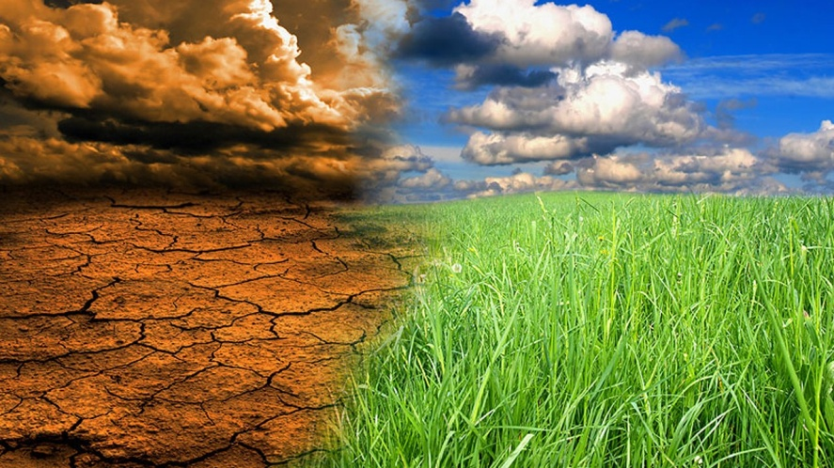
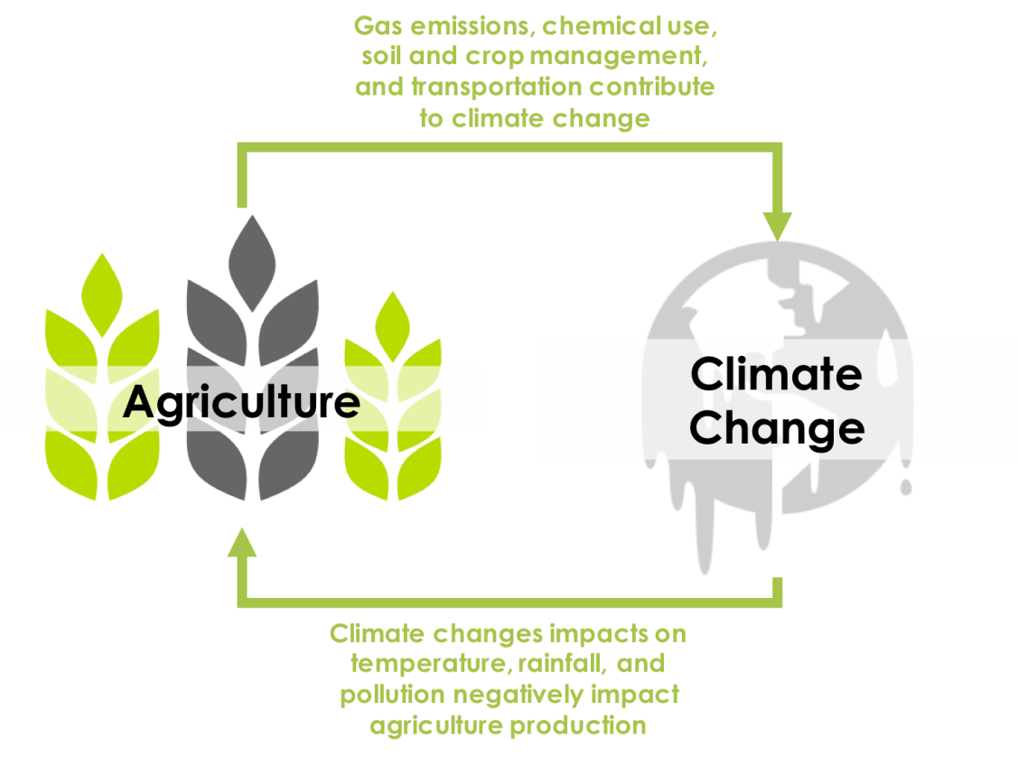
Climate change and agriculture
In the coming decades, climate change and other global trends will endanger agriculture, food security and rural livelihoods.

Slide 3
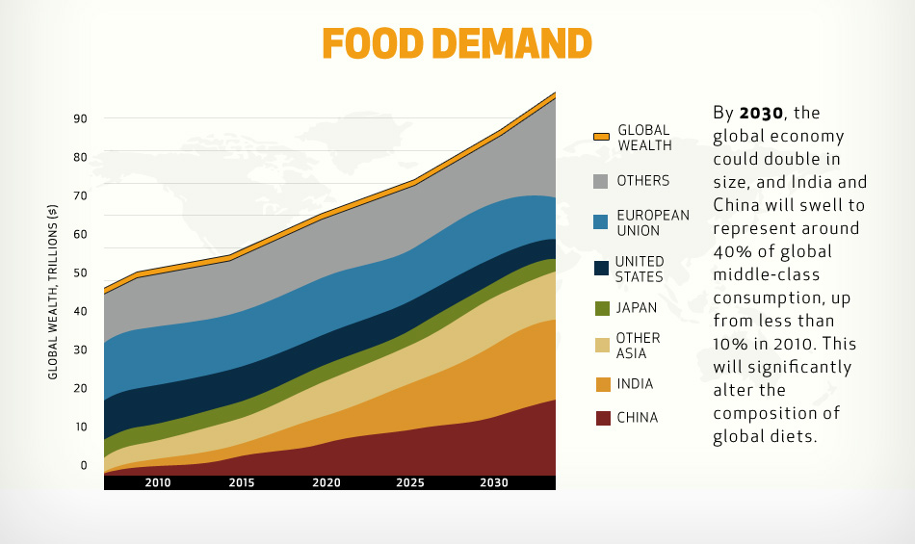
Food demands will rise
In order to meet global demands, we will need 60-70% more food by 2050

Slide 4
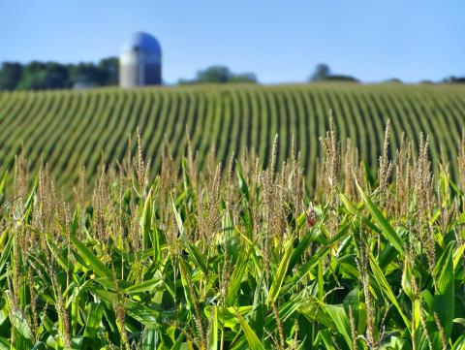
Current issues in agriculture
Overproduction in short term, yet food insecurity for a large population
Decline in yields
Diversification
Quality and quantity of water resources

Slide 5
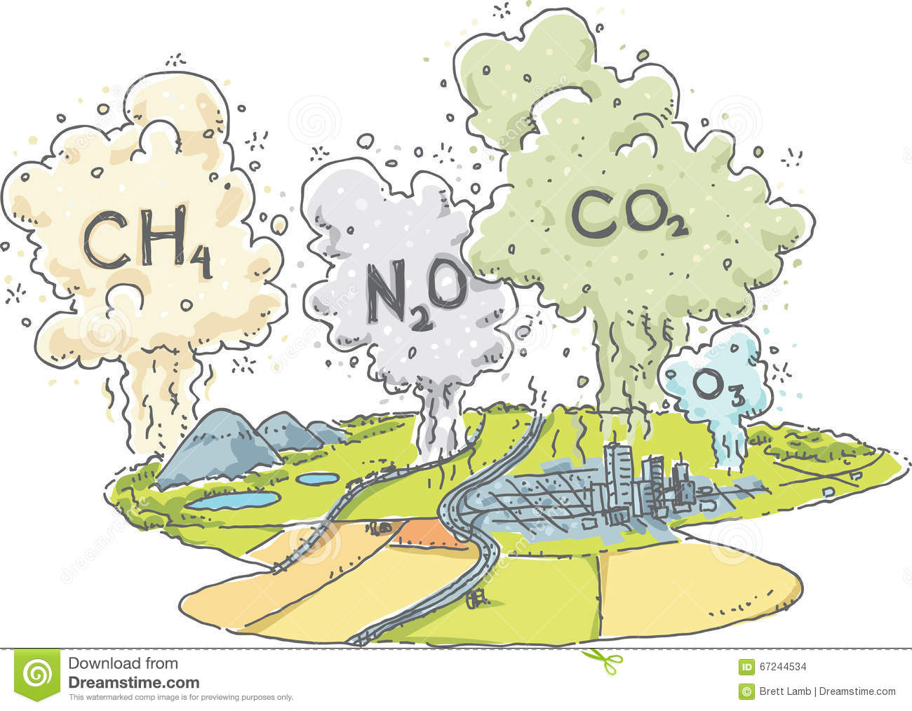
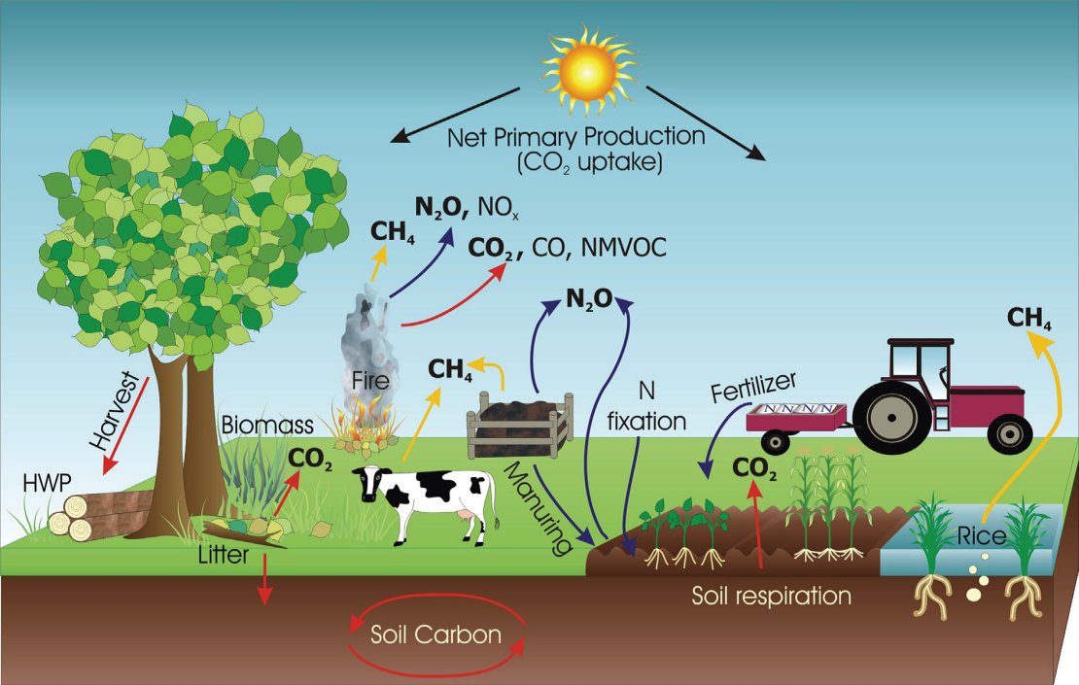
Impacts of climate change on agriculture
Every 1^{ο}C increase in temperature reduces wheat production by 4-5 million tons. Loss only 1-2 million tons if farmers could plant in time.
Reduced frequency of frost damage :less damage to potato, peas ,mustard
Increased droughts and floods are likely to increase production variability
Cereal productivity to decrease by 10-40% by 2100

Slide 6
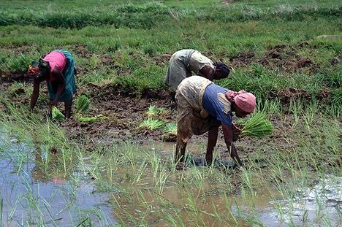
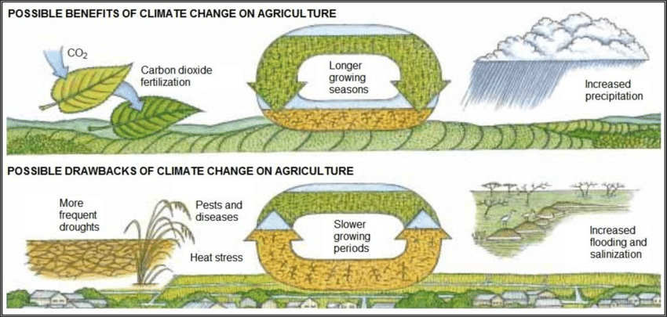
Agriculture as part of the solution
Increasing carbon sequestration through land management
Rotations with cover crops, green manure
Agroforestry
Conservation tillage
could reduce global CO2 emissions by 5-25%
Organic farming(but limited benefits)
Enhances carbon storage in soil

Slide 7
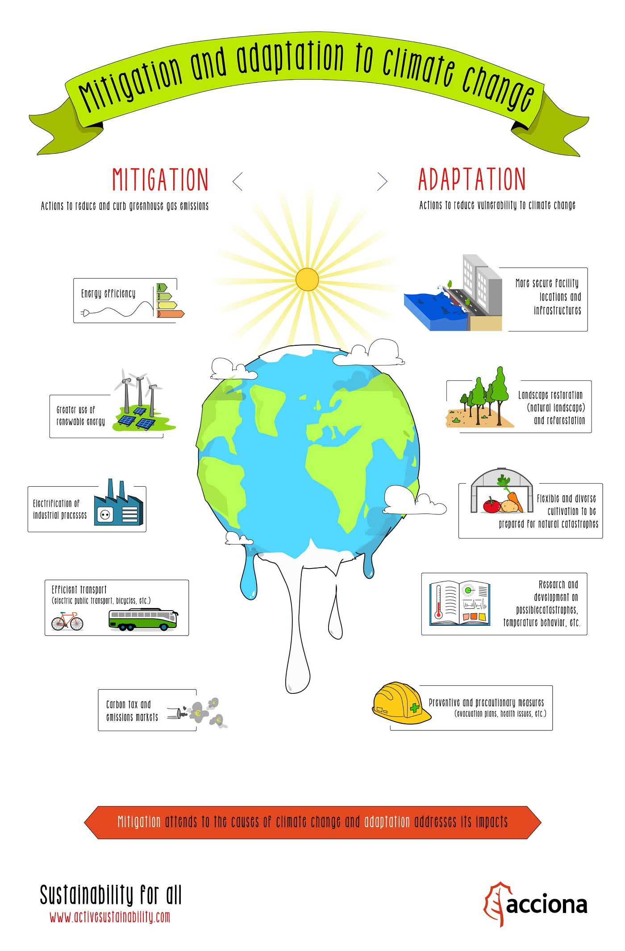
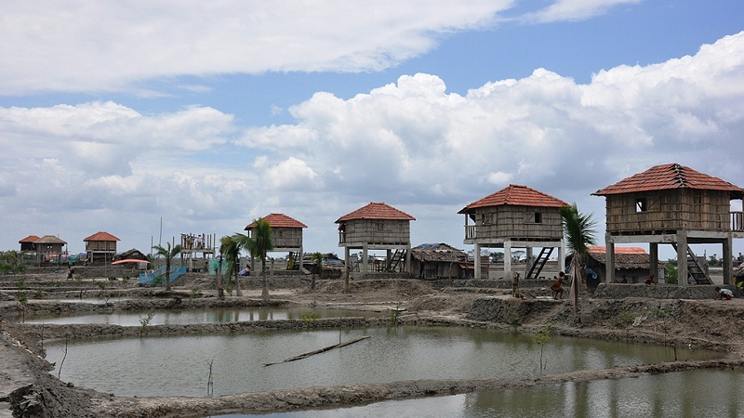
Adaptations to climate change
New varieties: drought/heat resistant
New farm management practices
Change in land use
Watershed management
agri-insurance

Slide 8
The end!
Zinovia Kontaxopoulou

