Slide 1
Climate refugees
Alytaus r. Simno gimnazija Erasmus+ project 2018-2020 Stop Climat Change – Together
Europe Achieves More

Slide 2
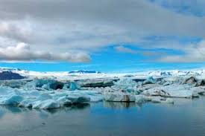
Climate change
Climate change occurs when changes in Earth's climate system result in new weather patterns that last for at least a few decades, and maybe for millions of years

Slide 3
What is climate refugee
Environmental migrants ( climate refugees) are people who are forced to leave their home region due to sudden or long-term changes to their local environment.
These are changes which compromise their well-being or secure livelihood. Such changes are held to include increased droughts, desertification, sea level rise, and disruption of seasonal weather patterns

Slide 4
According to statistics published by the Internal Displacement Monitoring Centre, every year since 2008, an average of 26.4 million persons around the world have been forcibly displaced by floods, windstorms, earthquakes or droughts.
With climate change, the number of 'climate refugees' will rise in the future.
Environmental refugees do not have legal rights under the UN Refugee Convention.

Slide 5
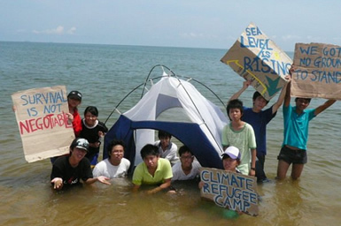

Slide 7
How can we help “No climate change, no climate refugees”
Between now and then, we need to address the effects of climate change that are happening now.
Introducing more sustainable farming methods.
Reducing inequalities of income and power
Improving access to justice
Cutting greenhouse gas emissions

Slide 8
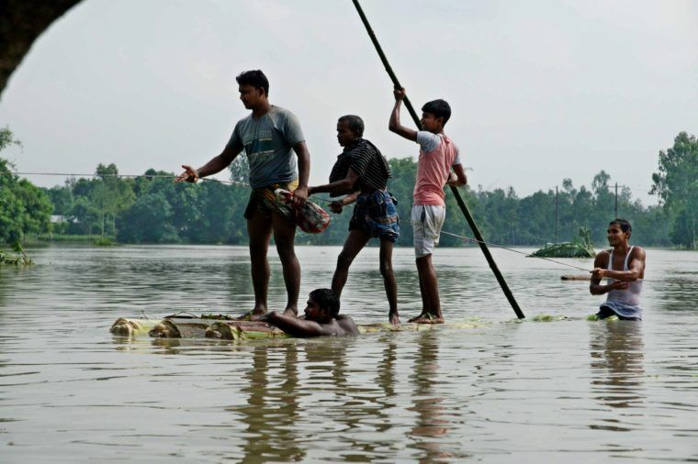
Syrian refugees and migrants walk in a field to cross the border between Greece and F.Y.R. of Macedonia
Floods in Bangladesh 2017

Slide 9
Organizations helping climate refugees
Climate Refugees is an organization that aims to raise awareness about climate refugees through field reports and social media.
The Environmental Justice Foundation (EJF) is one of the many organizations helping climate refugees. It works to help create a more sustainable world through film and photography.
United Nations High Commissioner for Refugees (UNHCR) works to protect and advocate for refugees around the world.
The International Organization for Migration (IOM) is an intergovernmental organization that works to ensure a process of migration that recognizes human rights around the world.

Slide 11
Information is from
https://inews.co.uk/opinion/want-solve-refugee-crisis-must-stop-creating-climate-refugees/
http://climatemigration.org.uk/climate-refugee-statistics/
https://borgenproject.org/organizations-helping-climate-refugees/
https://en.wikipedia.org/wiki/Environmental_migrant

