Slide 1
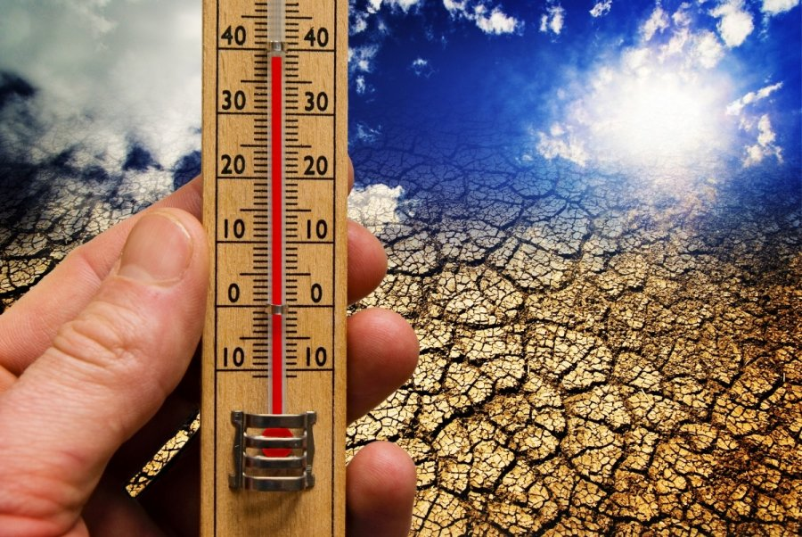


Climate change in Lithuania 2018
Alytaus r. Simno gimnazija
Erasmus+ project 2018-2020
Stop Climat Change – Together Europe Achieves More

Slide 2
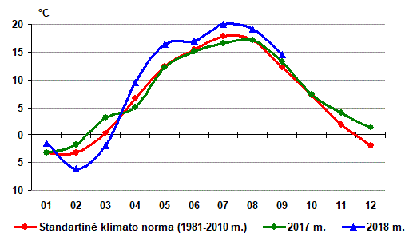
Temperature changes in 2018

Slide 3
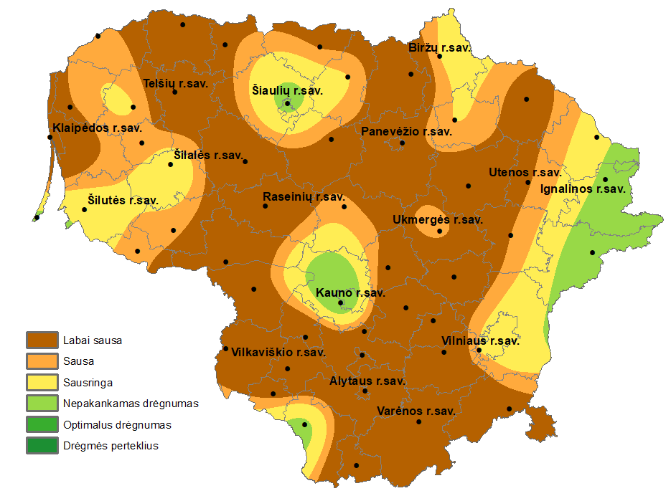
Drought map in 2018

Slide 4
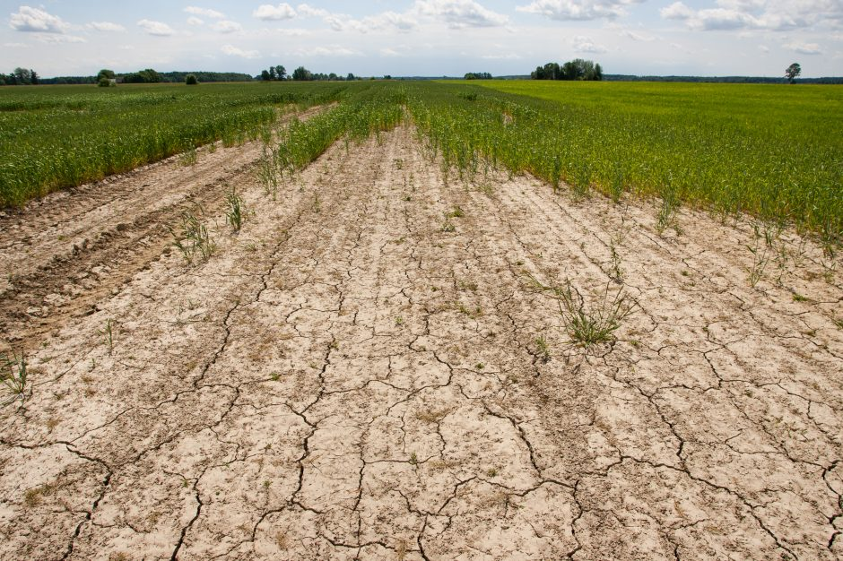
Consequences of drought

Slide 5
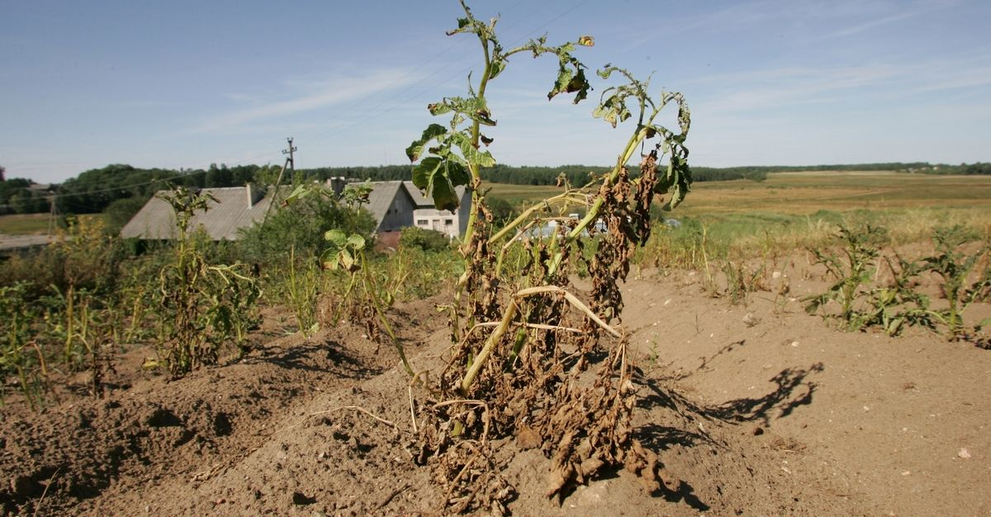
Consequences of drought

Slide 6
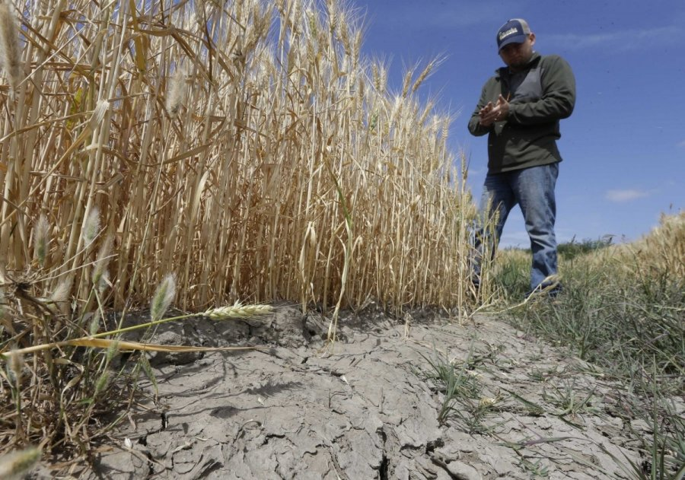
Consequences of drought

Slide 7
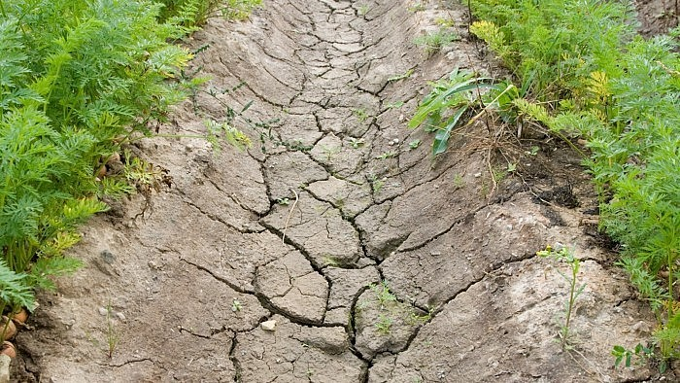
Consequences of drought

Slide 8
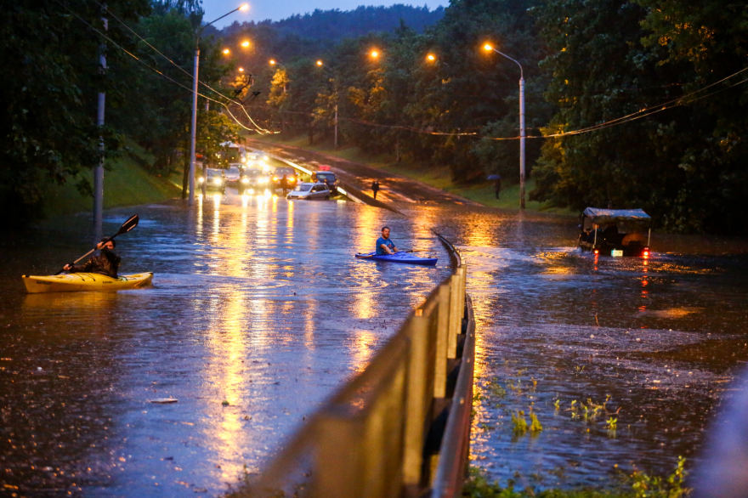
Sudden rains

Slide 9
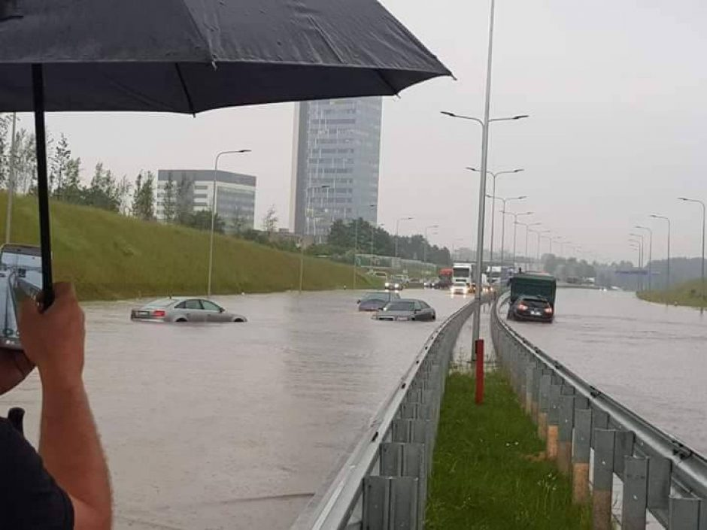
Sudden rains

Slide 10
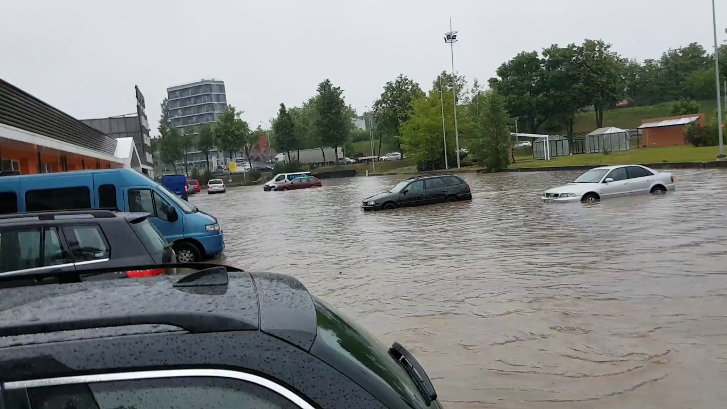
Sudden rains

