Slide 1
CARBON FOOTPRINT

Slide 2
WHAT IS IT?
Carbon footprint - the amount of carbon dioxide released into the atmosphere as a result of the activities of a particular individual, organization, or community

Slide 3
EFFECTS

Slide 4
OCCURRENCE OF
the ozone hole in the atmosphere

Slide 5
OCCURRENCE OF
the greenhouse effect caused by greenhouse gases, for example CO₂

Slide 6
SUMMARY
All this leads to global warming.

Slide 7
CAUSES AND PREVENTION

Slide 8
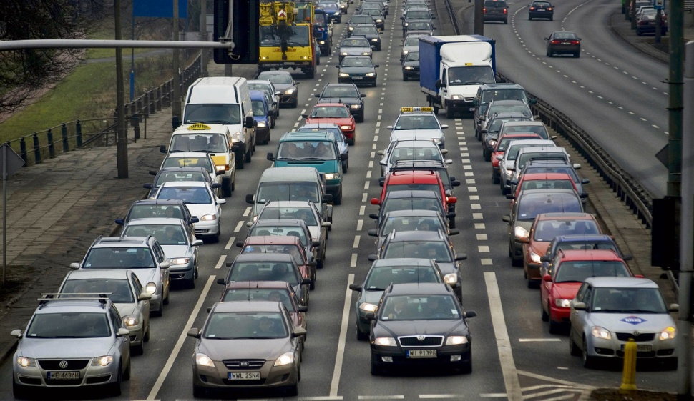
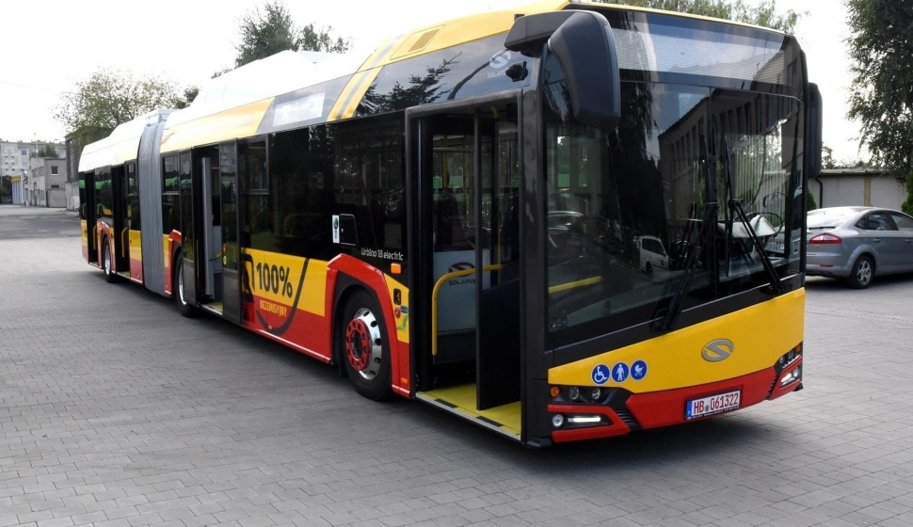
TRANSPORT
BAD
GOOD
Travelling by car individually as every car discharges a lot of CO₂
Travelling by bus or carpooling as one vehicle discharges less CO₂

Slide 9
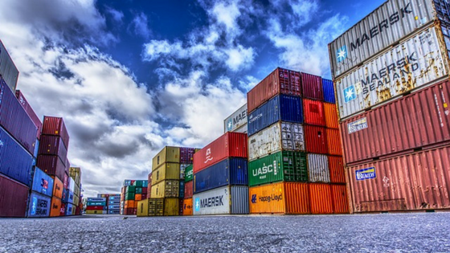
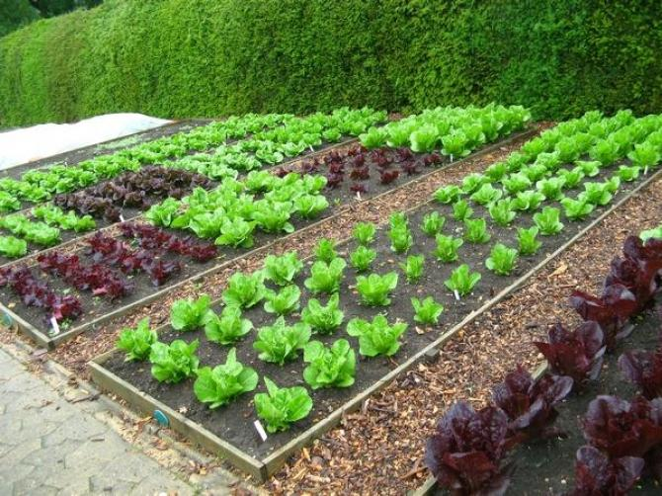
FOOD
BAD
GOOD
Buying export food due to the need of transportation
Buying local food or growing vegetables and fruit in your garden

Slide 10
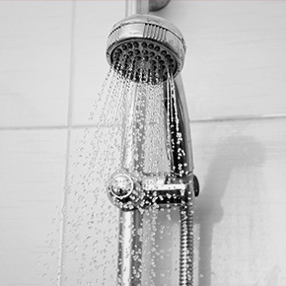
WASHING
BAD
GOOD
Taking a bath, because
a lot of water must be warmed up
Taking a shower, because when we take a shower we use less water

Slide 11
OTHER WAYS

Slide 12
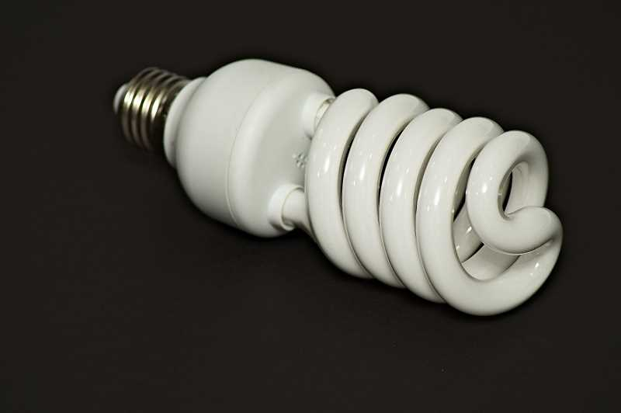
OTHER WAYS
Use energy-efficient light bulbs

Slide 13
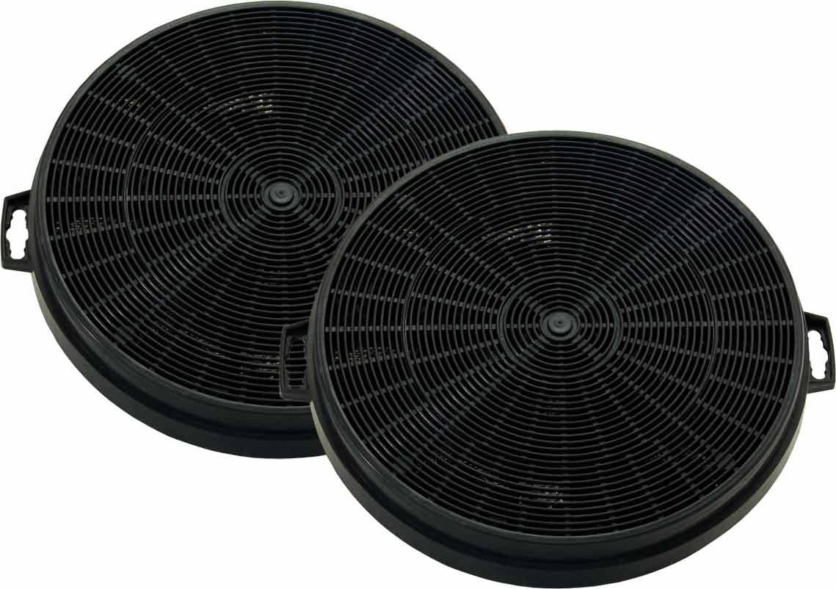
OTHER WAYS
Use filters into chimneys

Slide 14
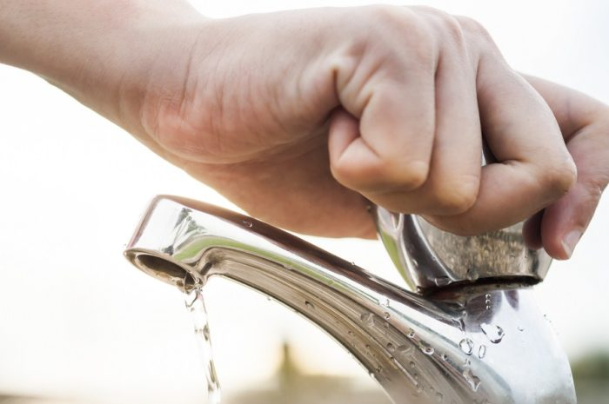
OTHER WAYS
Turn off water, don’t waste it

Slide 15
OTHER WAYS
Turn off the light

Slide 16
OTHER WAYS
Lower the temperature in your house by 1-2 °C

Slide 17
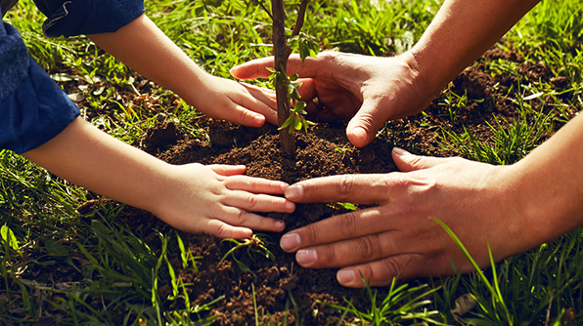
OTHER WAYS
Plant trees

Slide 18
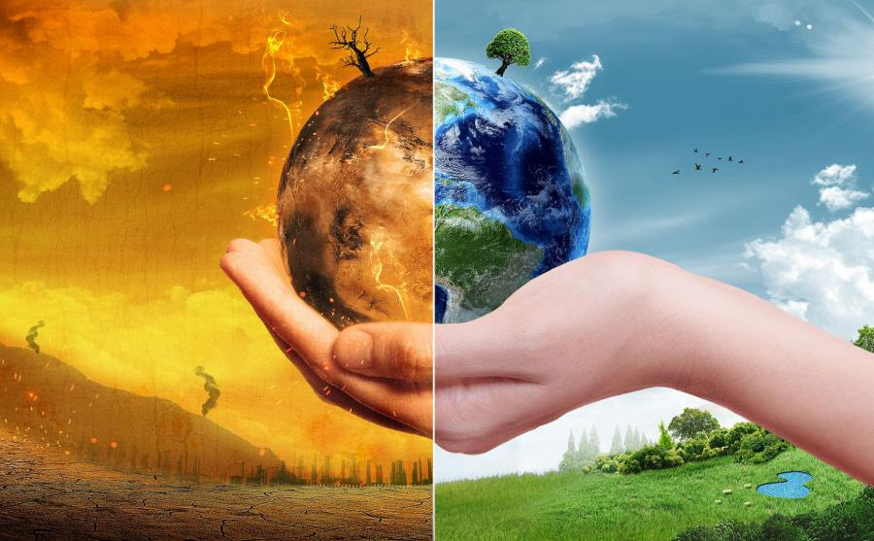
SUMMARY
Remember, we are responsible for our planet, it’s
our home
Which side do you choose?

Slide 19
THANKS FOR ATTENTION!
Erasmus + TEAM
SP 12 GDYNIA
JUNE 2019

