Slide 1
International Day for Biological Diversity
Anna Jędrzejewska
Poland, Gdynia
June 2020

Slide 2
This year's World Environment Day theme is biodiversity. Biodiversity is the variety and variability of life on Earth.
Polish flora is rich and diverse. There are over 2,300 species of flowering plants throughout the country, not including arable crops and plants that appear temporarily.
The following plants seem modest, but they can catch the eye:

Slide 3
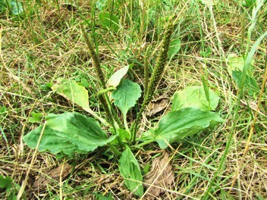
Broadleaf plantain (Babka zwyczajna)
Latin name: Plantago major Family: Plantains Flowering period: from June to September Habitat in Poland: common in wet, shady places
Interesting fact: in folk medicine it was used externally as a remedy for faster wound healing

Slide 4
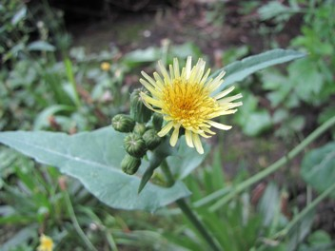
Common sowthistle (Mlecz zwyczajny)
Latin name: Sonchus oleraceus Family: daisy family Flowering period: from June to September Habitat in Poland: fields and mountains

Slide 5
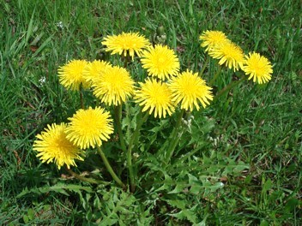
Common Dandelion (Mniszek pospolity)
Latin name: Taraxacum officinale Family: Daisy family Flowering period: from April to July Habitat in Poland: common in meadows and lawns
interesting fact: young dandelion leaves are edible (replace lettuce)

Slide 6
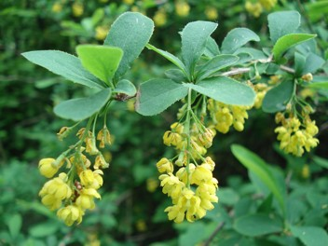
Common barberry (Berberys zwyczajny)
Latin name: Berberis vulgaris Family: Berberidaceae Flowering period: from May to June Habitat in Poland: on the edge of forests

Slide 7
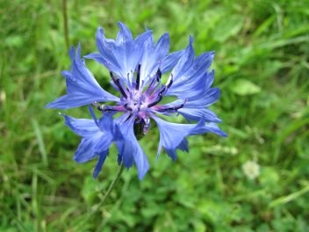
Cornflower (Chaber bławatek)
Latin name: Centaurea cyanus Family: Daisy family Flowering period: from May to September Habitat in Poland: farmlands, roadsides

Slide 8
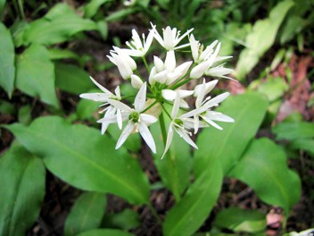
Ramsons (Czosnek niedźwiedzi)
Latin name: Allium ursinum Family: Amaryllidaceae Flowering period: May Habitat in Poland: moist deciduous forests Interesting fact: the leaves are edible, have the smell and taste of ordinary garlic

Slide 9
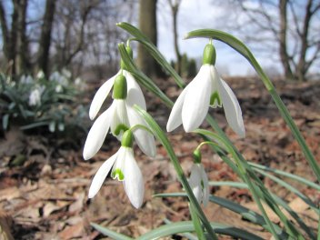
Snowdrop (Śnieżyczka przebiśnieg)
Latin name: Galanthus nivalis Family: Amaryllidaceae Flowering period: from February to March Habitat in Poland: fertile and moist deciduous forests

Slide 10
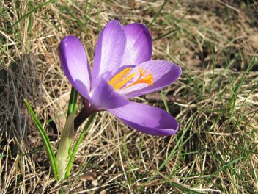
Crocus scepusiensis (Szafran spiski)
Latin name: Crocus scepusiensis Family: Iris family Flowering period: from March to April Habitat in Poland: meadows and glades

Slide 11
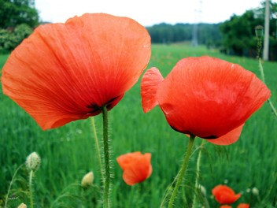
Common poppy (Mak polny)
Latin name: Papaver rhoeas Family: Poppies Flowering period: from May to August Habitat in Poland: common in the lowlands, arable fields, wasteland

Slide 12
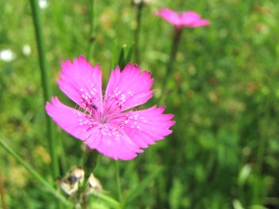
Maiden pink (Goździk kropkowany)
Latin name: Dianthus deltoides Family: Pinks Flowering period: from June to October Habitat in Poland: common in the lowlands, dry meadows, wasteland

Slide 13
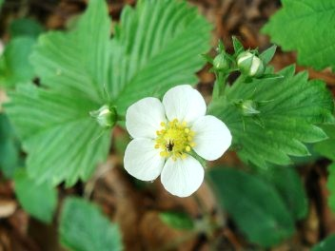
Wild strawberry (Poziomka pospolita)
Latin name: Fragaria vesca Family: Rose family Flowering period: from May to July Habitat in Poland: common in the whole country in forests, glades, roadsides

Slide 14
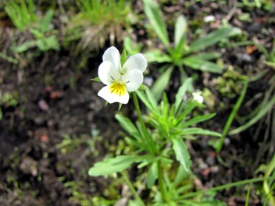
European field pansy (Fiołek polny)
Latin name: Viola arvensis Family: Violaceae Flowering period: from April to October Habitat in Poland: roadsides, fallow, farmland

Slide 15
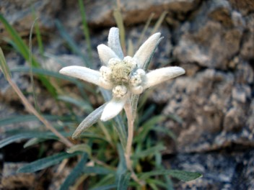
Edelweiss (Szarotka alpejska)
Latin name: Leontopodium alpinum Family: Edelweiss Flowering period: from June to August Habitat in Poland: grasslands, crevices, Tatra MOUNTAINS

Slide 16
Thank YOU for Your attention ☺

