Slide 1
Alytaus r. Simno gimnazija Erasmus+ project 2018-2020 Stop Climat Change – Together
Europe Achieves More
Educational trip to the Alytus Regional Waste Management Centre, 2020

Slide 2
ALYTUS REGIONAL WASTE MANAGEMENT CENTRE
It is the only one centre in Lithuania, has implemented a separate sorting collection of food / kitchen waste was started not only from the residents of individual houses in the cities of Alytus region, but also from budgetary municipal institutions and other companies. In 2018 the company, the first of all Lithuanian regional waste management centers started to develop waste re-use and preparation for re-use activities. Pavilions have been built and other waste collection sites, where objects that have become waste are received and stored.

Slide 3
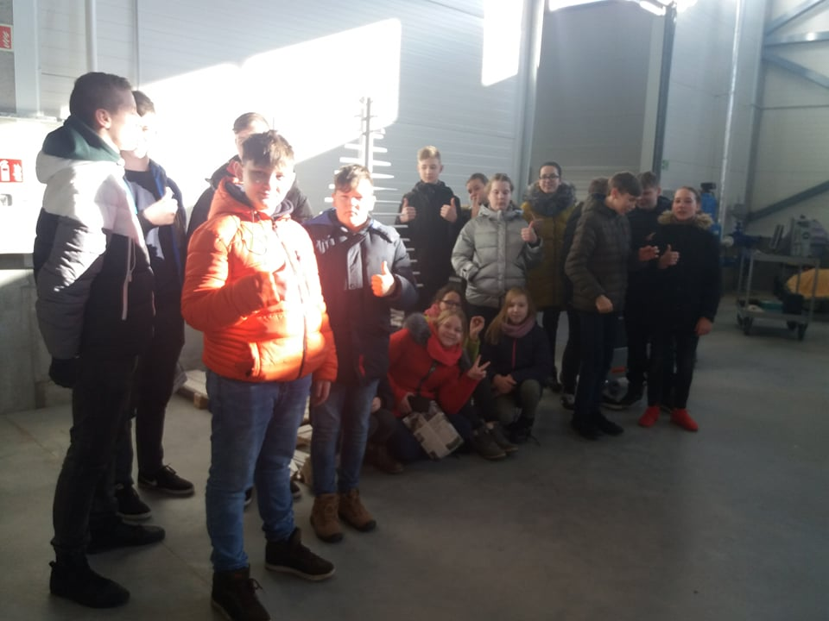
On February 26,2020 students of grades 5-8 went to Alytus Regional Waste Management Center

Slide 4
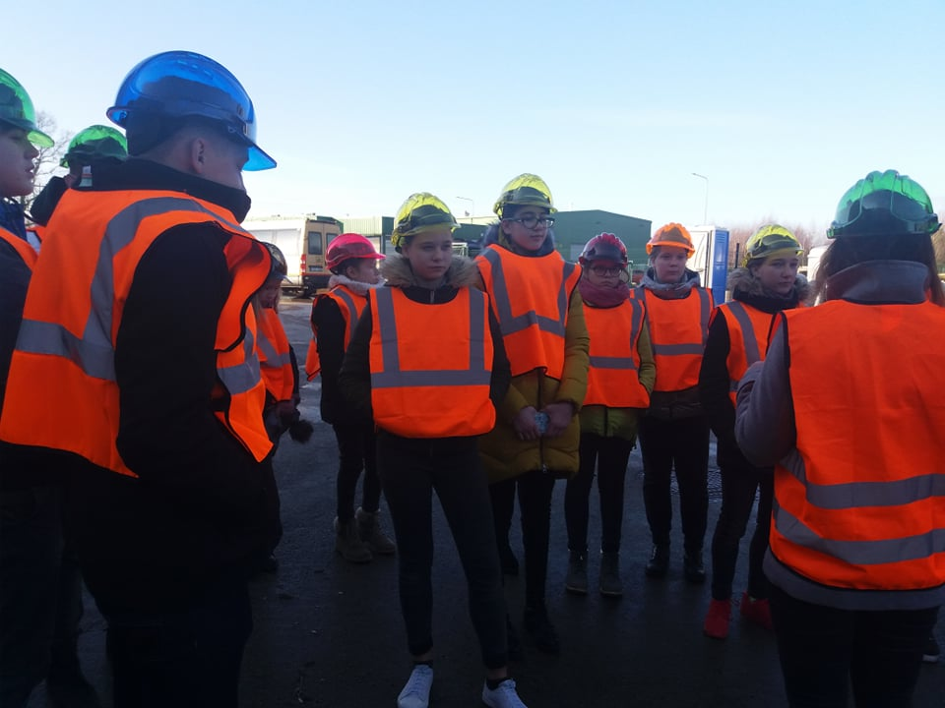
Wearing bright and colorful vests, students were introduced with the peculiarities of waste management.

Slide 5
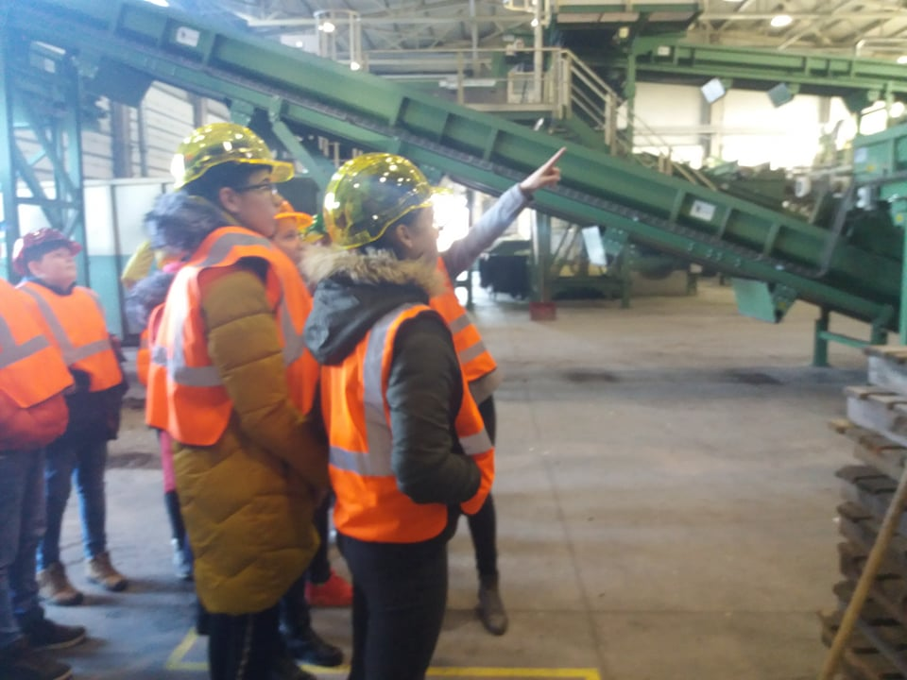
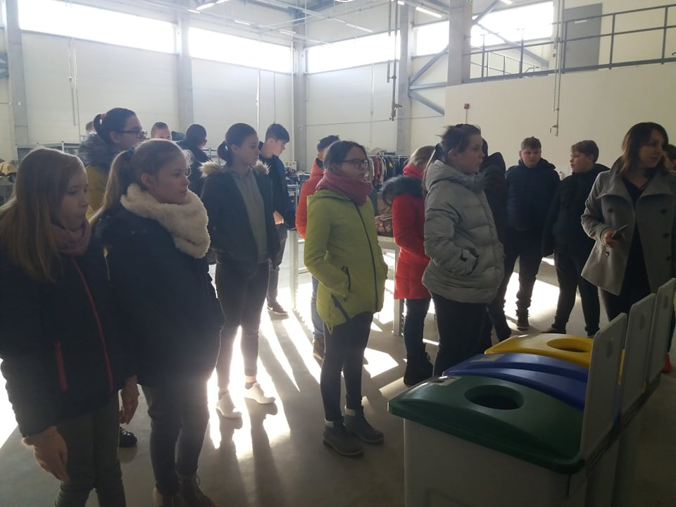
Students saw how waste is managed

Slide 6
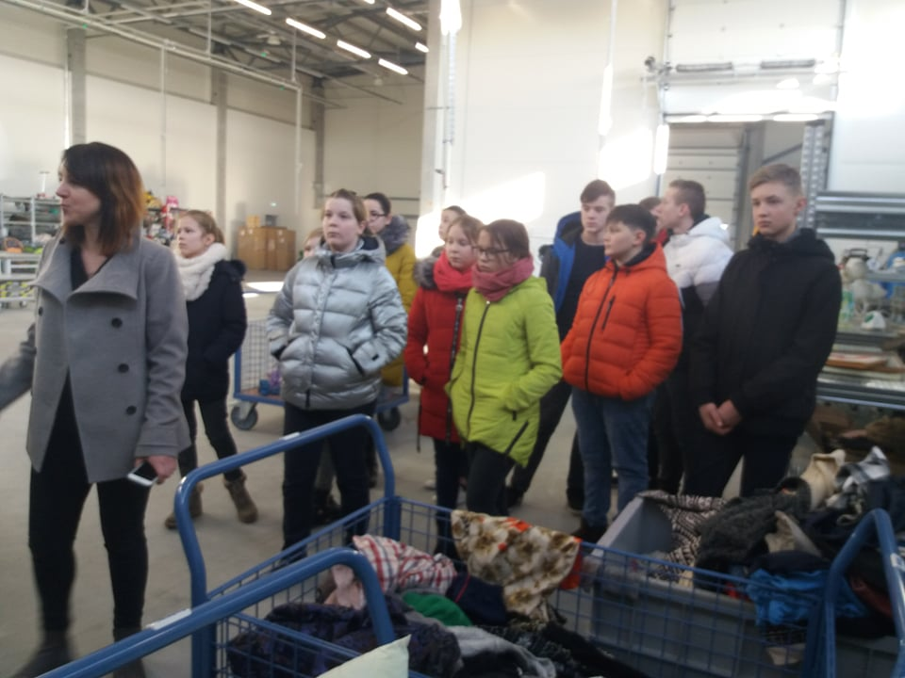
Vaida Undzėnienė, an environmental education specialist, showed us the things left by people, which are resurrected here for a second life

Slide 7
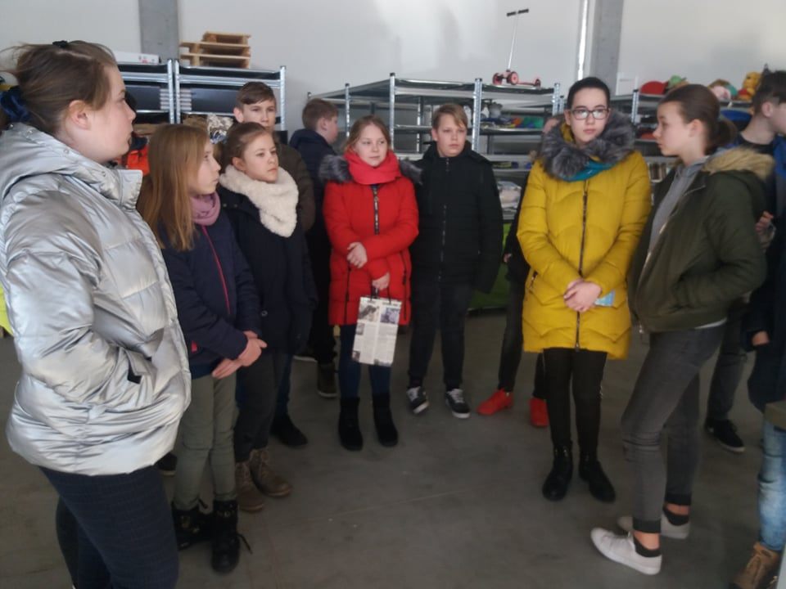
After answering the questions about waste management correctly, the students received gifts made of recycled paper

