Slide 1
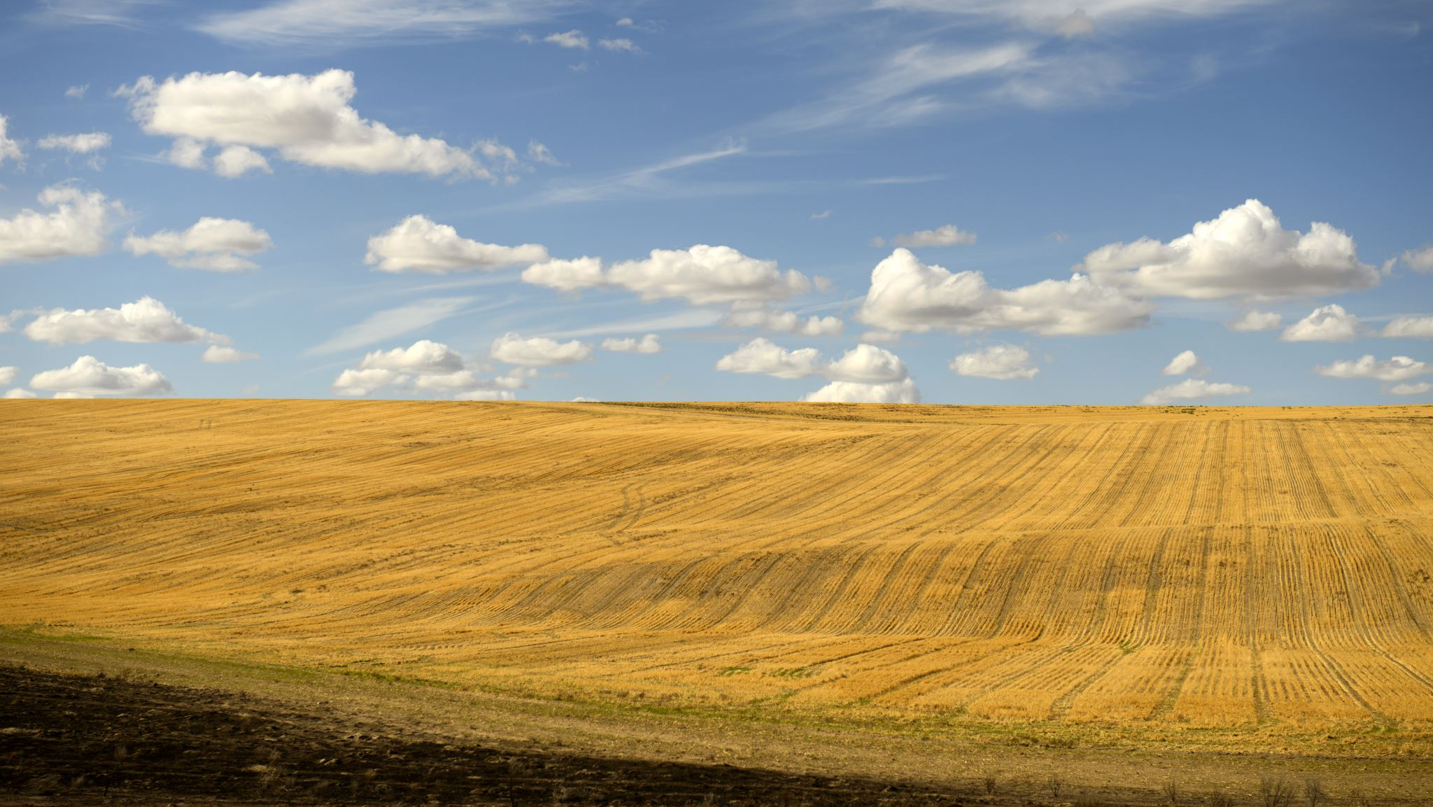
Agriculture and climate change
By Emilia Beyer -Wróblewska

Slide 2
Climate change and agriculture are interrelated processes, both of which take place on a global scale

Slide 3
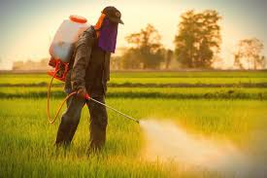
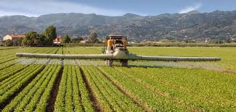
Agriculture contributes to climate change both by anthropogenic emissions of greenhouse gases and by the conversion of non-agricultural land such as forests into agricultural land.

Slide 4
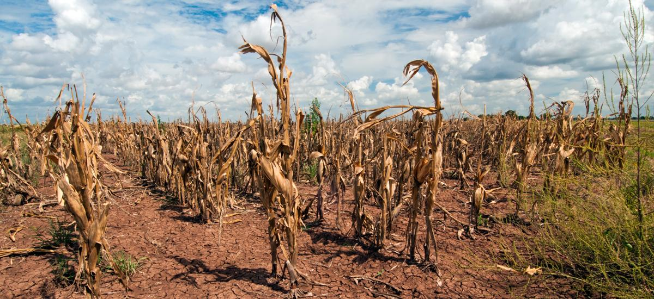
Global warming affects agriculture in a number of ways:
changing rainfall patterns
rising temperatures
variability in seasonality
extreme weather events, such as heatwaves, droughts, storms, and floods
changes in pests and diseases
changes in atmospheric carbon dioxide and ground-level ozone concentrations
changes in the nutritional quality of some foods

Slide 5
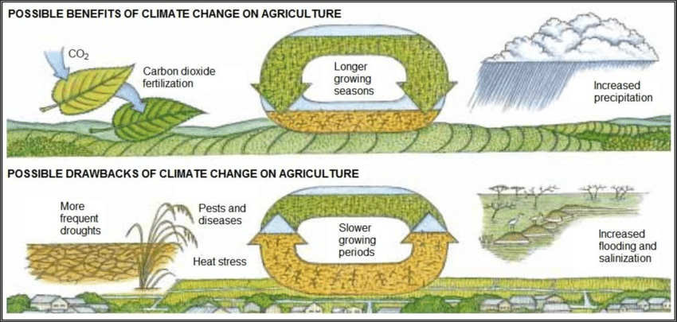

Slide 6
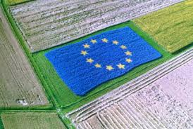
According to some reports, global warming will have a generally positive impact on the volume of agricultural production in the European Union.
However, the effects of climate change will exhibit significant geographical variation. The main beneficiaries will be such countries as Poland, Germany, and the United Kingdom

Slide 7
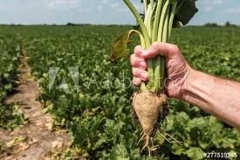
Global warming will promote sunflowers, soybeans and more sugar beets growing in the Polish countryside

Slide 8
Climate-related challenges faced by Polish agriculture
increasing frequency of extreme events, such as - prolonged droughts, - floods, - storms and heavy showers
water shortage

Slide 9
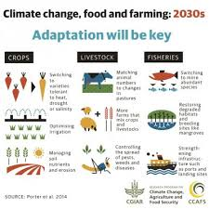
Ways Farmers Can Fight Climate Change:
Efficient Irrigation Management.
Conserving water use is vital to any
farm,
particularly in times of drought.
Adaptation of crops to the
climate changes
Renewable energy

Slide 10
Organic Practices
Increasing Soil Health
Keeping Agriculture Green
Reducing Livestock Methane
Emissions
Pushing for Climate-Friendly
Policies

Slide 11
SOURCES
https://en.wikipedia.org/wiki/Climate_change_and_agriculture
https://ec.europa.eu/info/food-farming-fisheries/sustainability-and-natural-resources/agriculture-and-environment/agriculture-and-climate-change_en
https://climatepolicyinfohub.eu/agriculture-and-climate-change-eu-overview
https://www.researchgate.net/publication/328956833_Climate_impacts_in_Europe_final_report_of_the_JRC_PESETA_III_project
https://www.climatechangepost.com/poland/agriculture-and-horticulture/
https://www.obserwatorfinansowy.pl/in-english/business/polish-agriculture-could-benefit-from-global-warming/

