Slide 1
ERASMUS+ 2018 - 2020 1st Gymnasiun of Cholargos MOBILITY TO GDYNIA (6 – 12 OCTOBER 2019)

Slide 2
Arriving in Gdansk

Slide 3
1st DAY

Slide 4
Teachers and students of 1st Gymnasium of Cholargos in front of polish school.

Slide 5
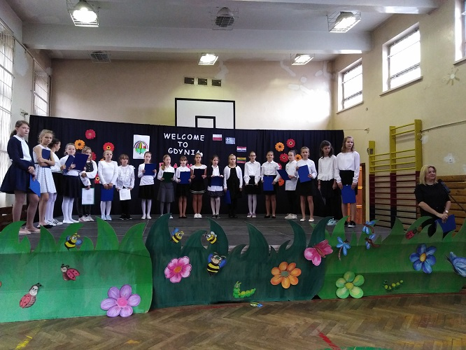
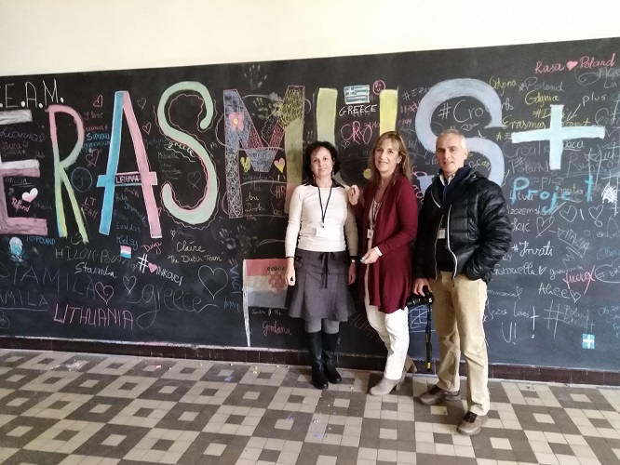
A welcome at Szkola Podstawowa nr 12 with an opening ceremony

Slide 6
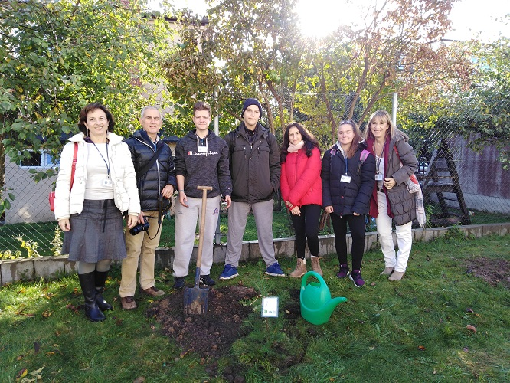
Planting trees at school yard

Slide 7
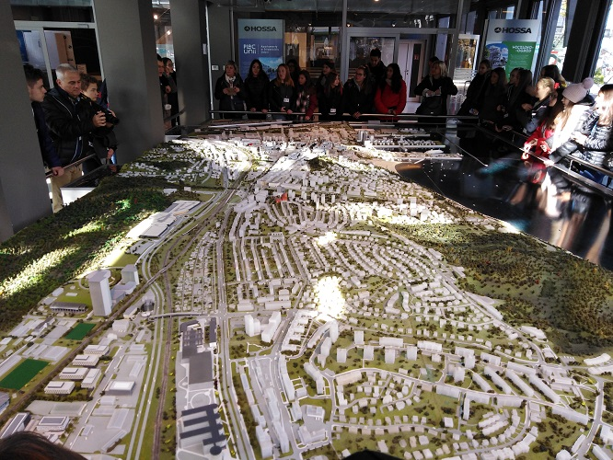
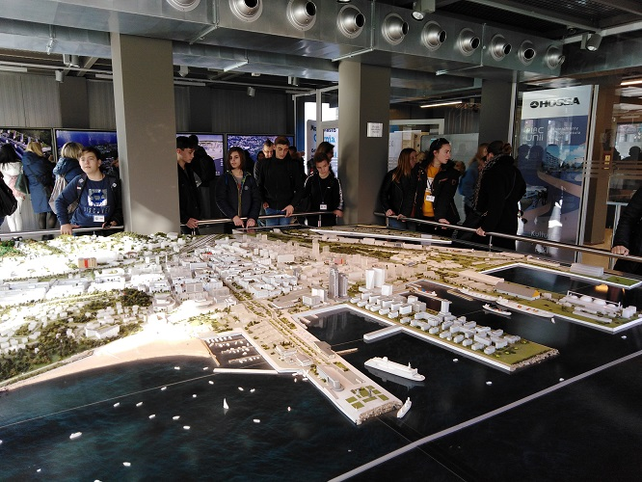
At info box – learning about Gdynia and the woods it is surrounded by

Slide 8
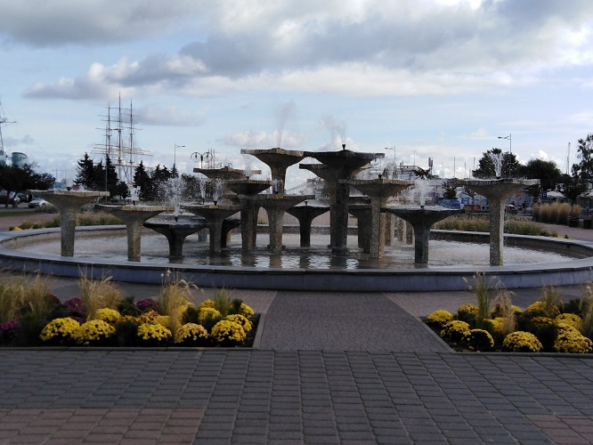
Sightseeing in Gdynia …

Slide 9
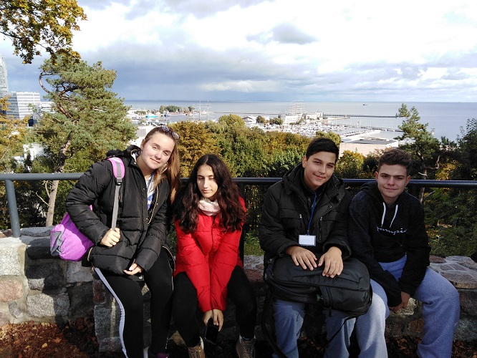

Slide 10
… and a welcome by authorities

Slide 11
2nd DAY

Slide 12
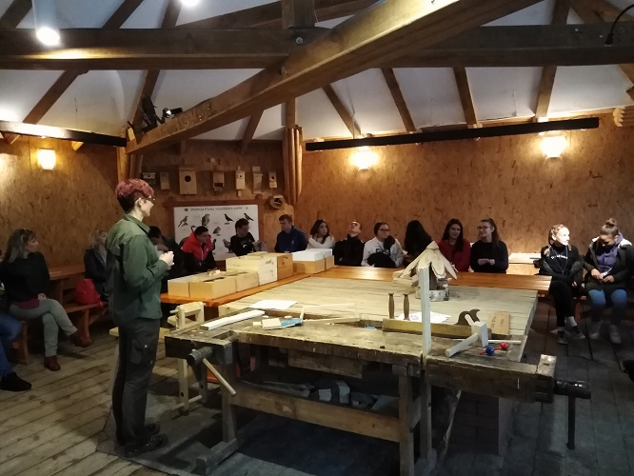
Marszewo Botanical Garden A lecture about birds’ life and migration

Slide 13
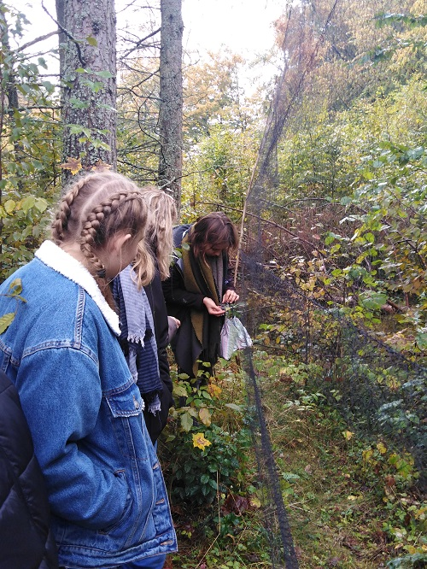
Showing the way to catch birds

Slide 14
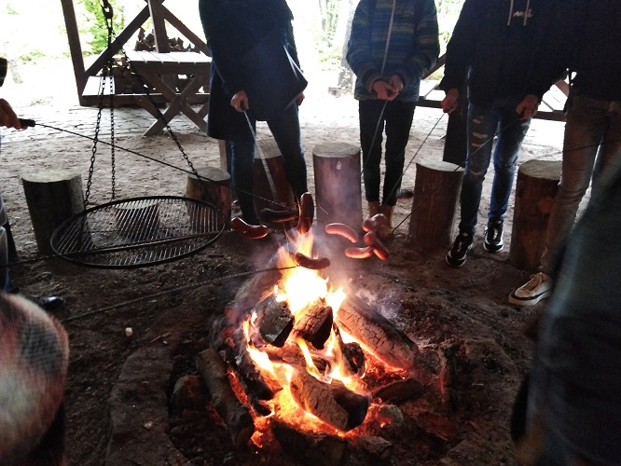
Cooking sausages over fire

Slide 15
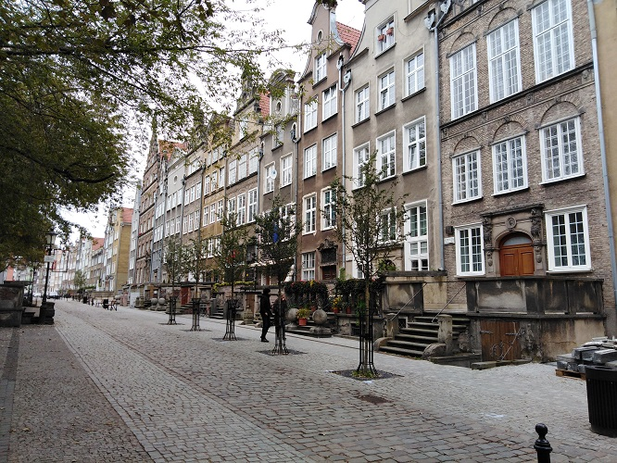
Sightseeing in Gdansk

Slide 16
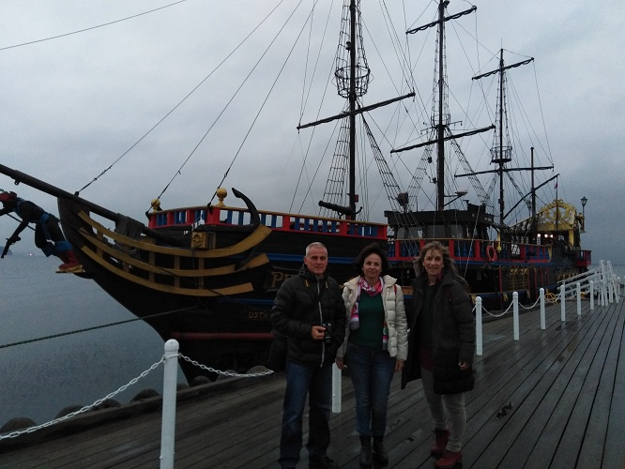
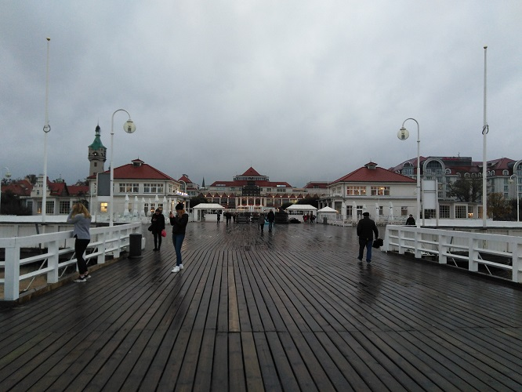
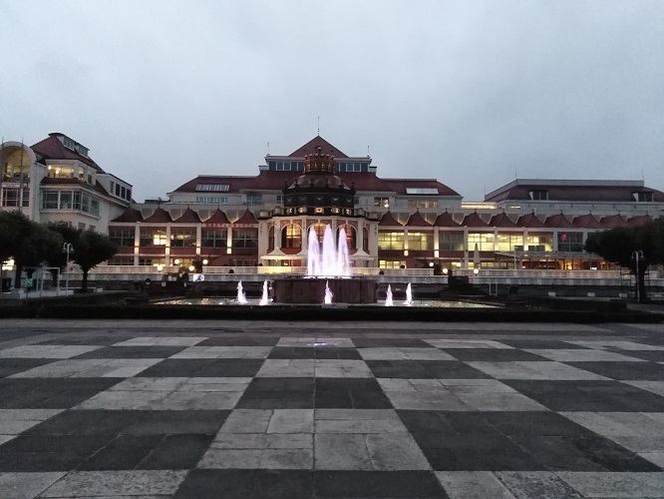
Sightseeing in Sopot, visiting the pier often damaged by strong storms

Slide 17
3rd DAY

Slide 18
Coordinators’ meeting at polish school

Slide 19
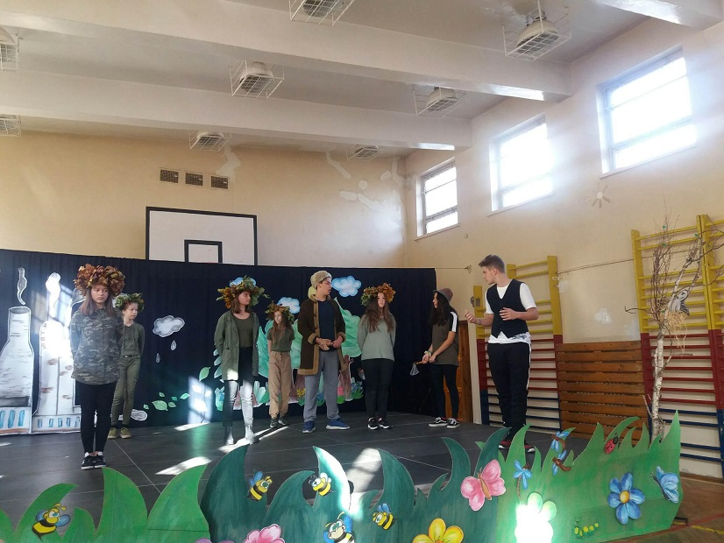
Putting on the play “Save the Lofty Trees”

Slide 20
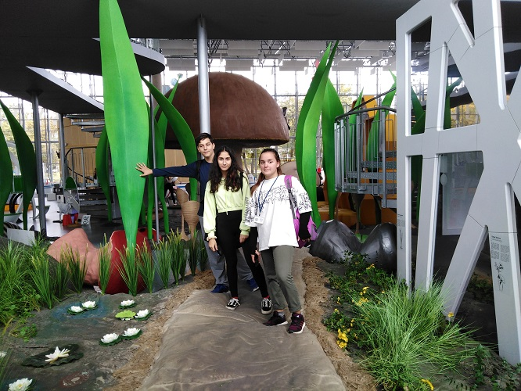
Visiting the Experiment Centre …

Slide 21
Making a model of Carbon – low - city

Slide 22
4th DAY

Slide 23
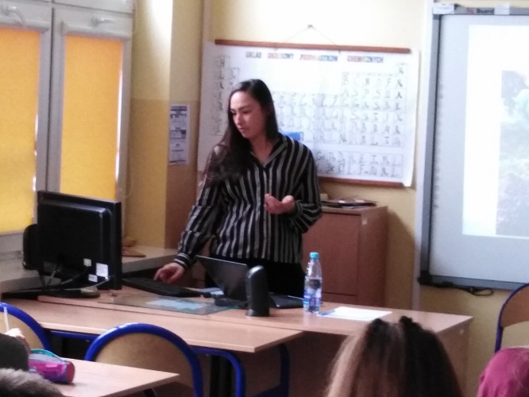
Lessons on climate change at school

Slide 24
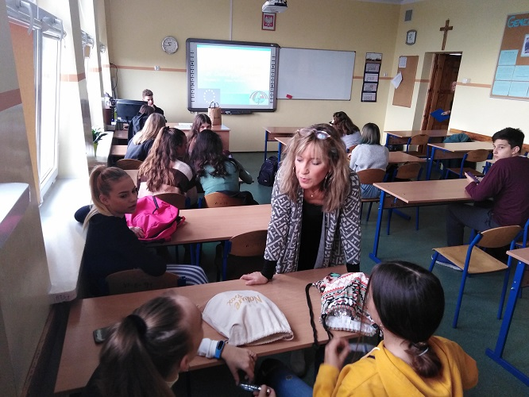
The Greek teacher Mrs. Papandreou conducted the lesson about carbon footprint

Slide 25
At Gdynia Aquarium

Slide 26
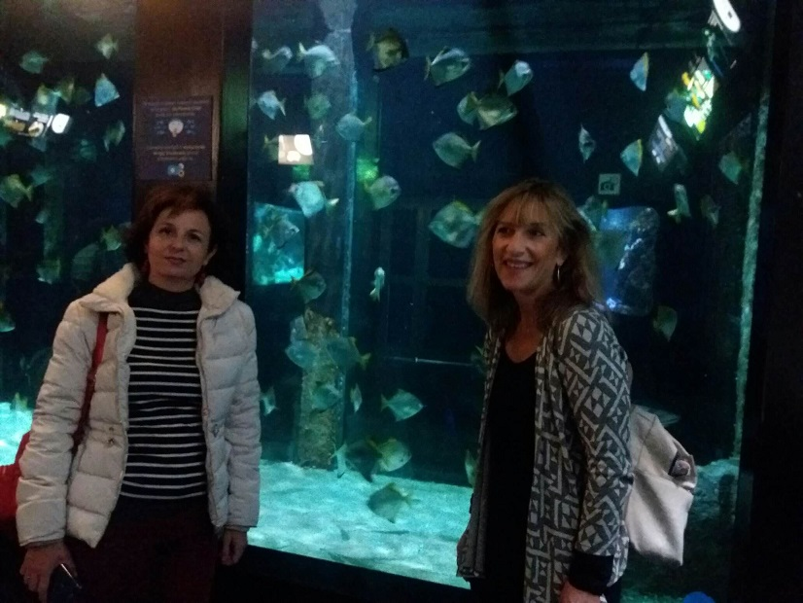
Learning about Baltic Sea - Laboratory workshops – Showing several species of fish

Slide 27
5th DAY

Slide 28
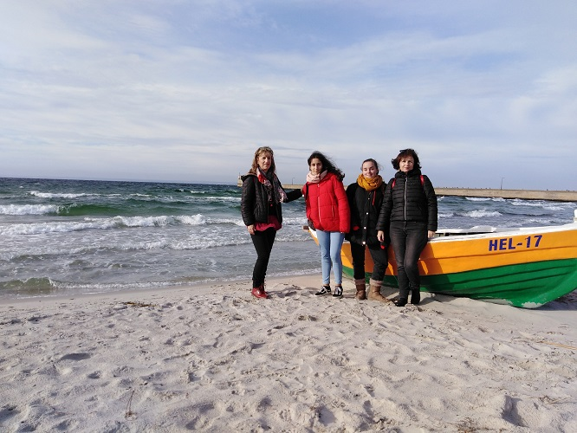
Visit the town on Hel peninsula

Slide 29
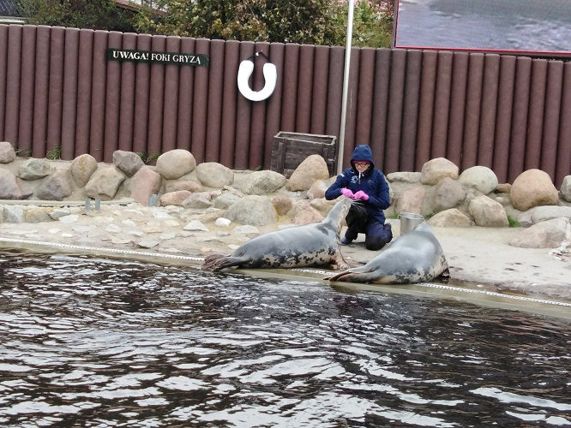
Seal station in Hel Visiting a fisheries museum – Watching seals’ feeding

Slide 30
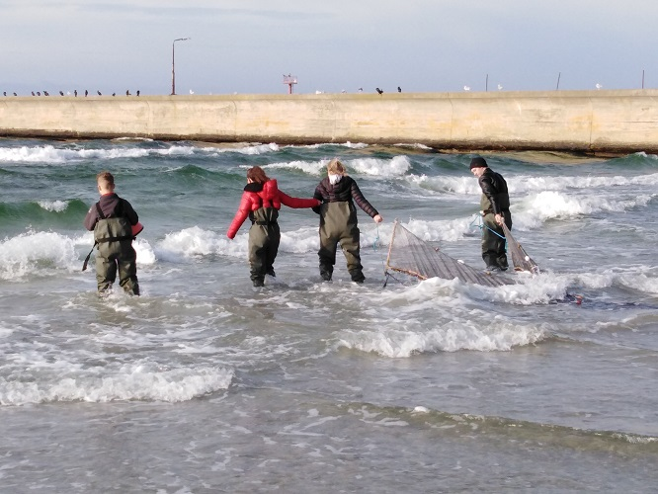
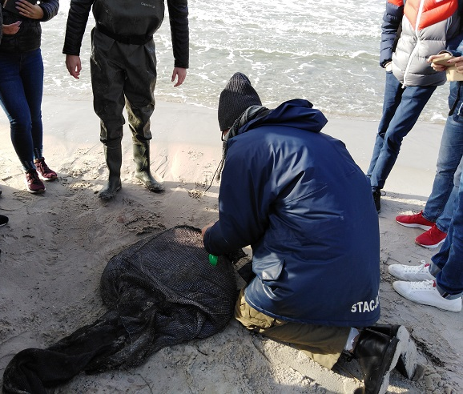
Catching small fish with drag net

Slide 31
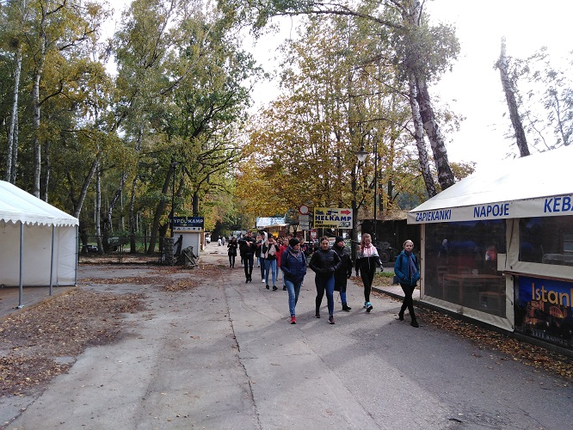
A walk along the peninsula

Slide 32
Teachers of all delegations at lunch in a typical polish restaurant of Gdynia

Slide 33
The last day of the visit : Greek students with host families

